Slide 1
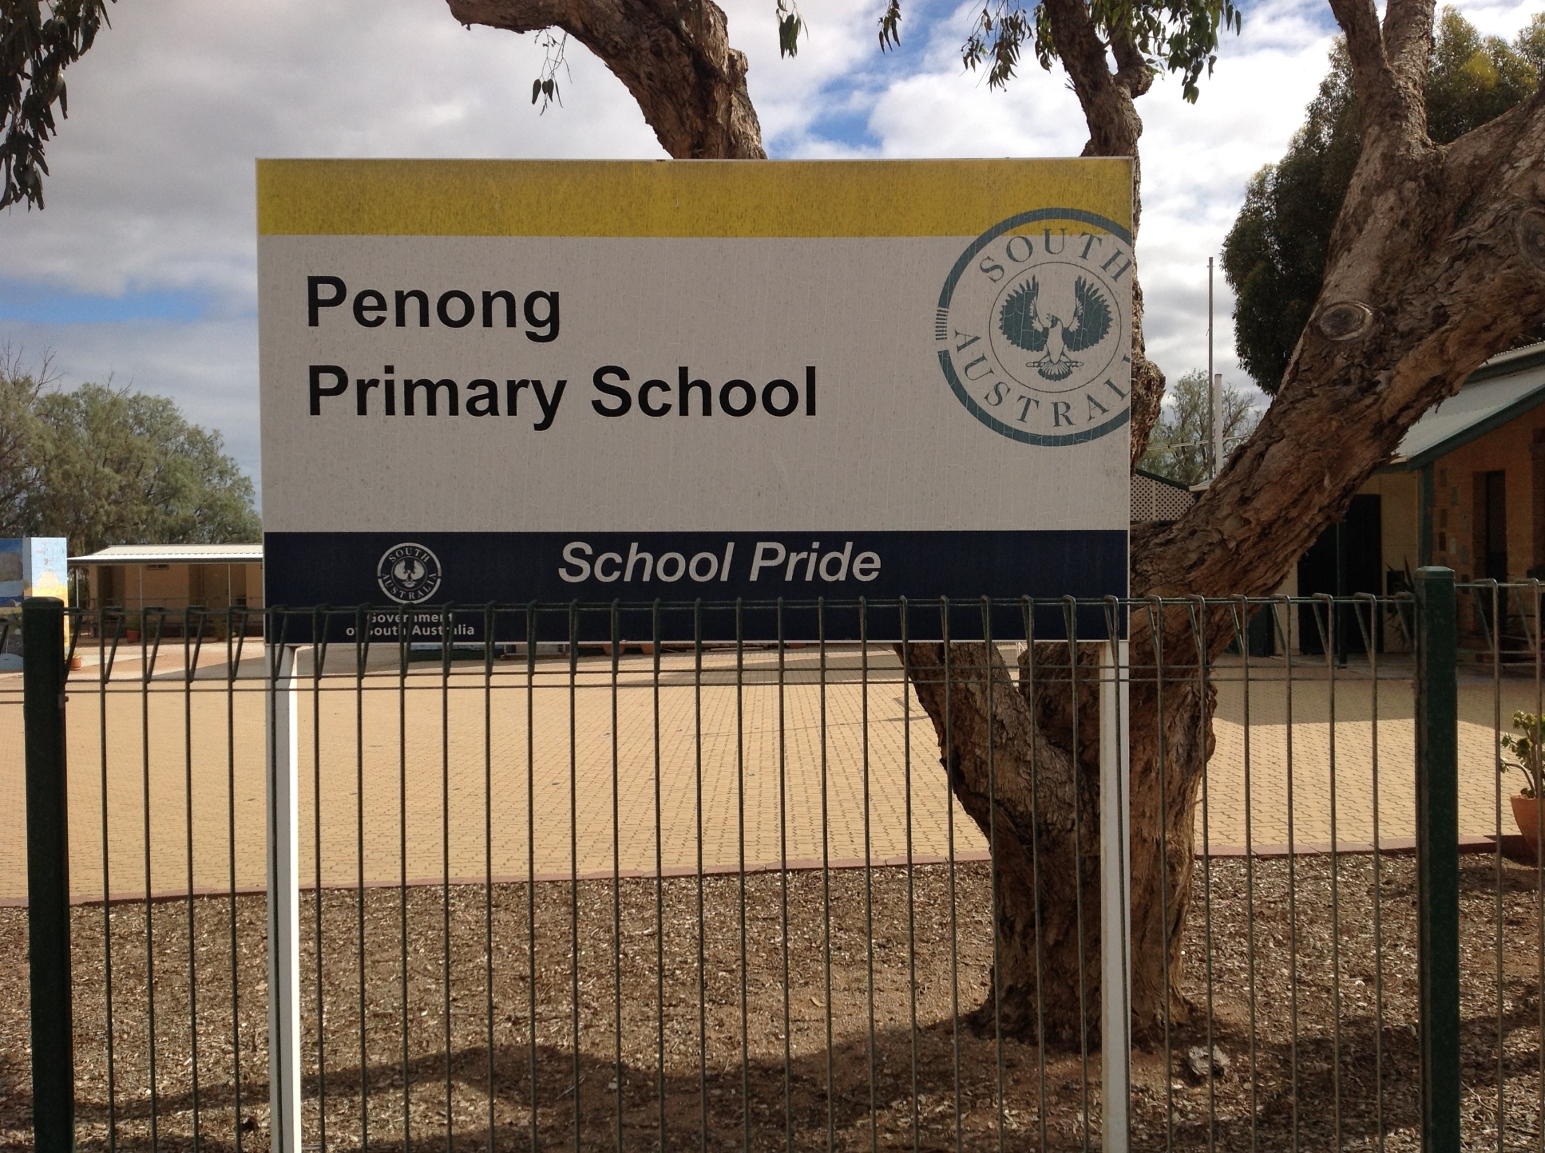

Slide 2
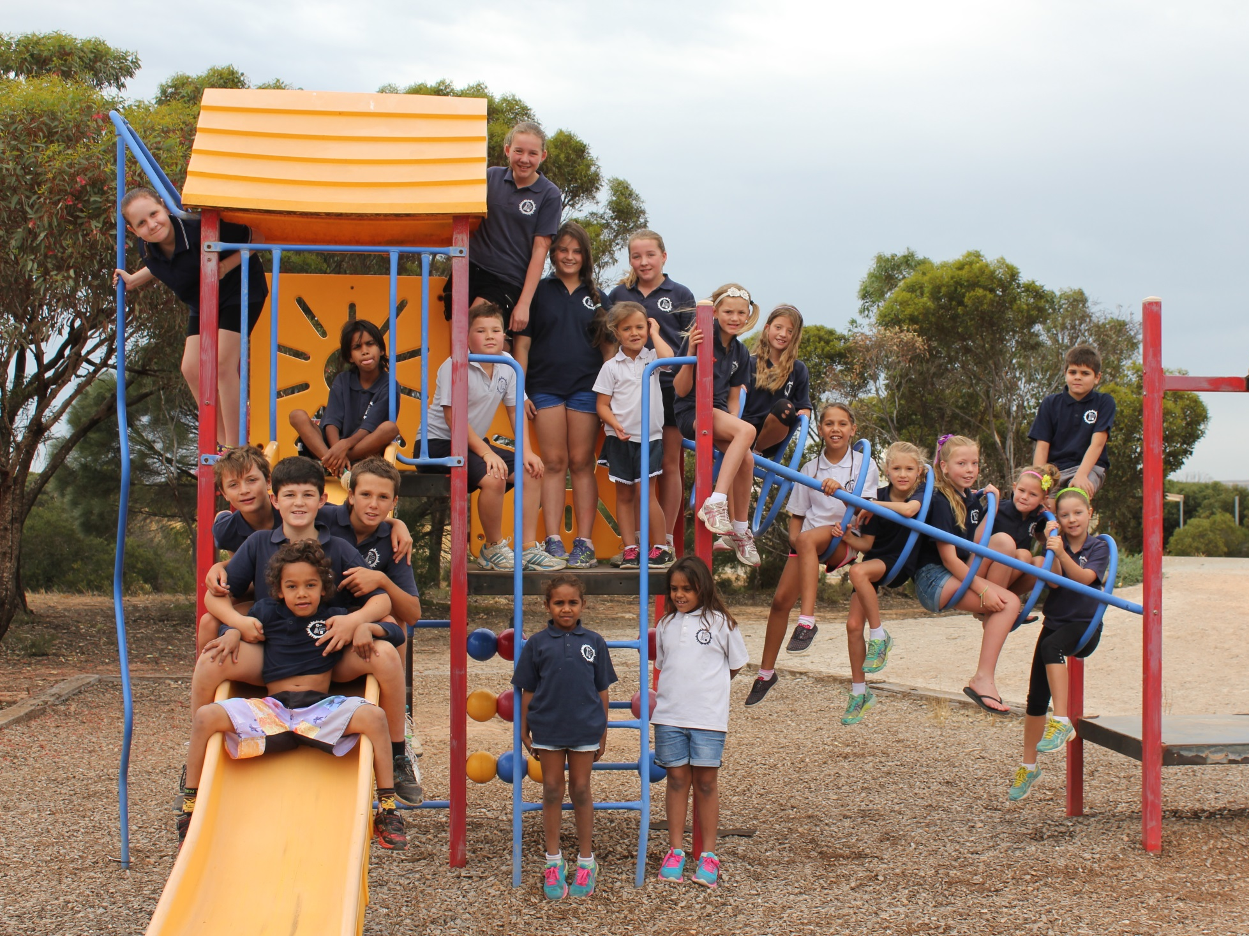
Penong Primary School

Slide 3
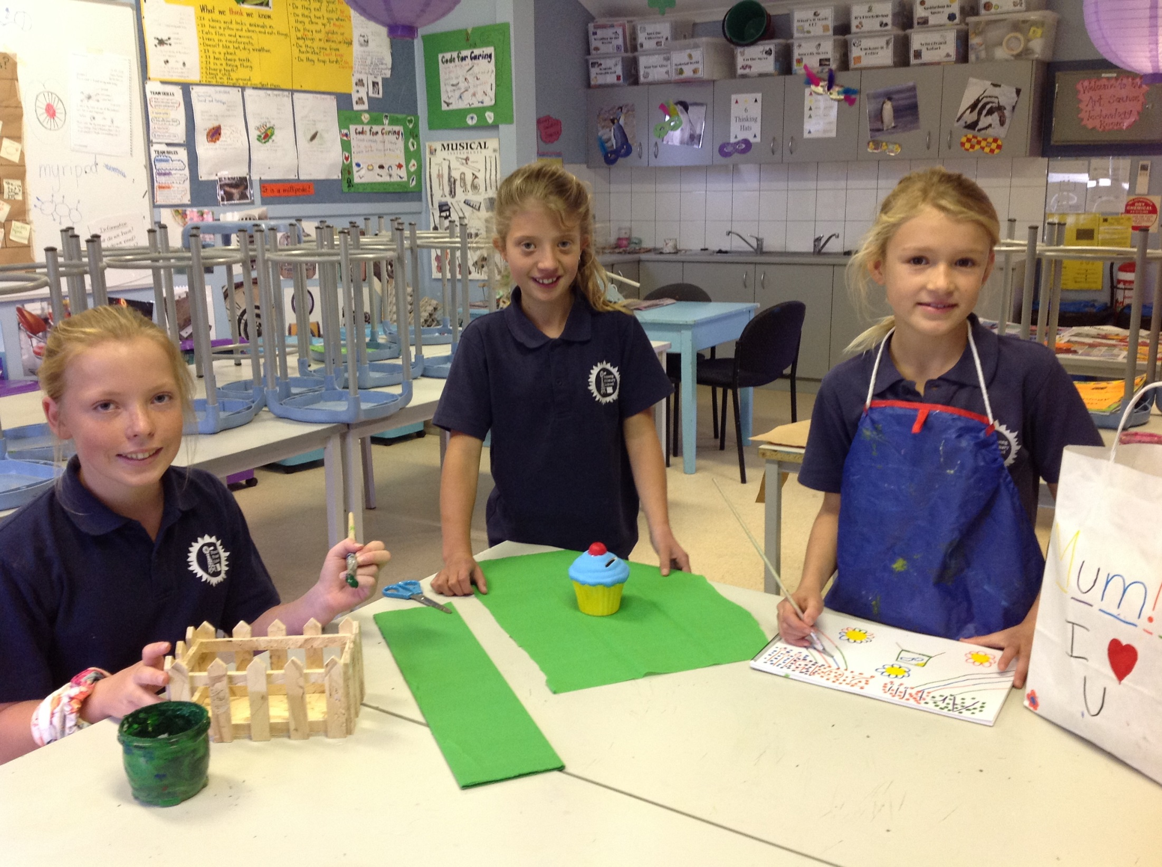
Some of the U.P girls doing work in the art room.

Slide 4
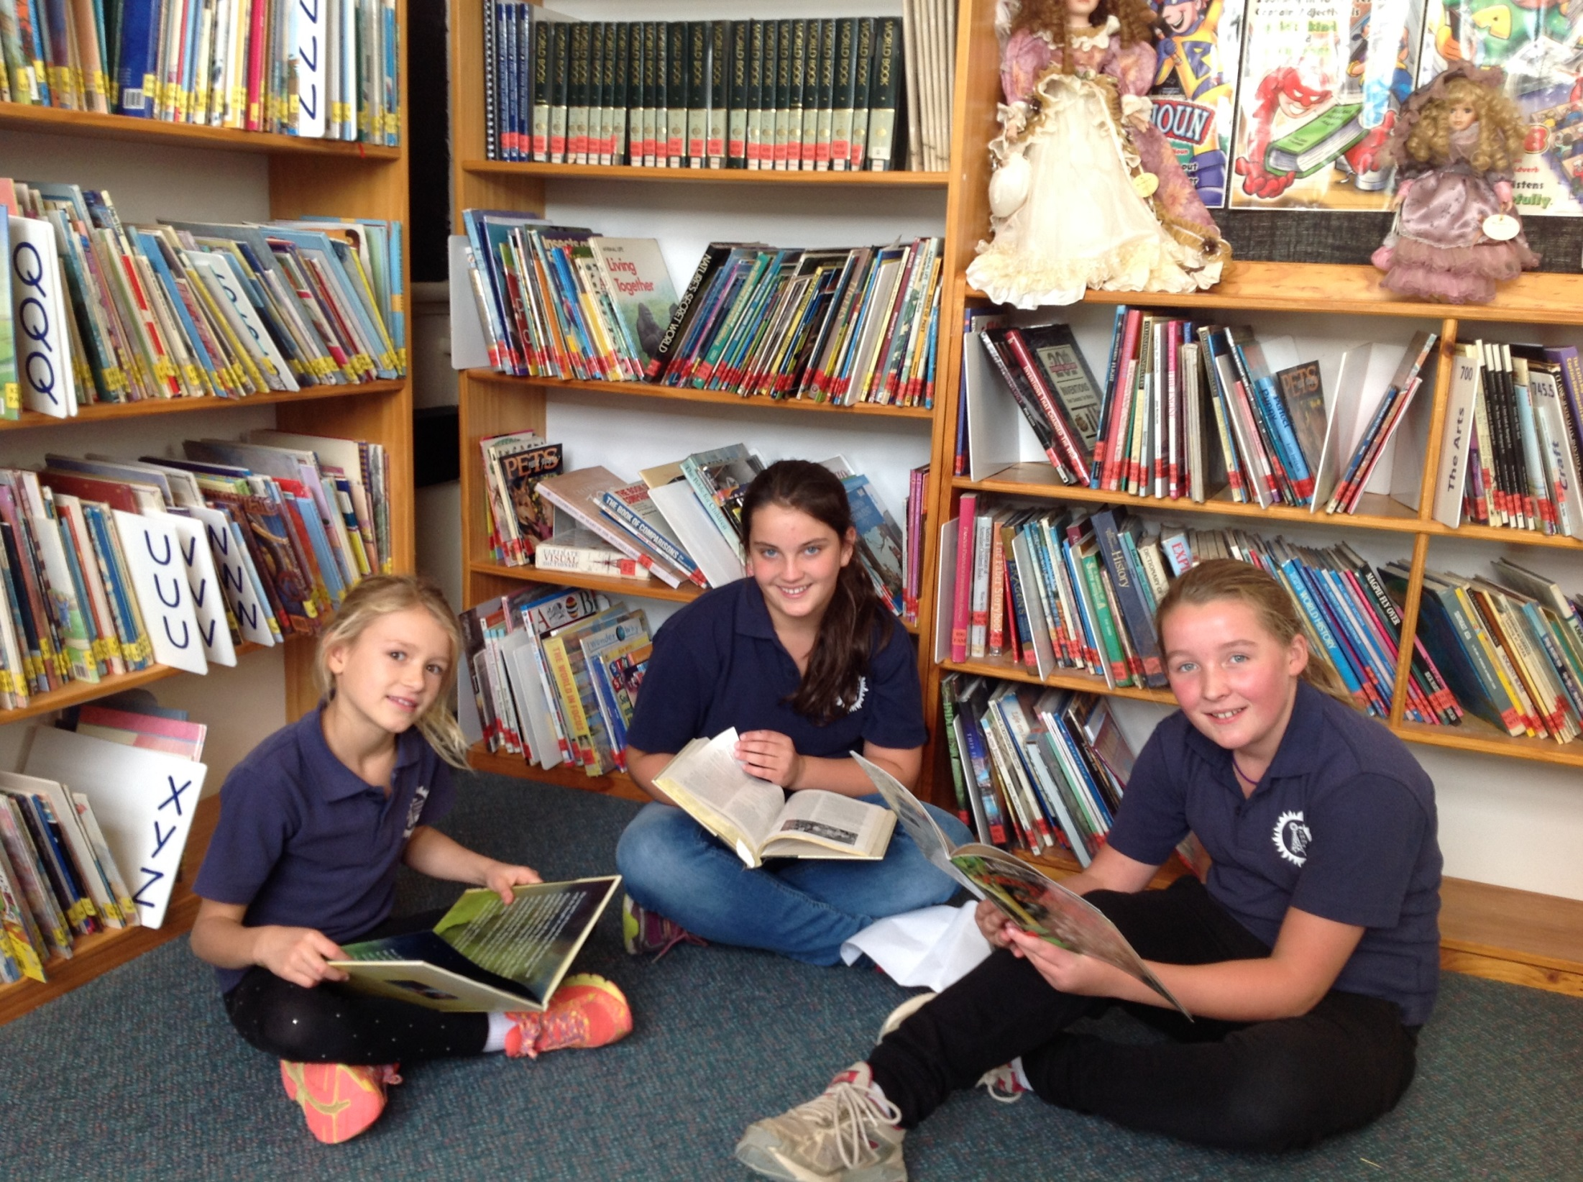
U.P reading in the library

Slide 5
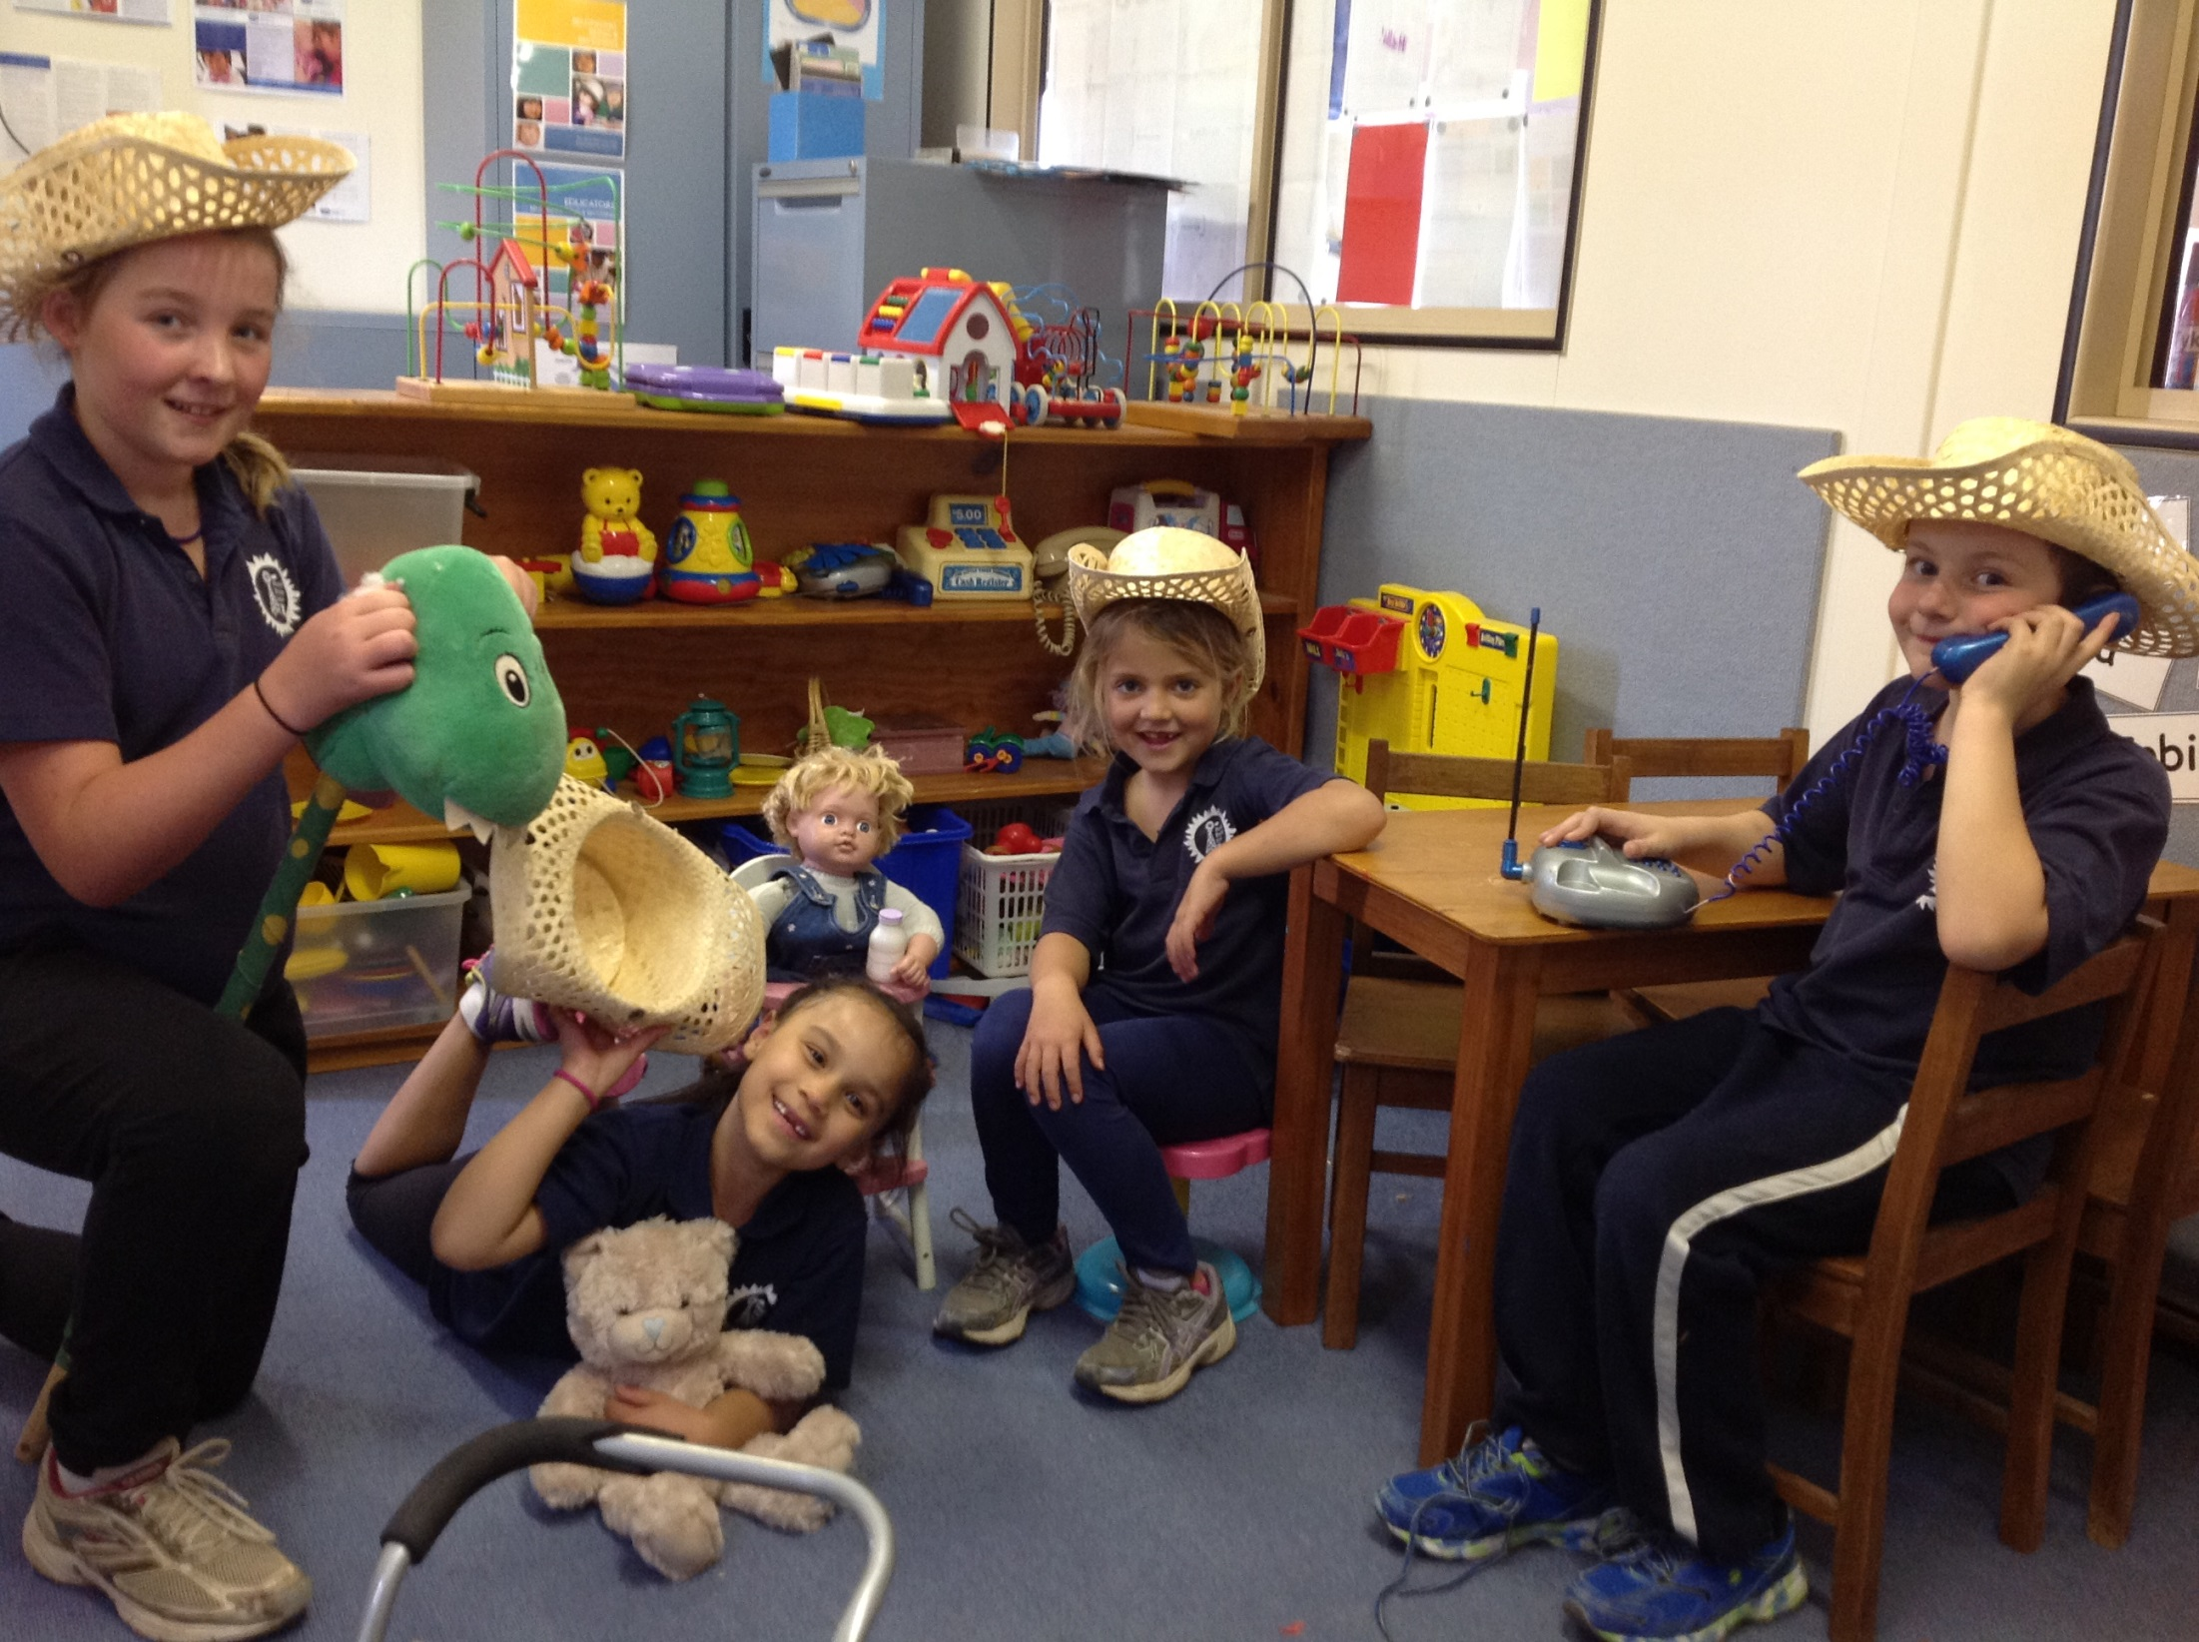
Some of the students having fun in the kindy.

Slide 6
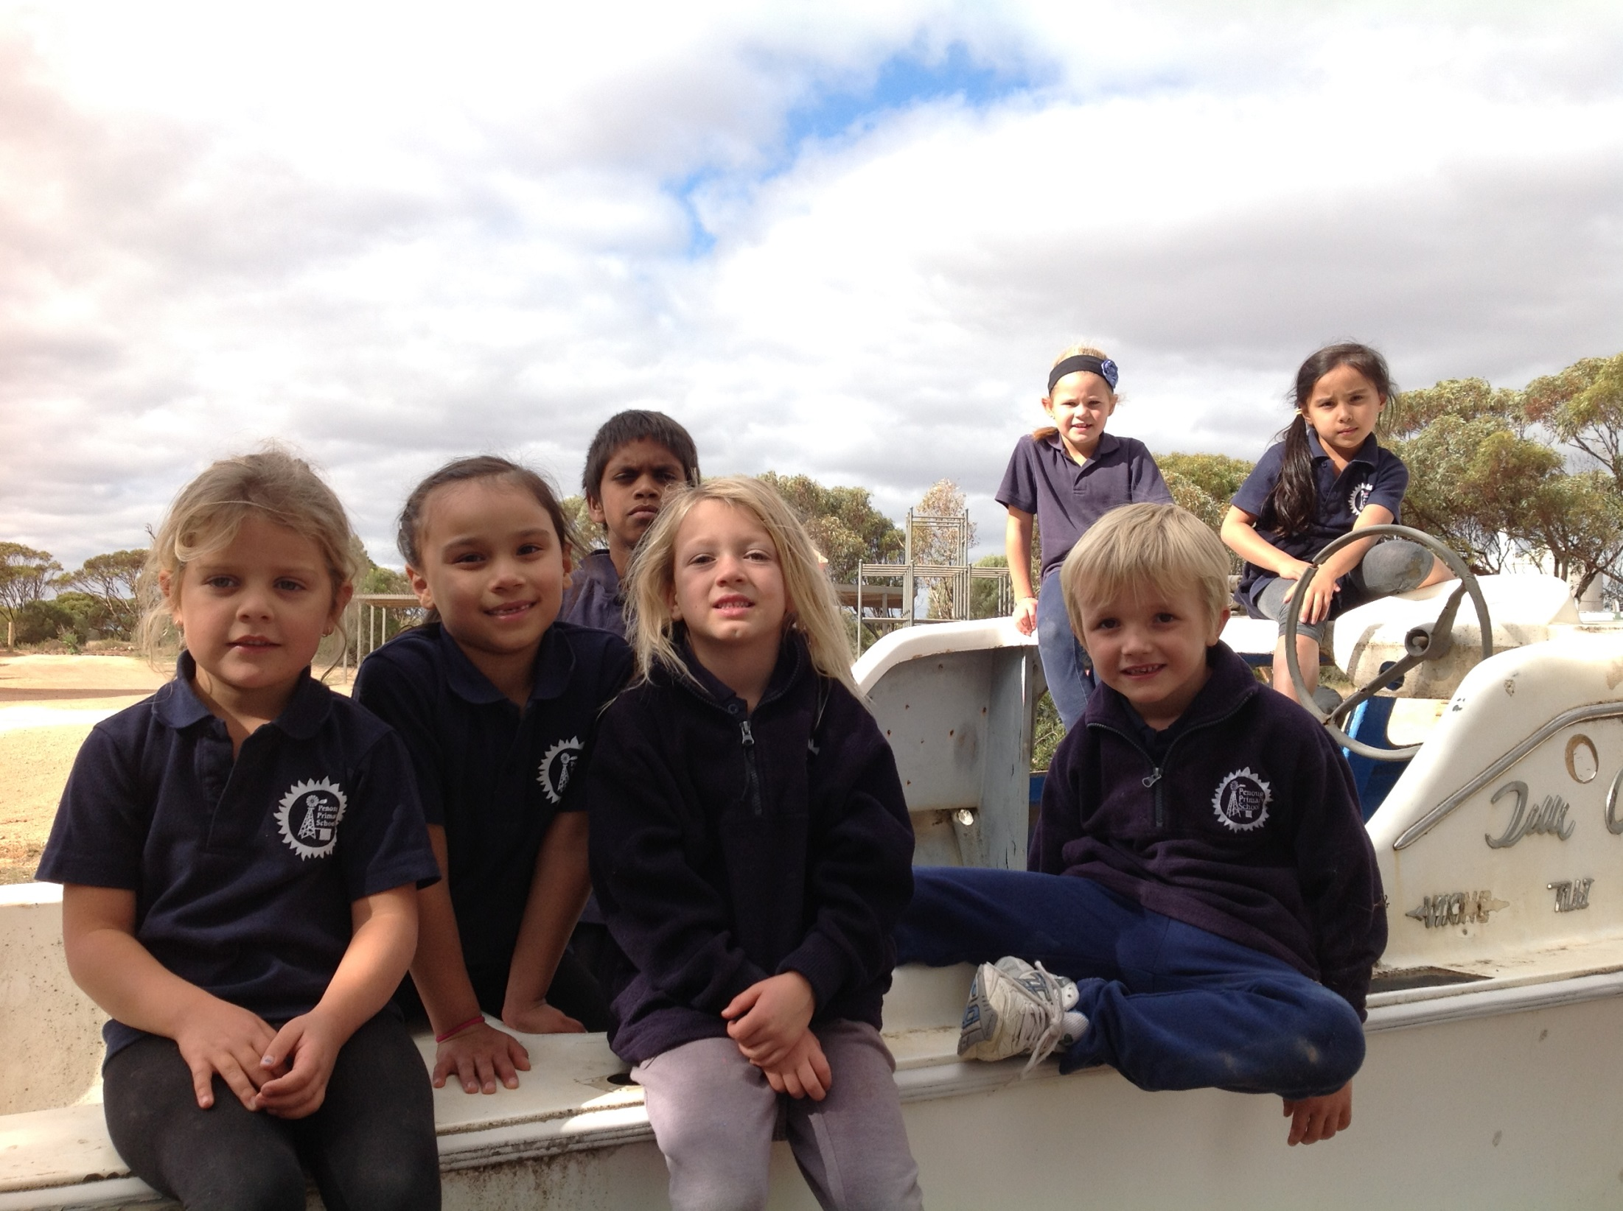
J.P playing in the boat.

Slide 7
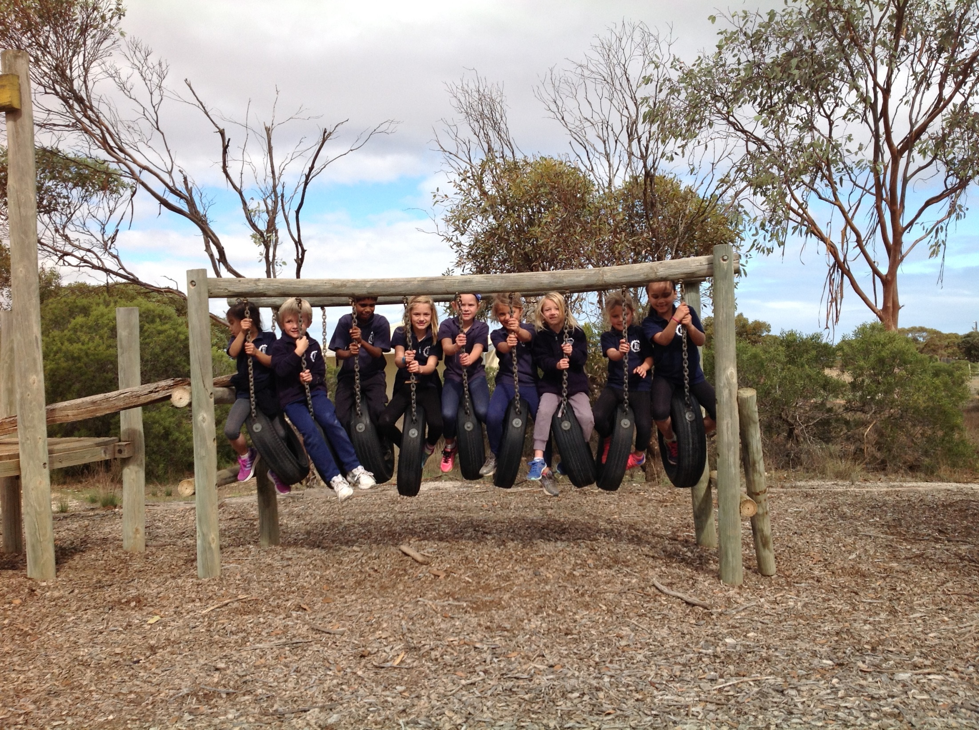
J.P love riding the horses.

Slide 8
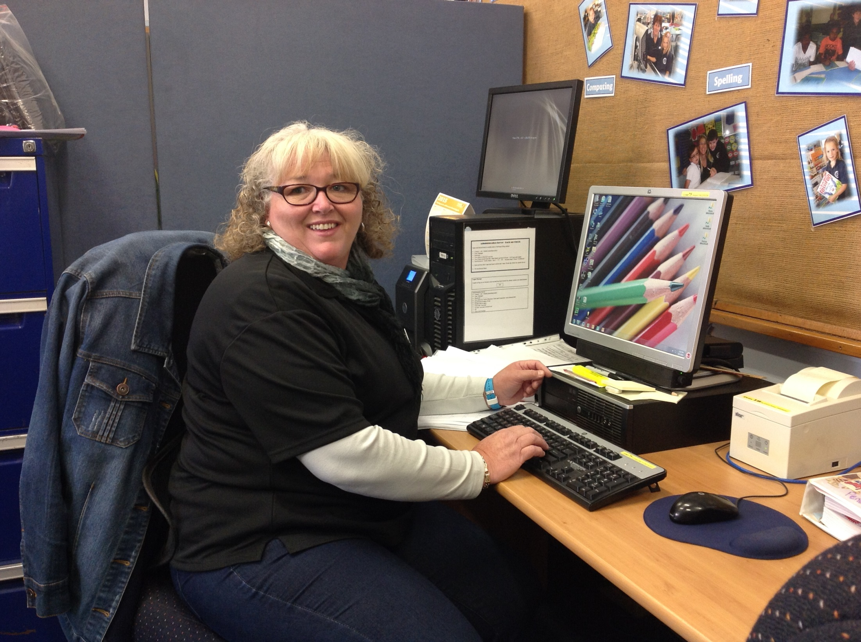
Hazel is one of our helpful SSO’s.

Slide 9
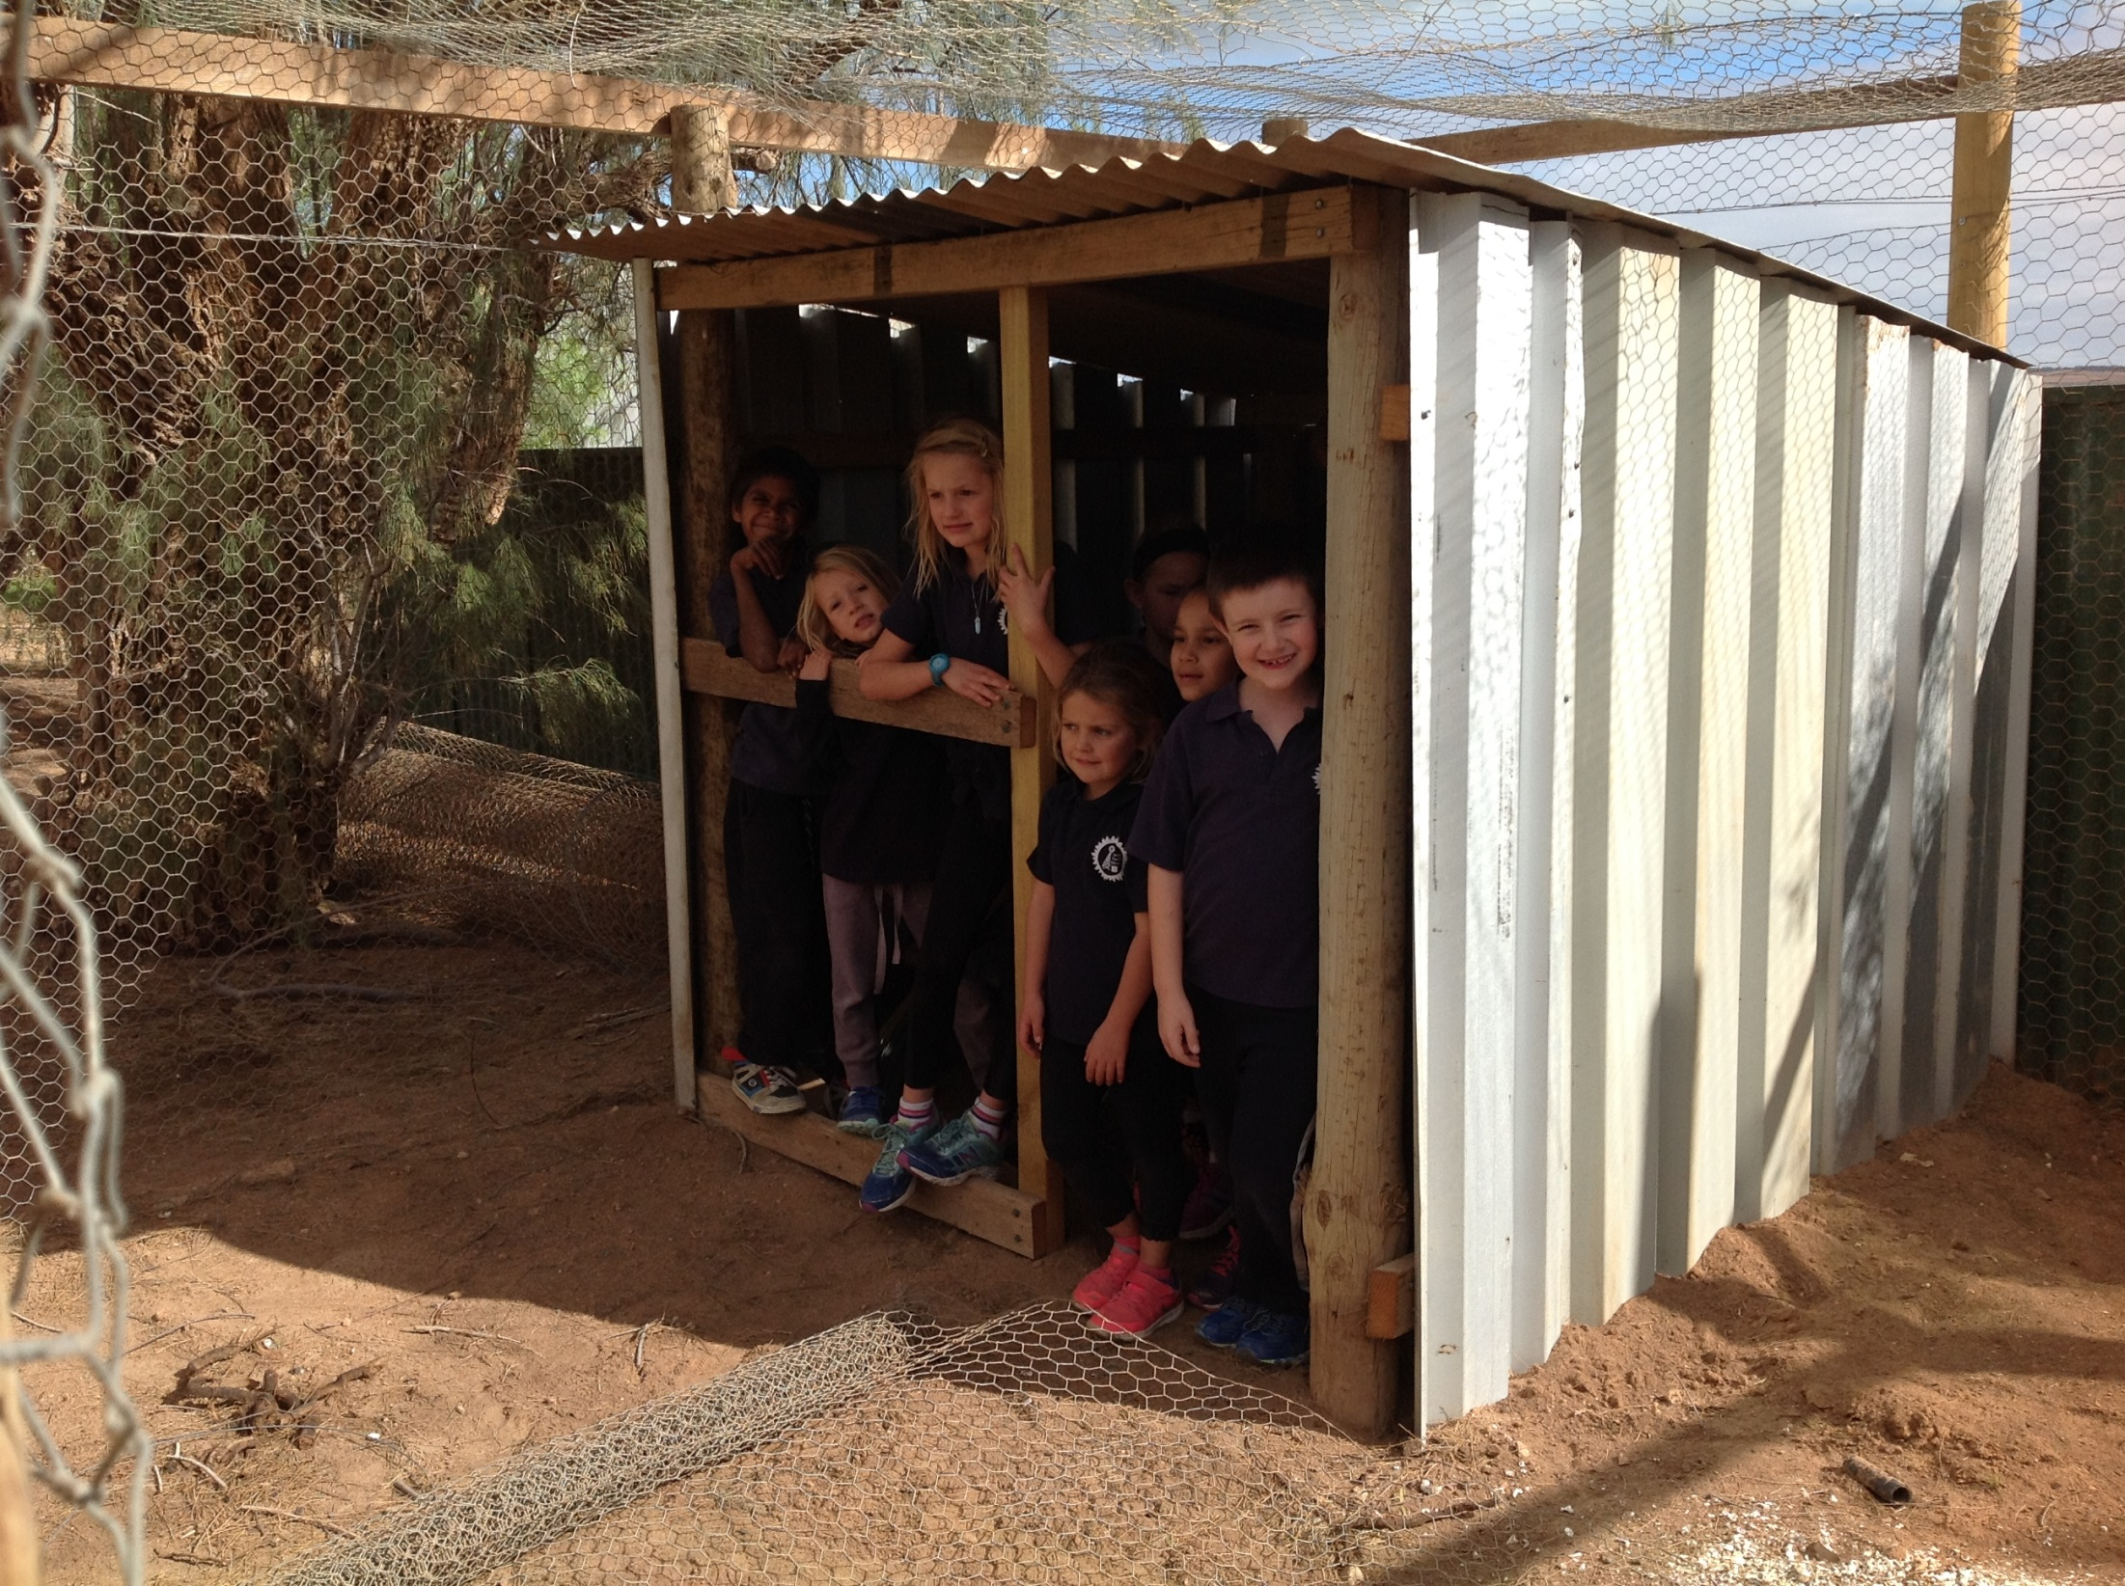
J.P playing in the new chook yard.

Slide 10
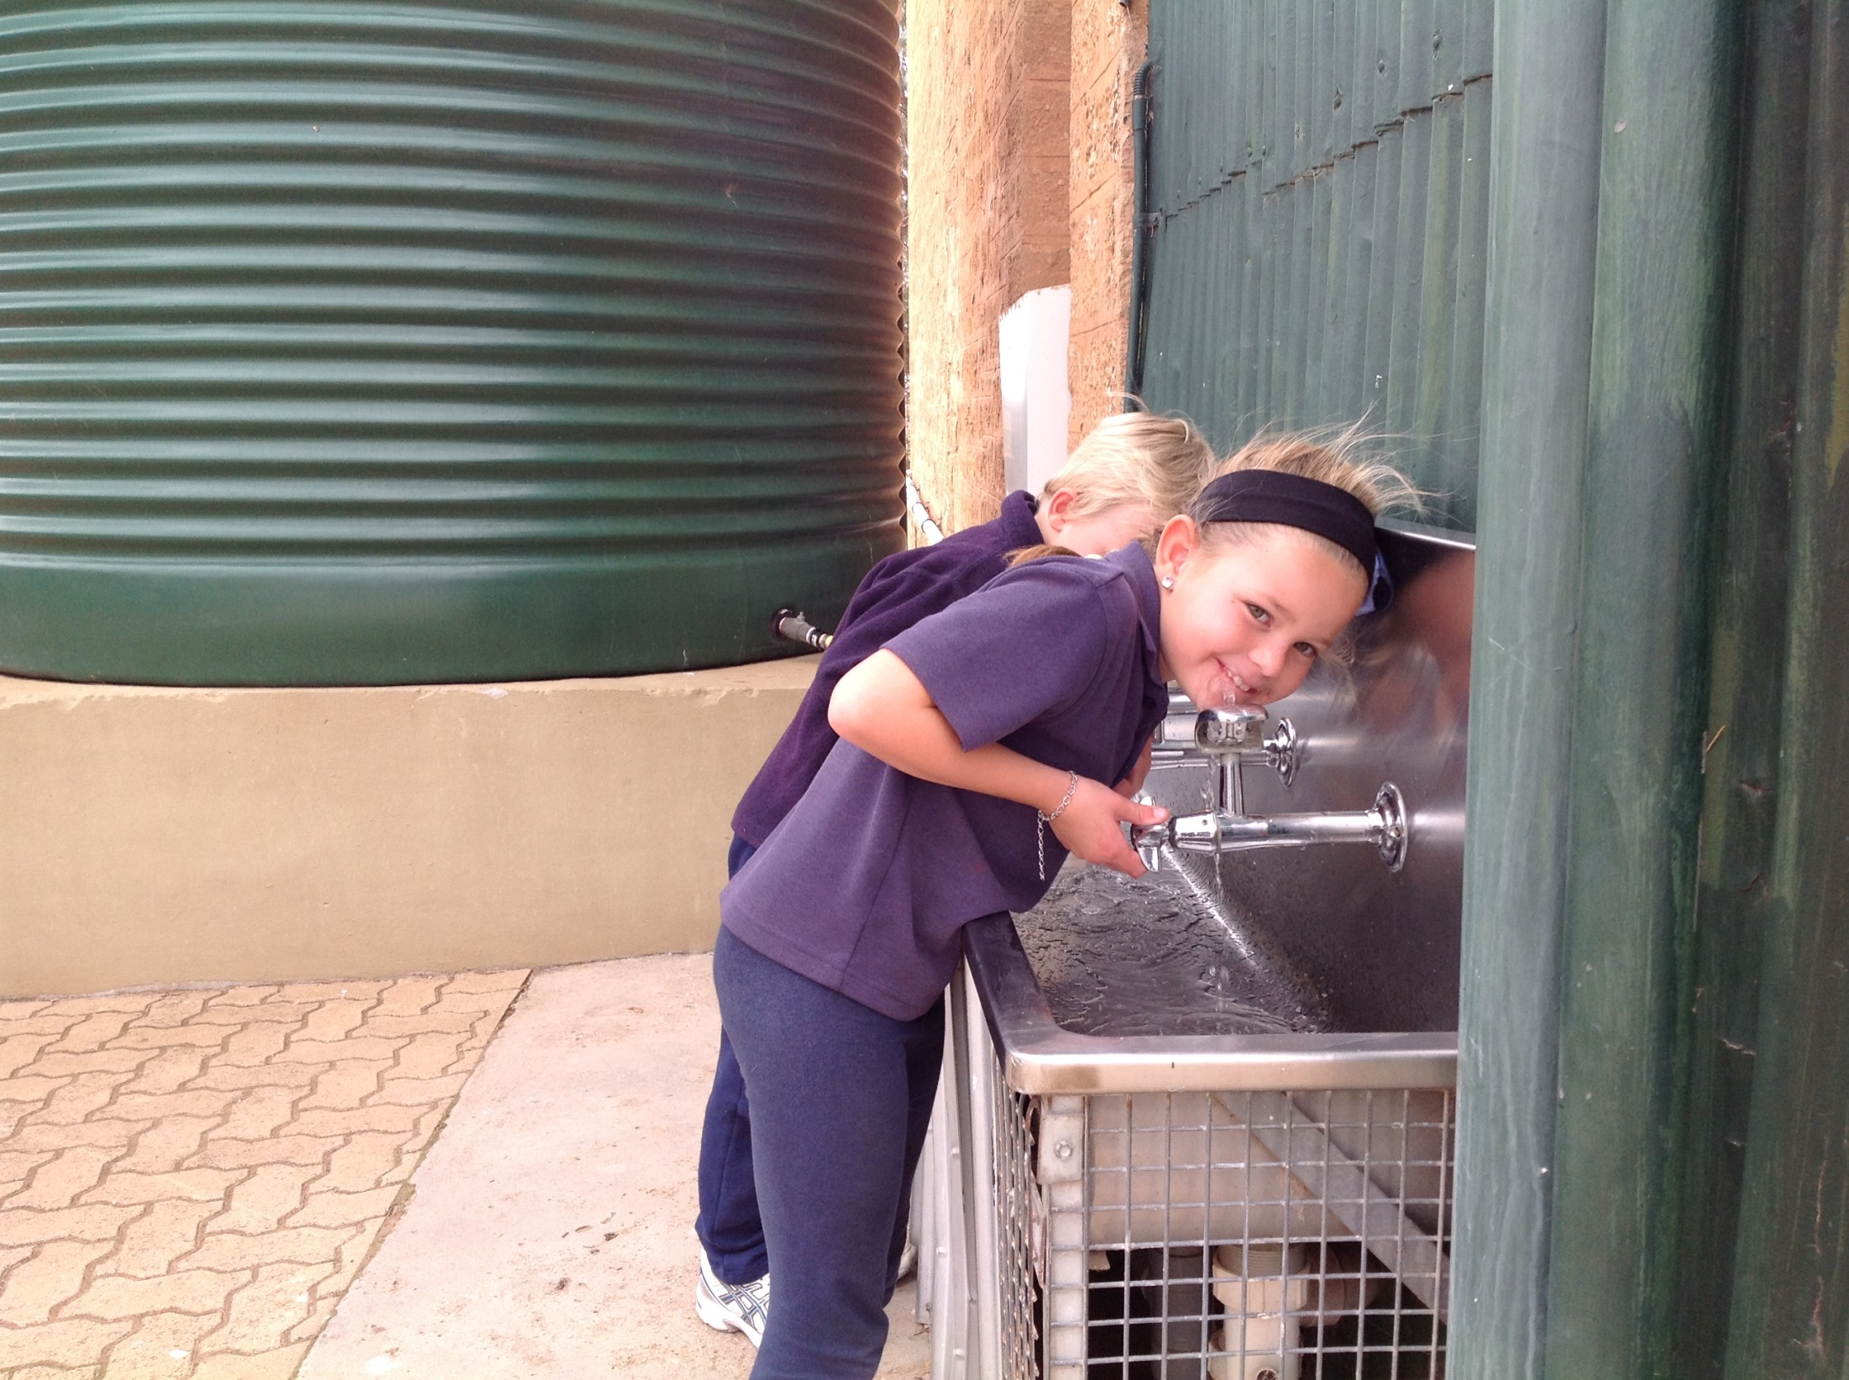
Students drinking out the fountain.

Slide 11
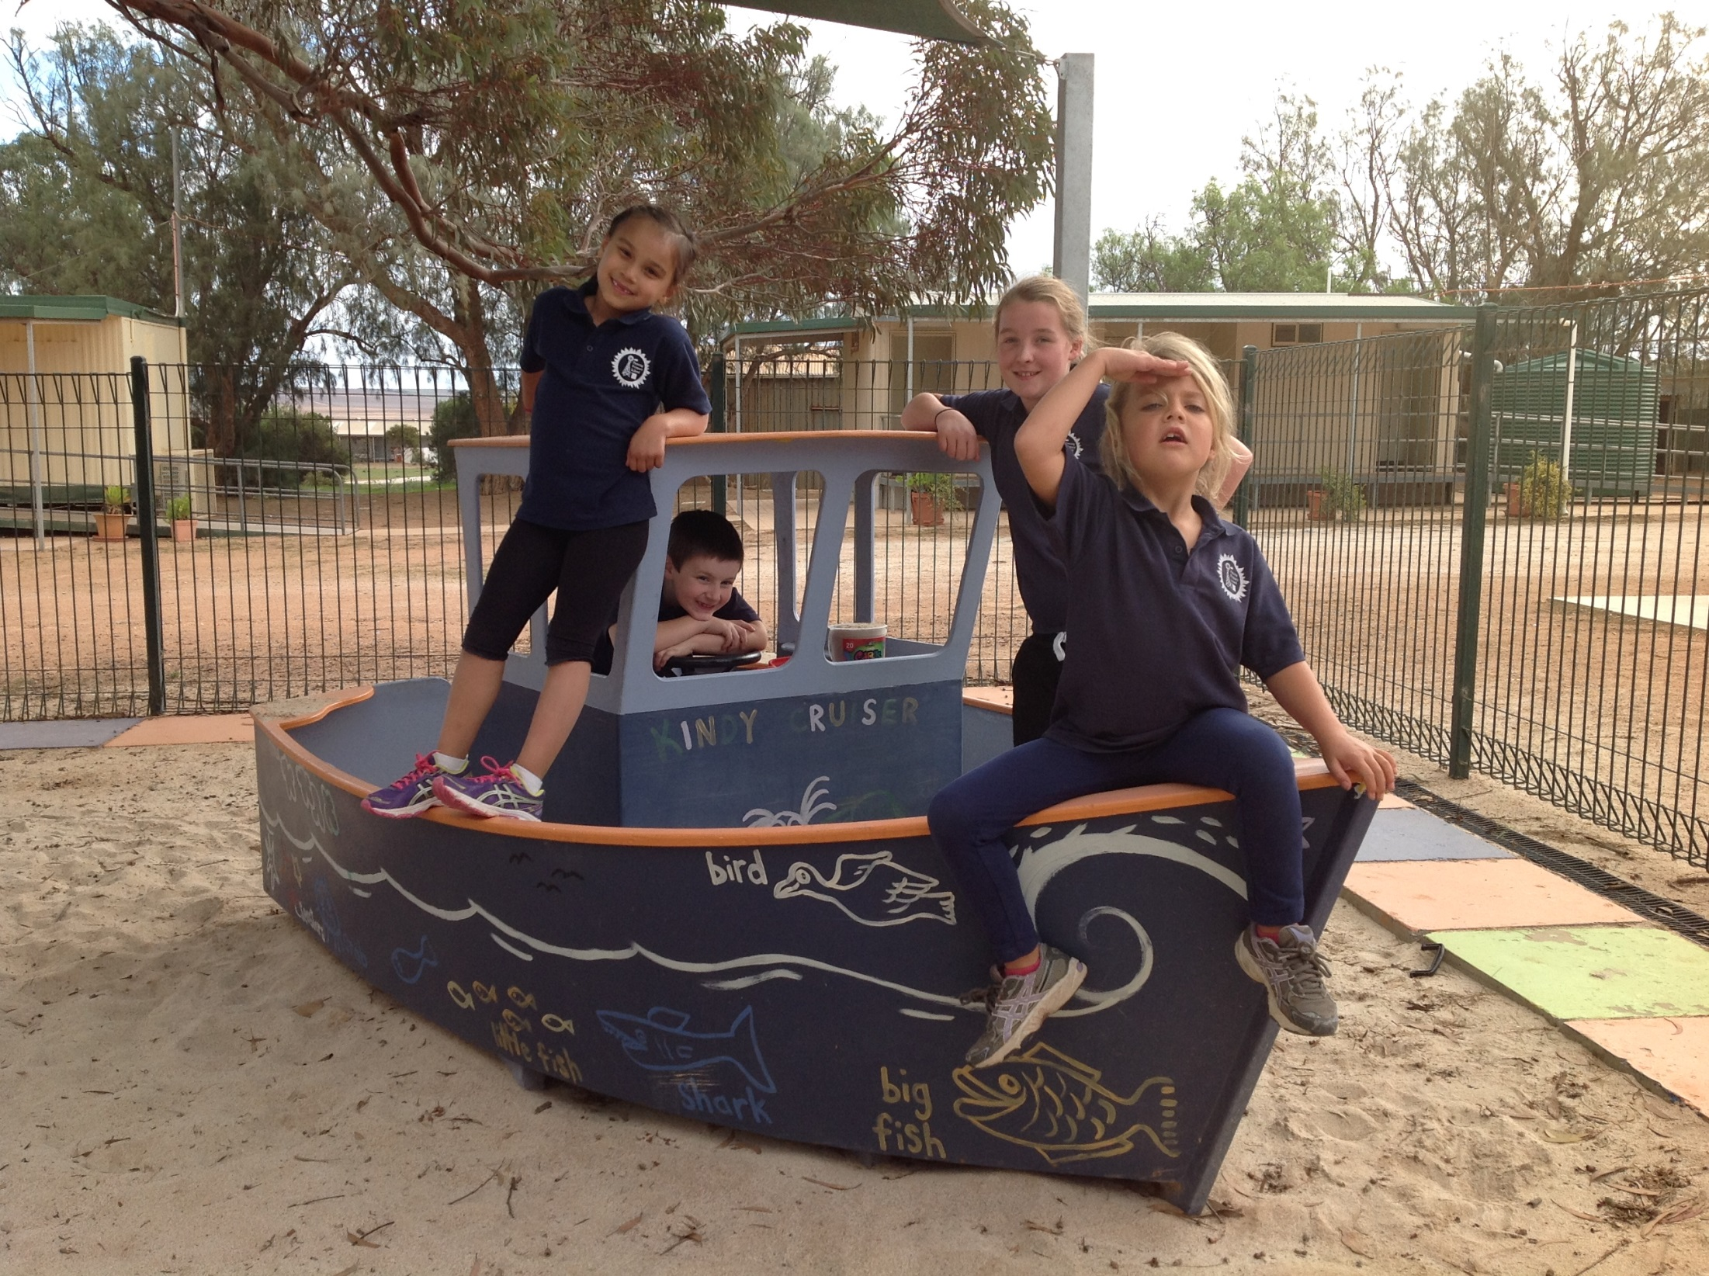
Kids playing in the kindy cruiser.

