Slide 1
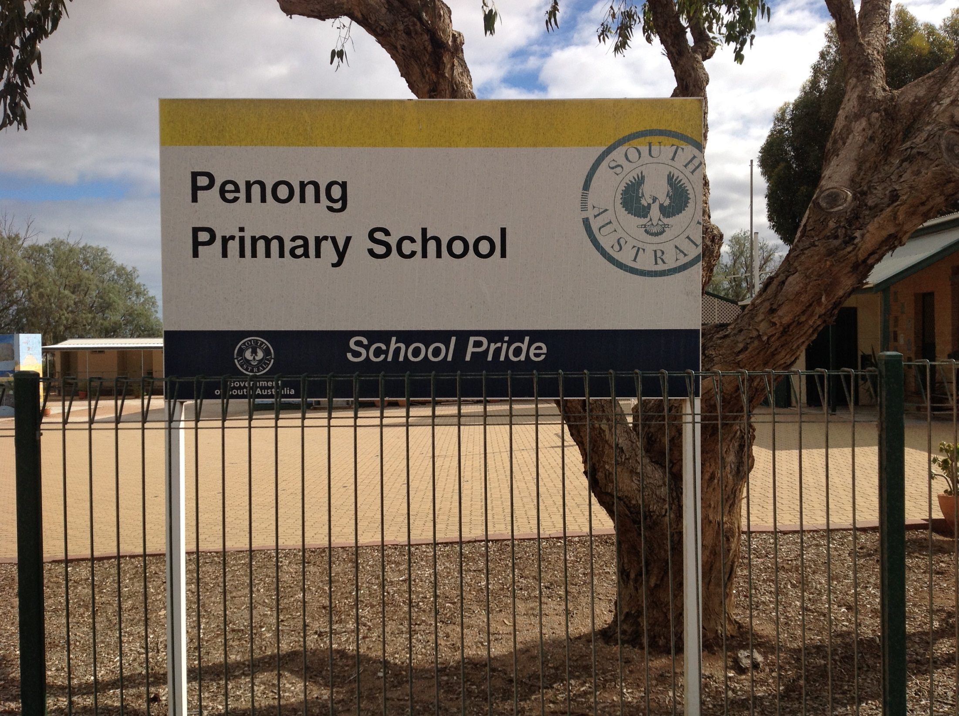
Welcome

Slide 2
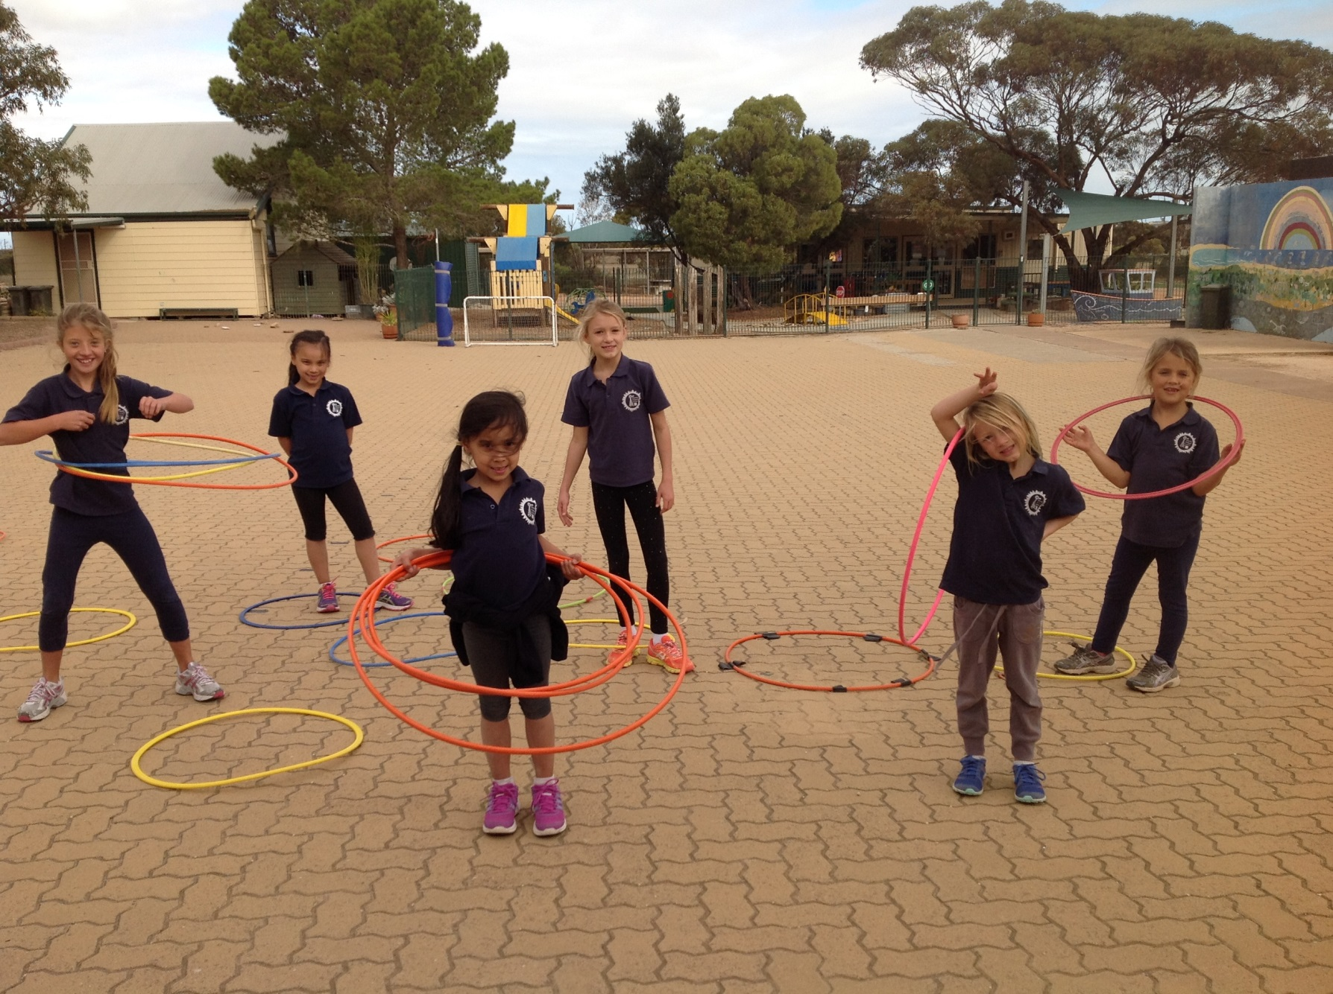
This is the playing area where we play all our sport.

Slide 3
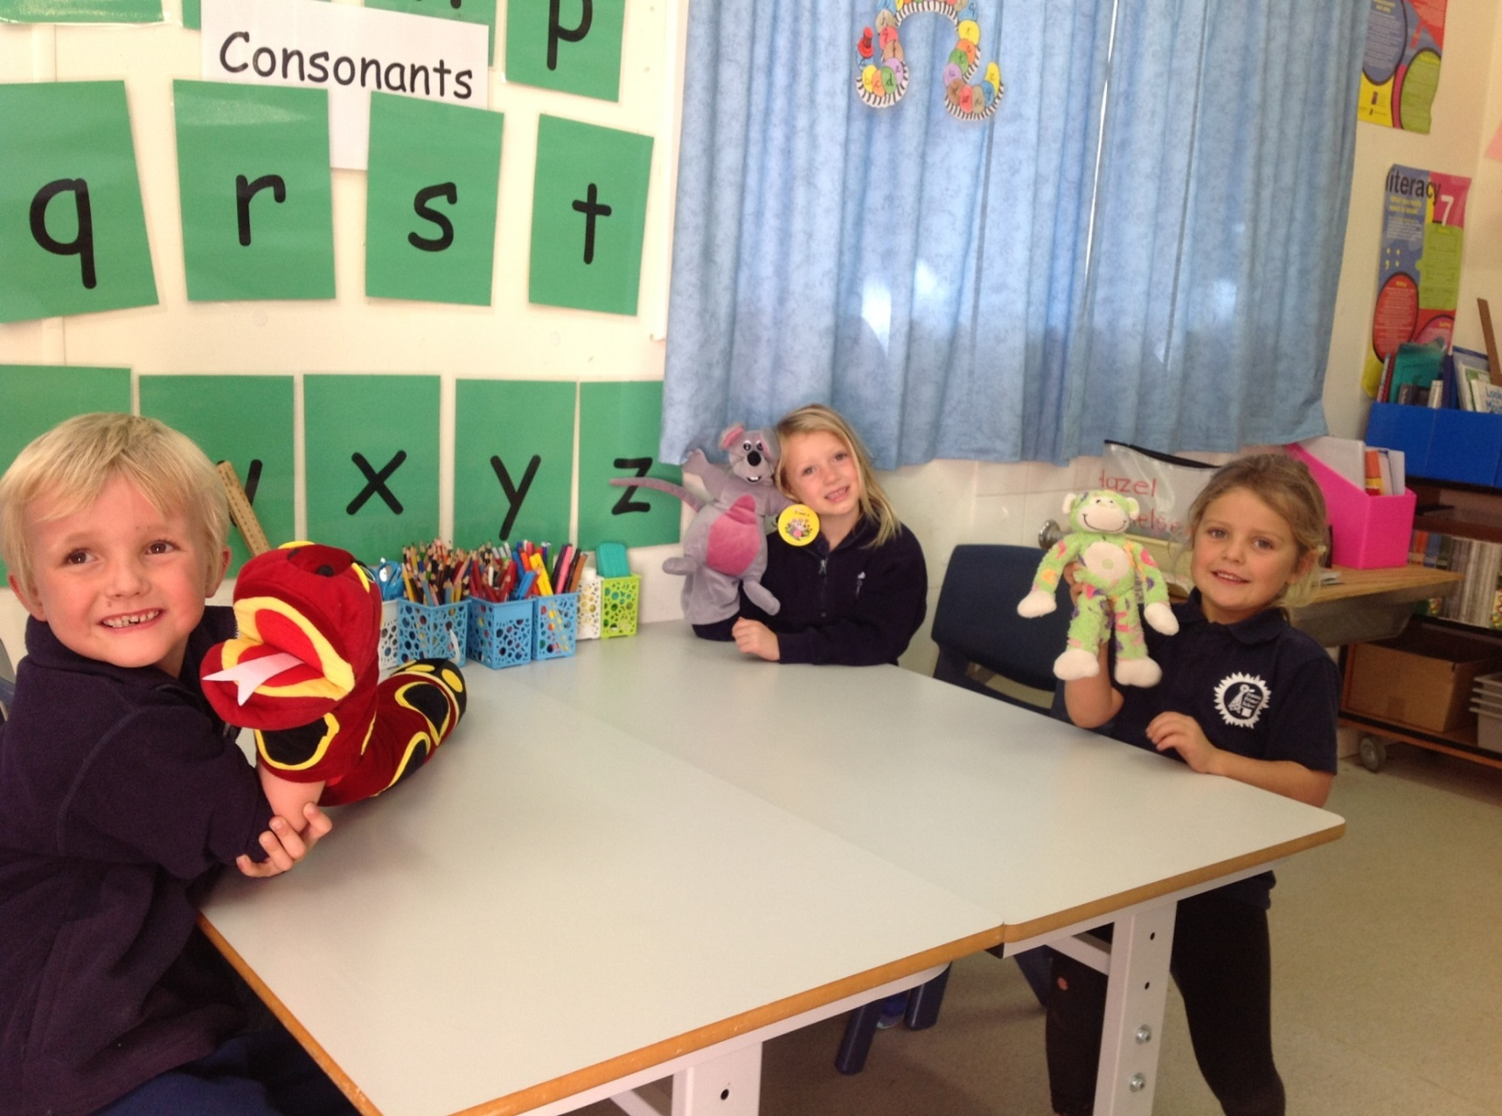
The younger students go to the white elephant to learn more grammar with our SSO’s

Slide 4
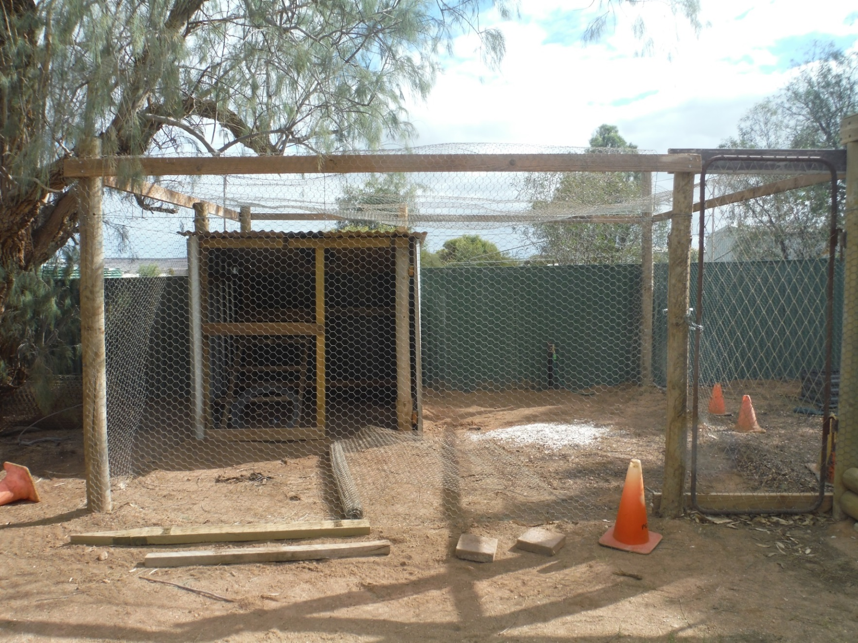
Soon we will be getting some chickens for our newly built chicken pen.

Slide 5
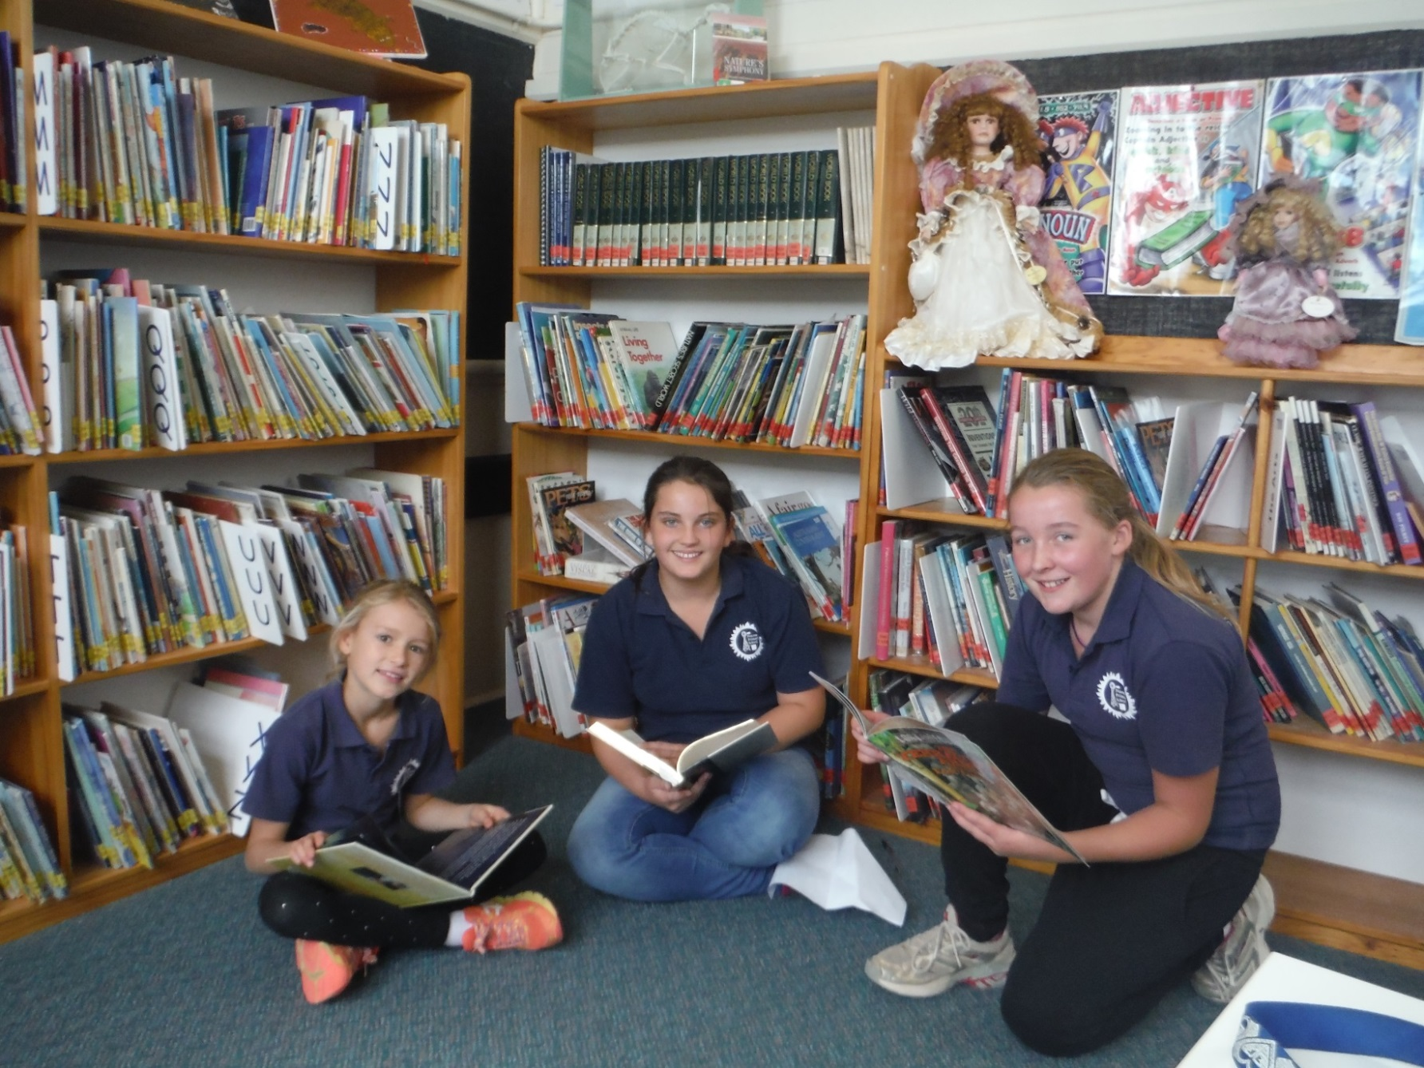
Our library is full of great books to read from novels to picture books and fiction to non-fiction books.

Slide 6
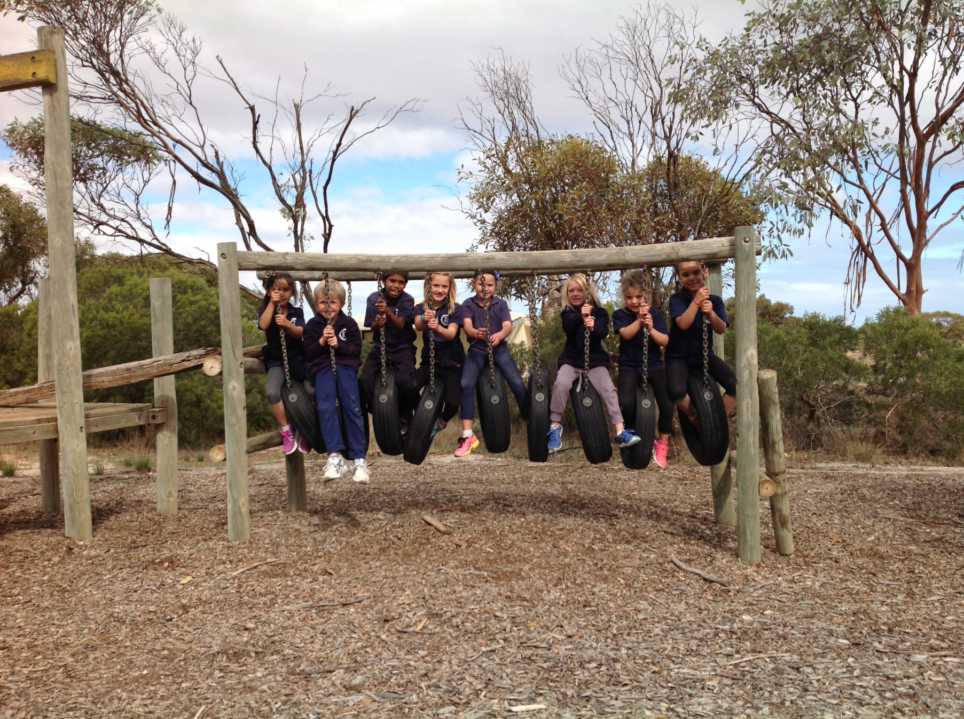
We love to play on our back playground equipment during recess and lunch.

Slide 7
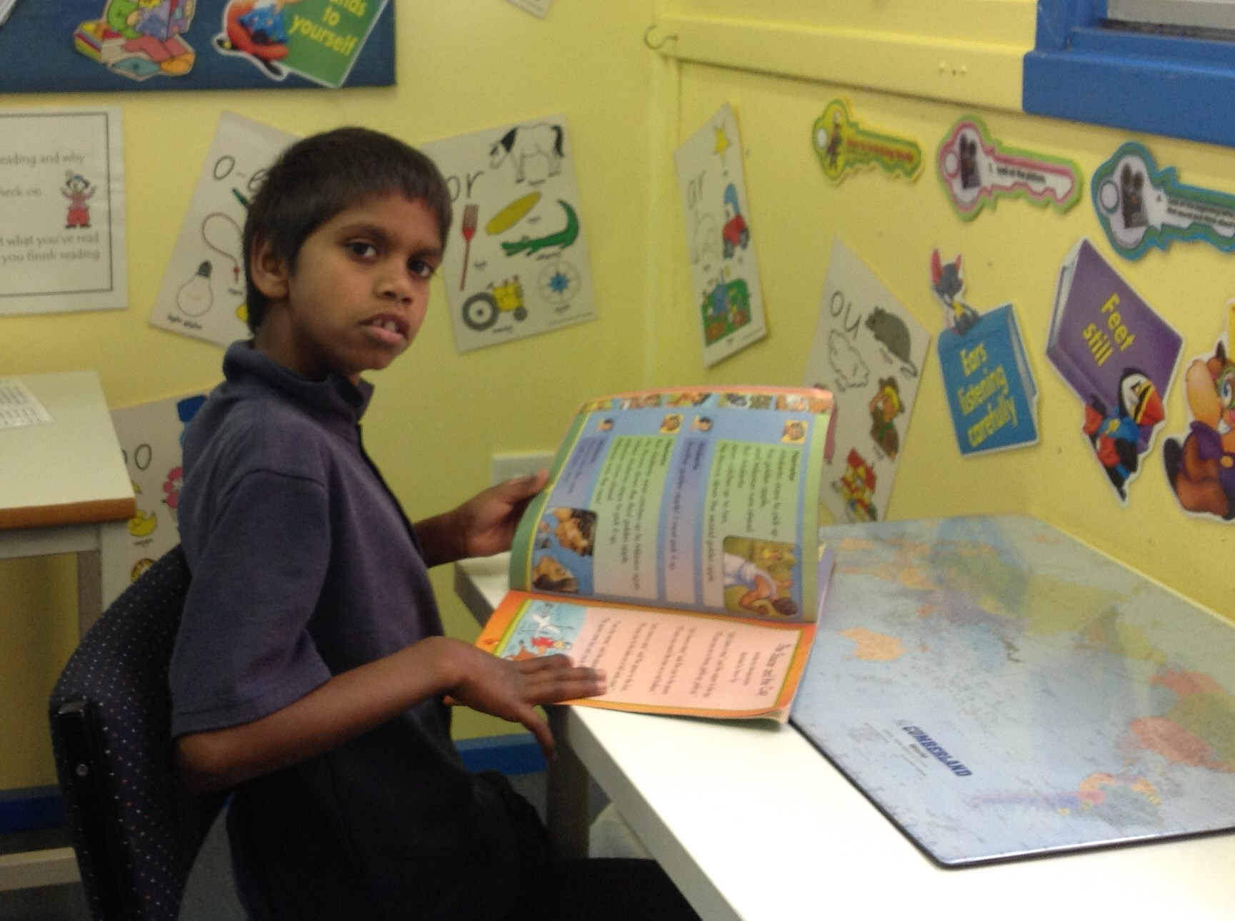
Our reading programs teach students how to get better at reading .

Slide 8
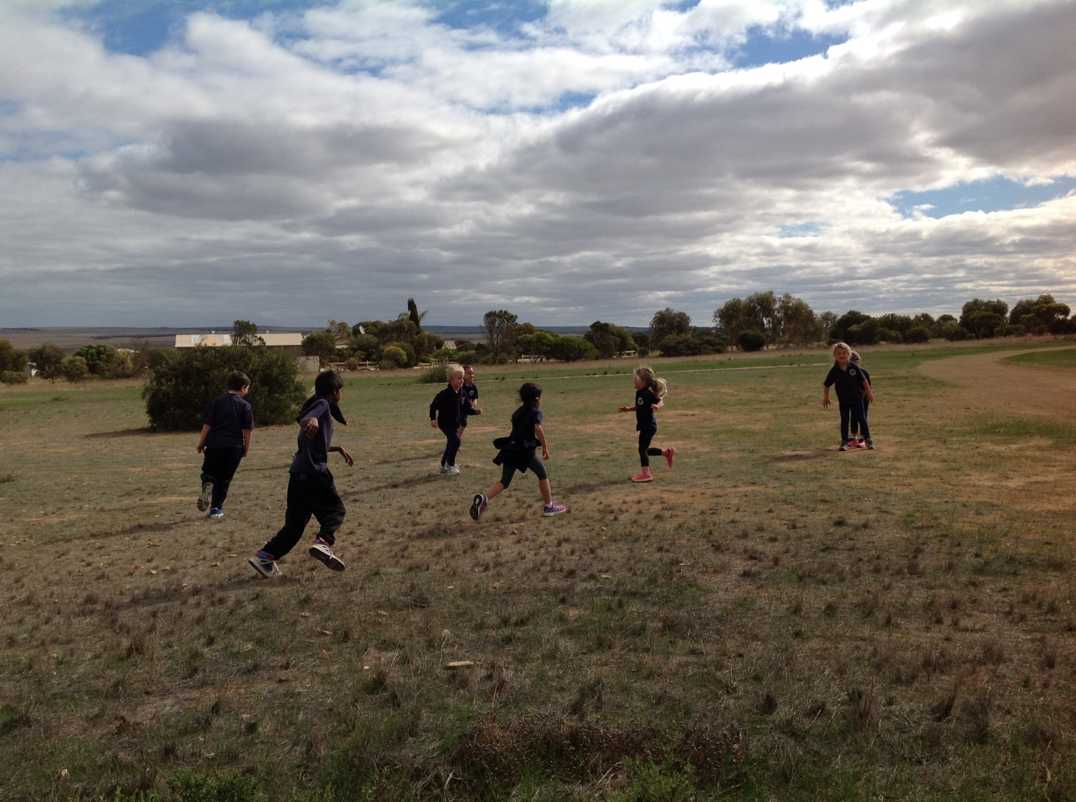
All the JP love to run around and play

Slide 9
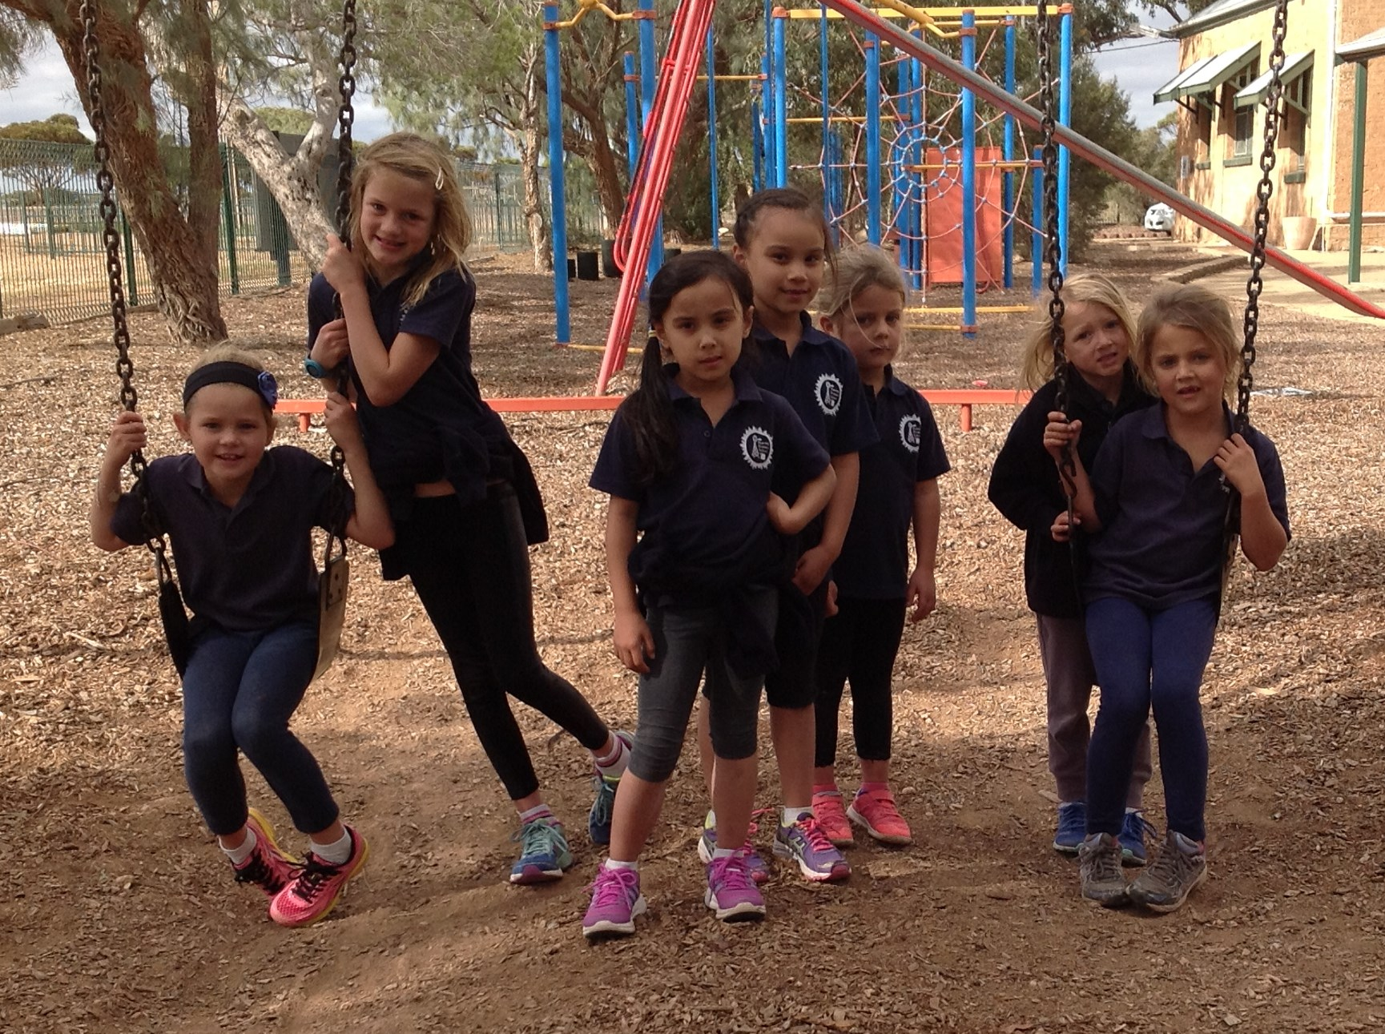
The swings are so fun to play on.

Slide 10
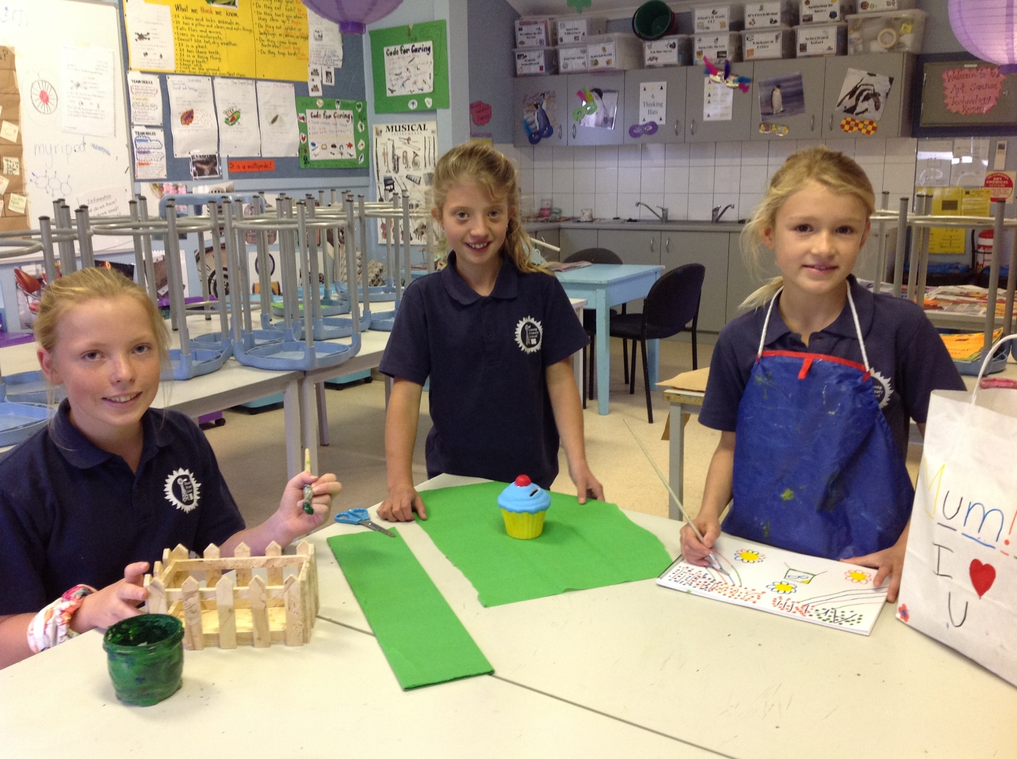
We learn how to make so many things in art and we have so much fun.

