Slide 1
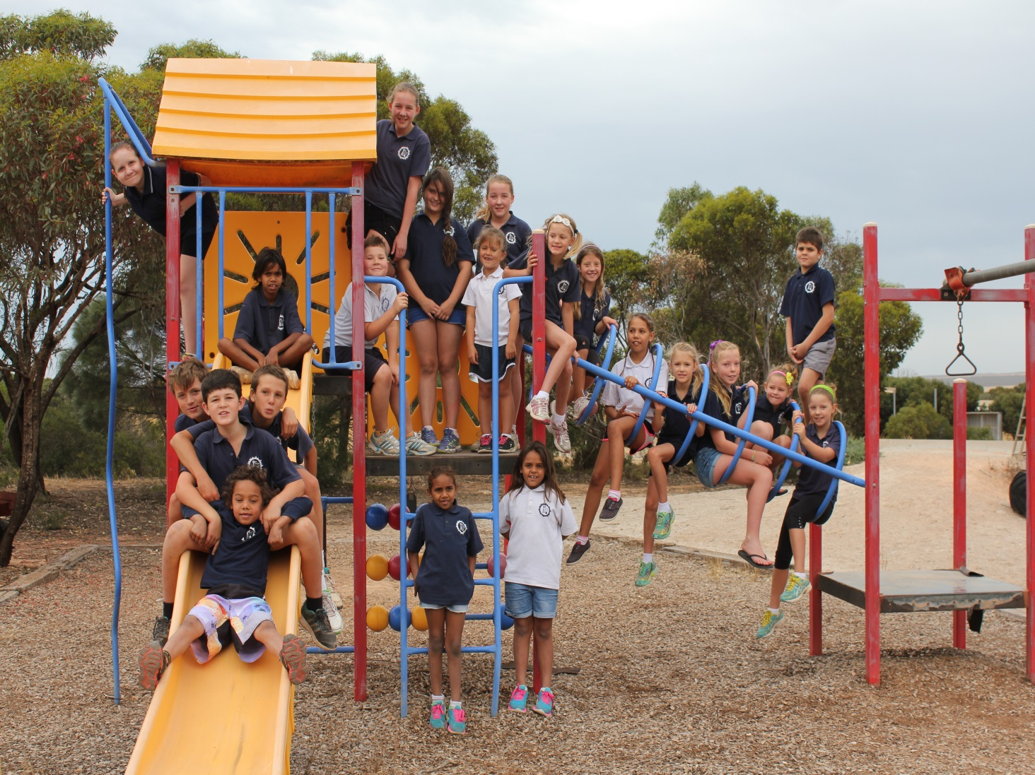
These are the students of our school at 1 of the 3 playgrounds we have.

Slide 2
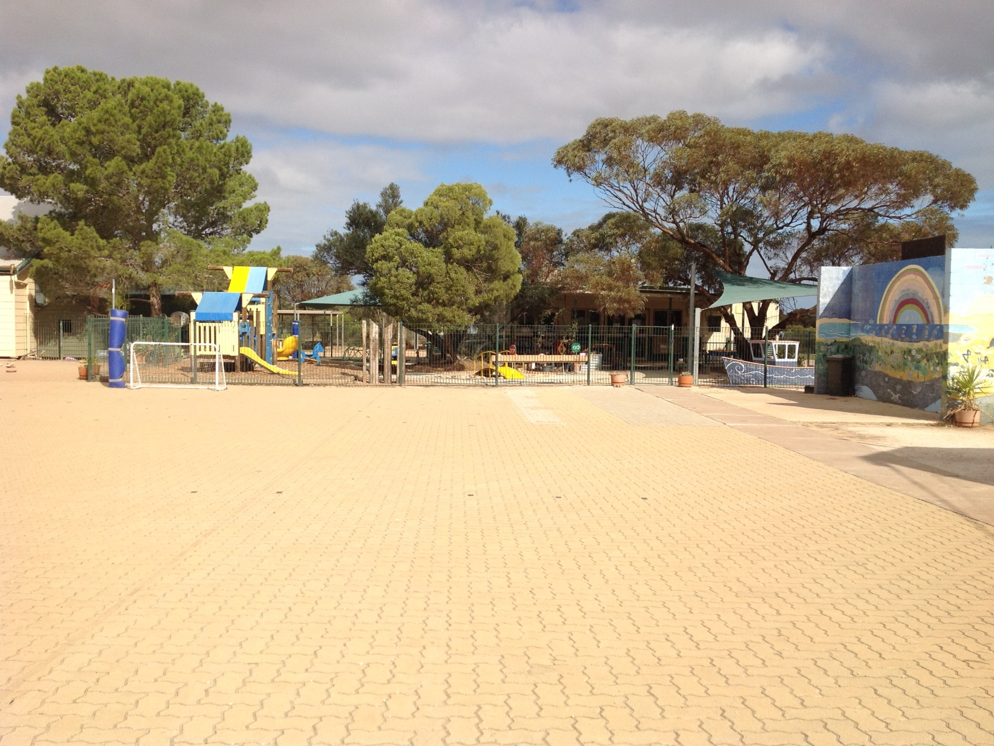
This is our fantastic sporting court, we have heaps of fun in this area.

Slide 3
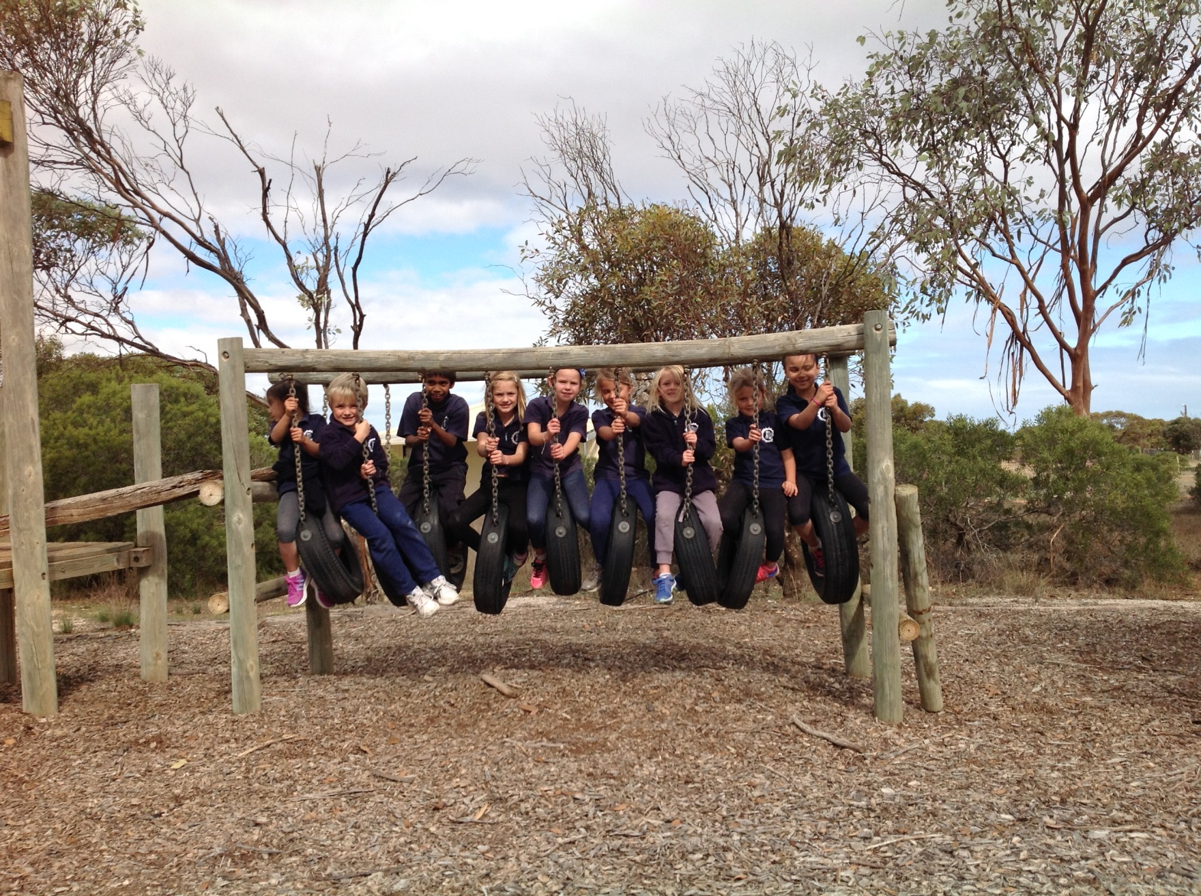
Here we have our junior primary class enjoying their playtime on the stepping tyres .

Slide 4
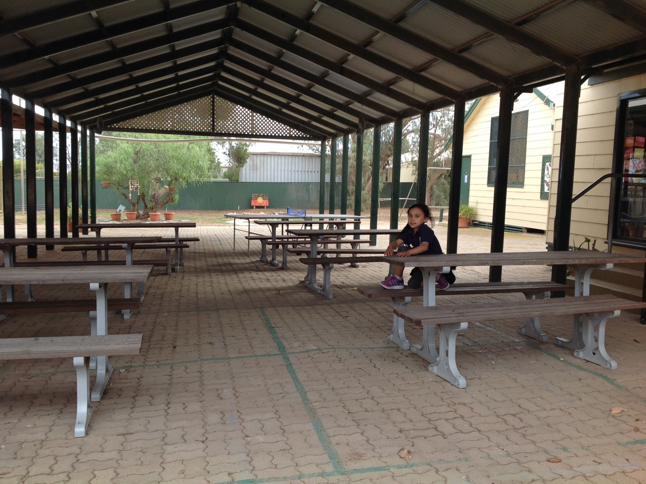
This is our shelter which is where we eat our recess and lunch's.

Slide 5
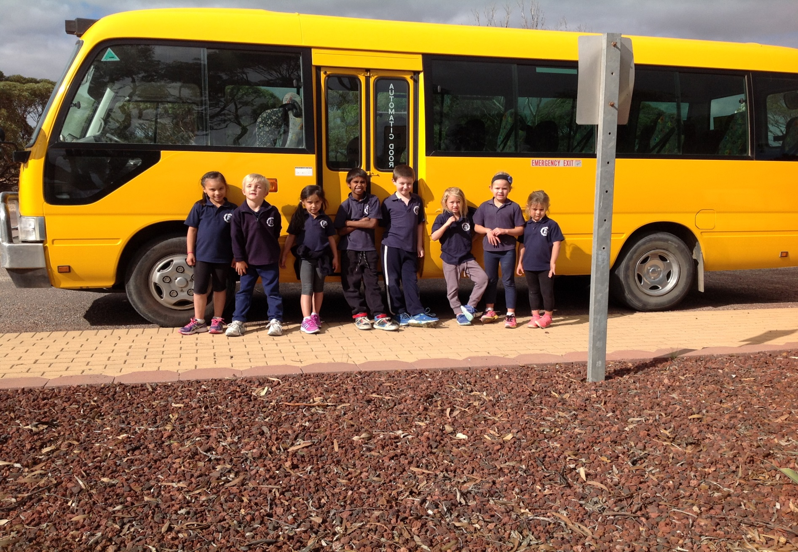
Here are the junior primary's showing you our bus in which we have 11 students who come to school with this.

Slide 6
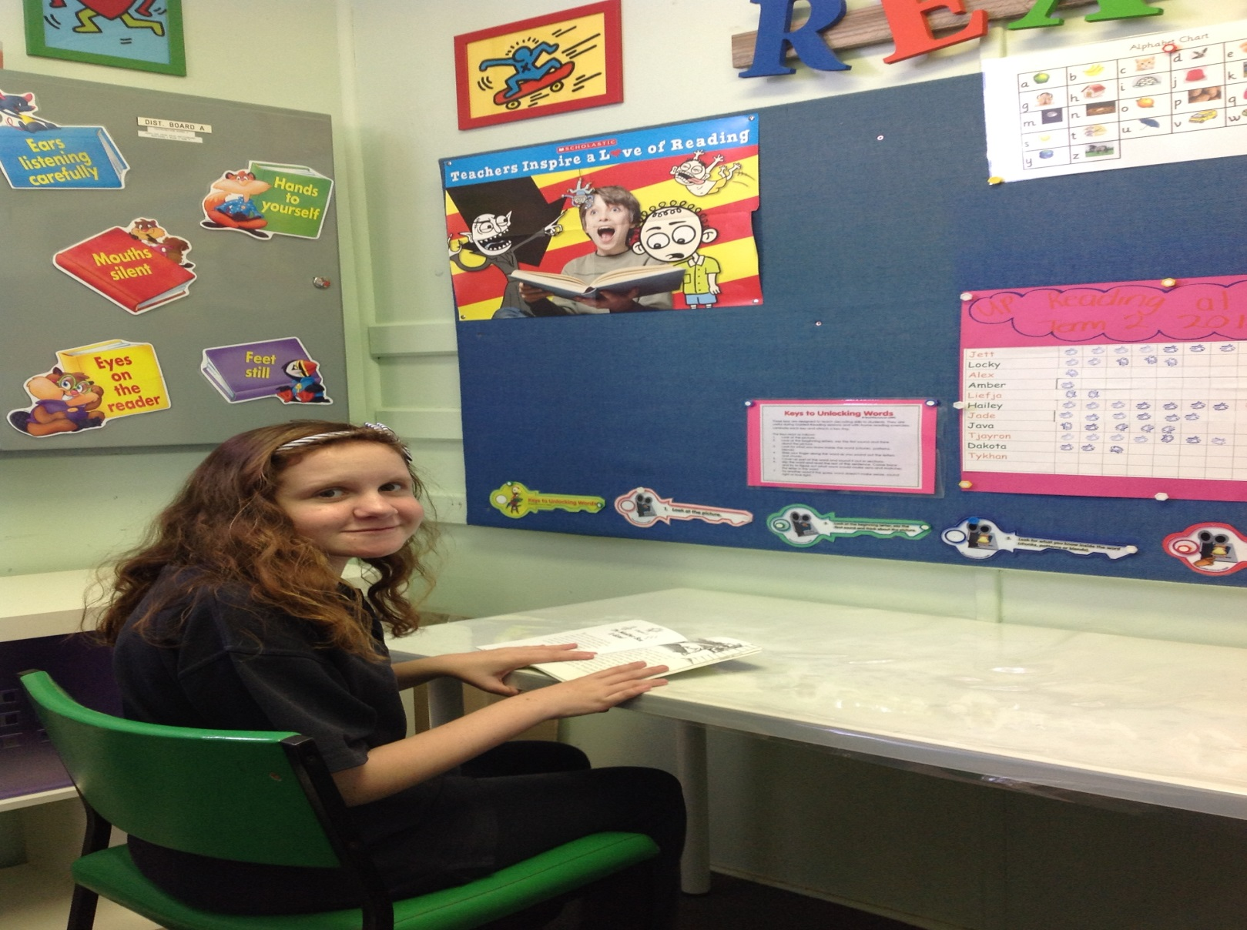
This is were our teachers listen to us reading and help us to improve on the way we pronounce and comprehend what we are reading.

Slide 7
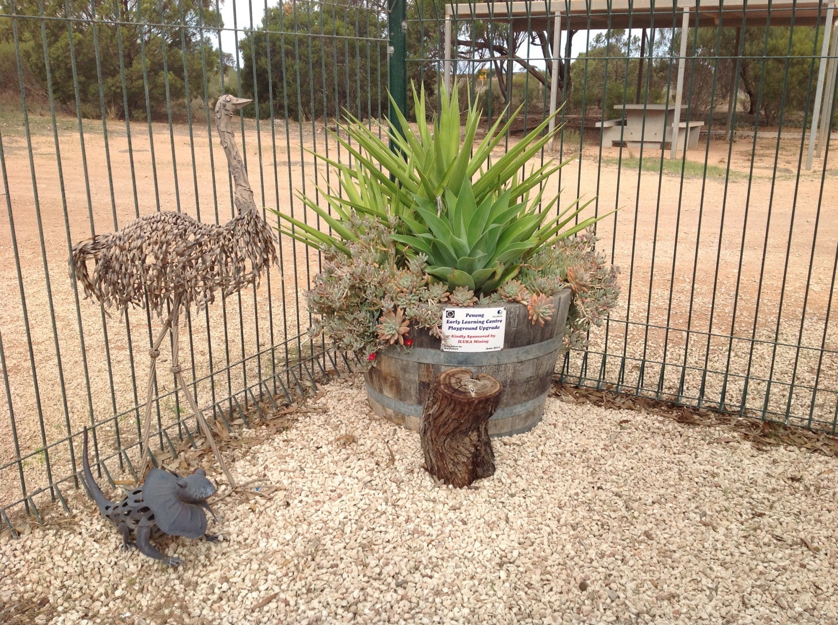
One of the many marvellous displays at our beautiful little school.

Slide 8
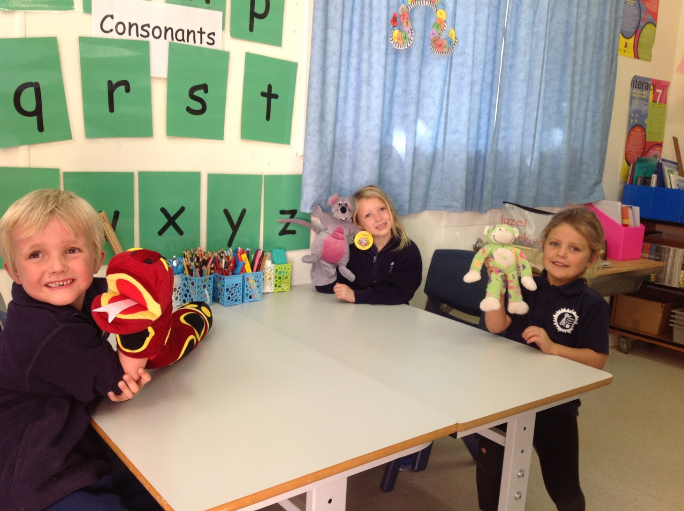
These are our three clever, confident little receptions learning their sounds with puppets in the white elephant.

Slide 9
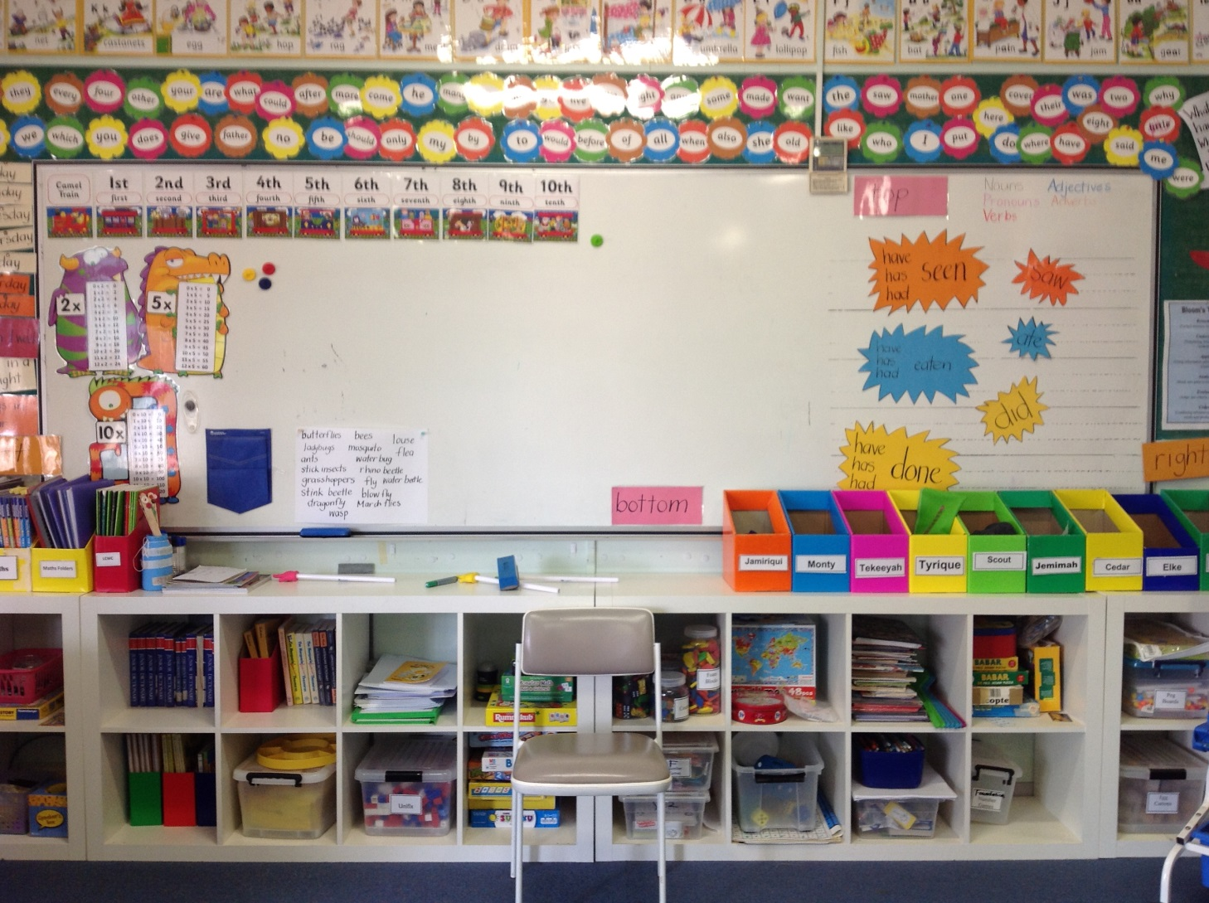
This one of our bright and poppy classrooms, as you can see learning is made fun at our super superb school.

Slide 10
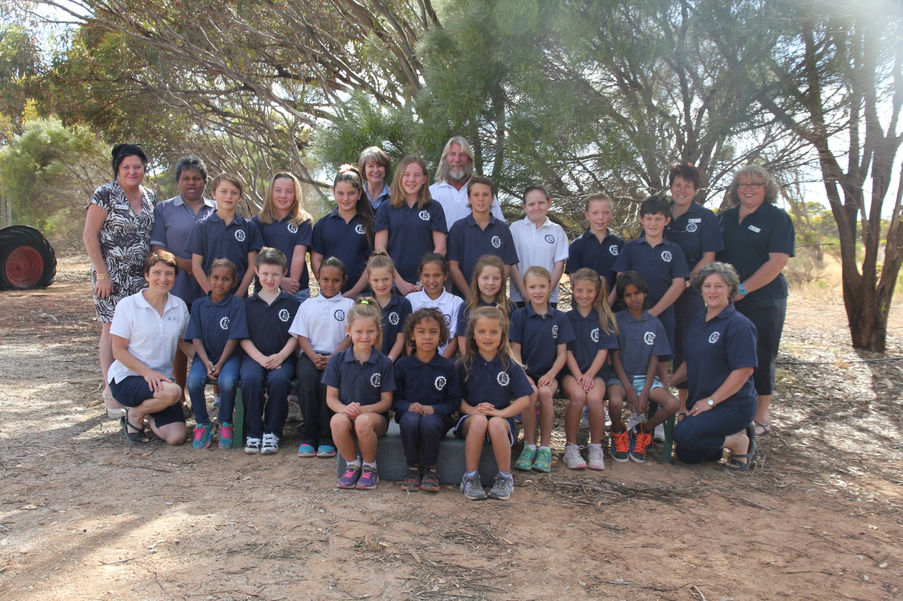
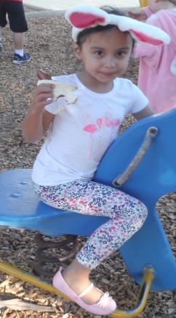
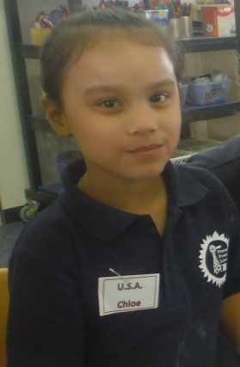
Our school is extremely accepting and respectful of many different cultures our school includes many backgrounds such as, European, Indigenous, Dutch, Asian and Malayan.

Slide 11
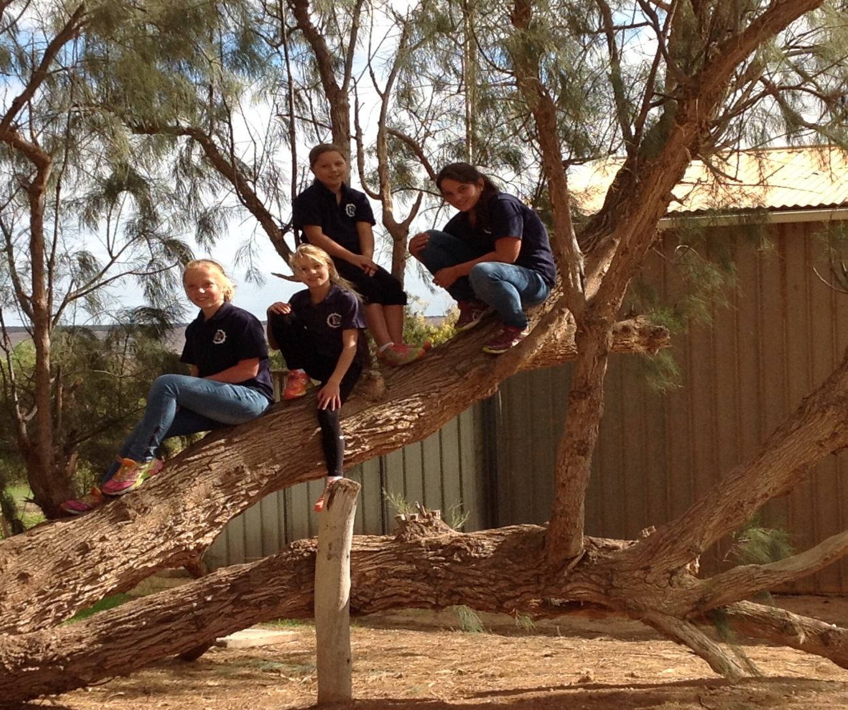
These are some of our elder girls at the tree they love.

Slide 12
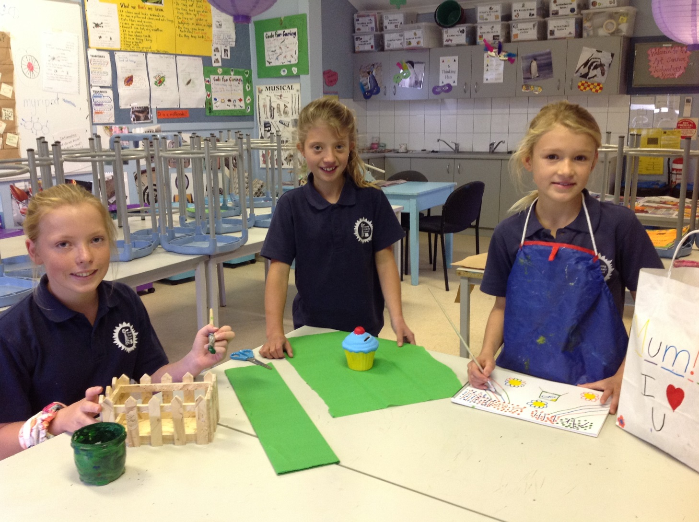
Here are the older girls doing there mothers day art.

Slide 13
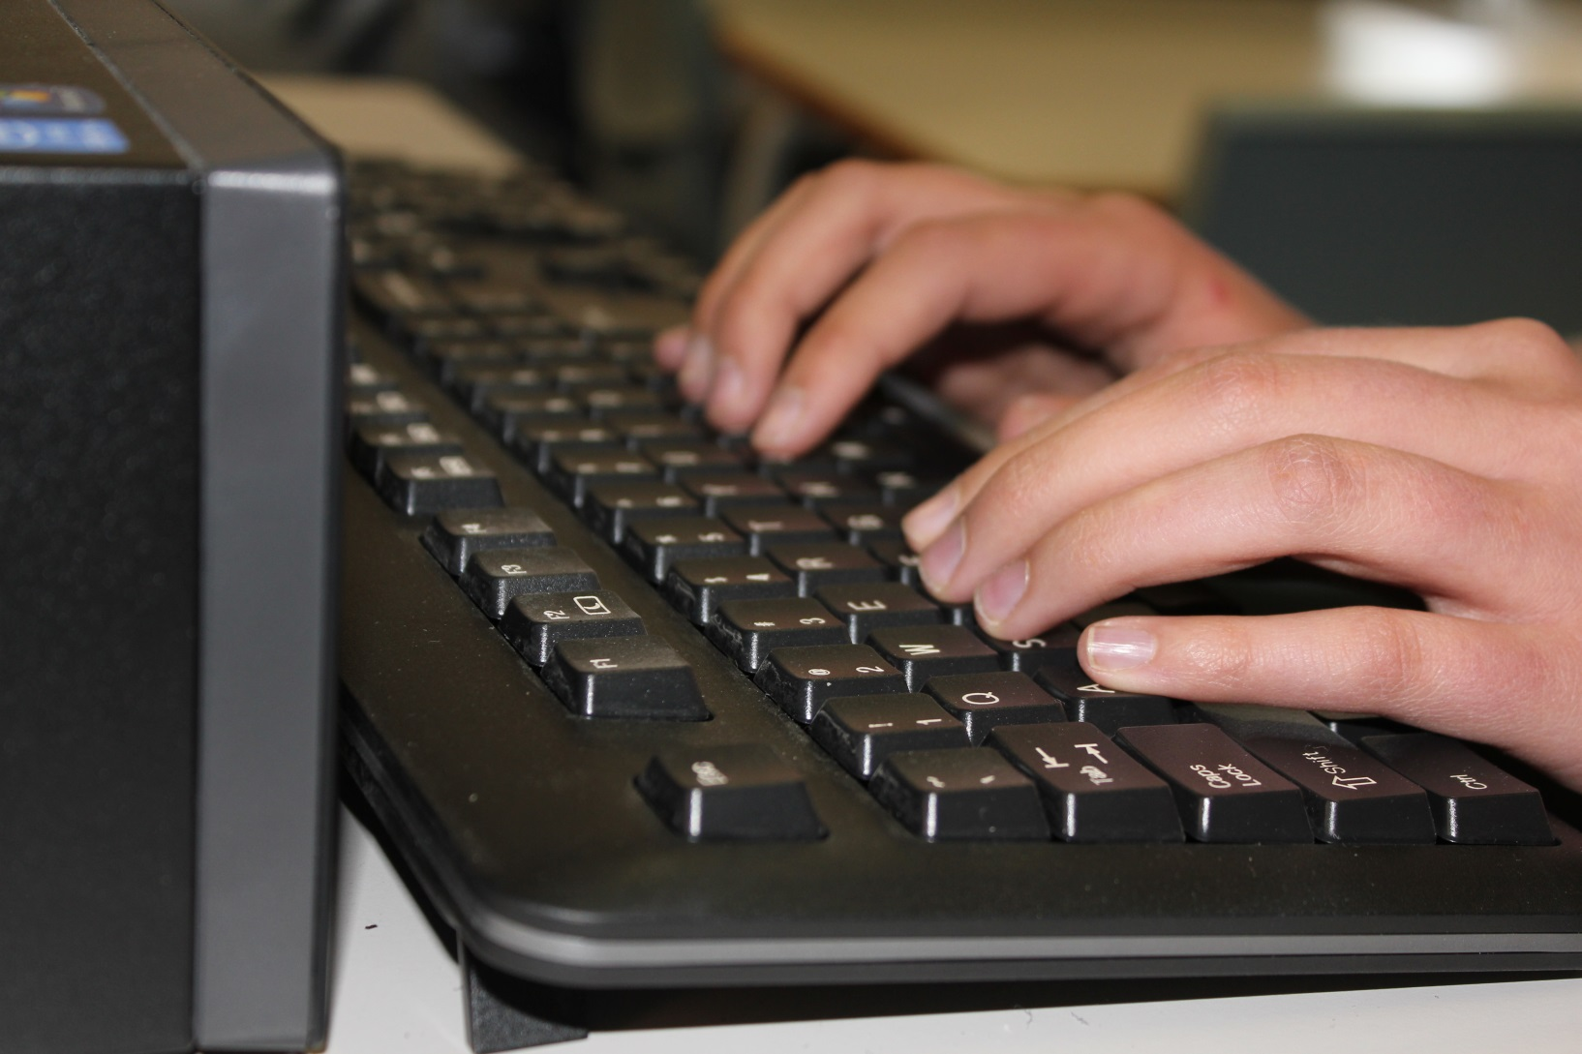
We practise typing every morning at Penong Primary School.

Slide 14
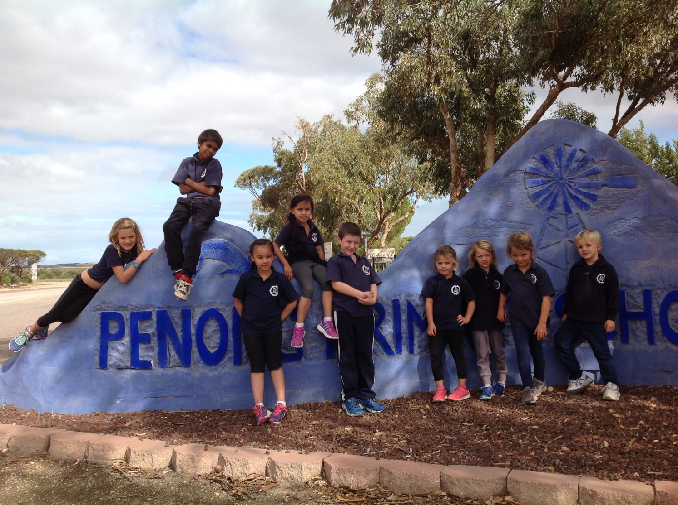
This is the mural that some artists and our students created.

Slide 15
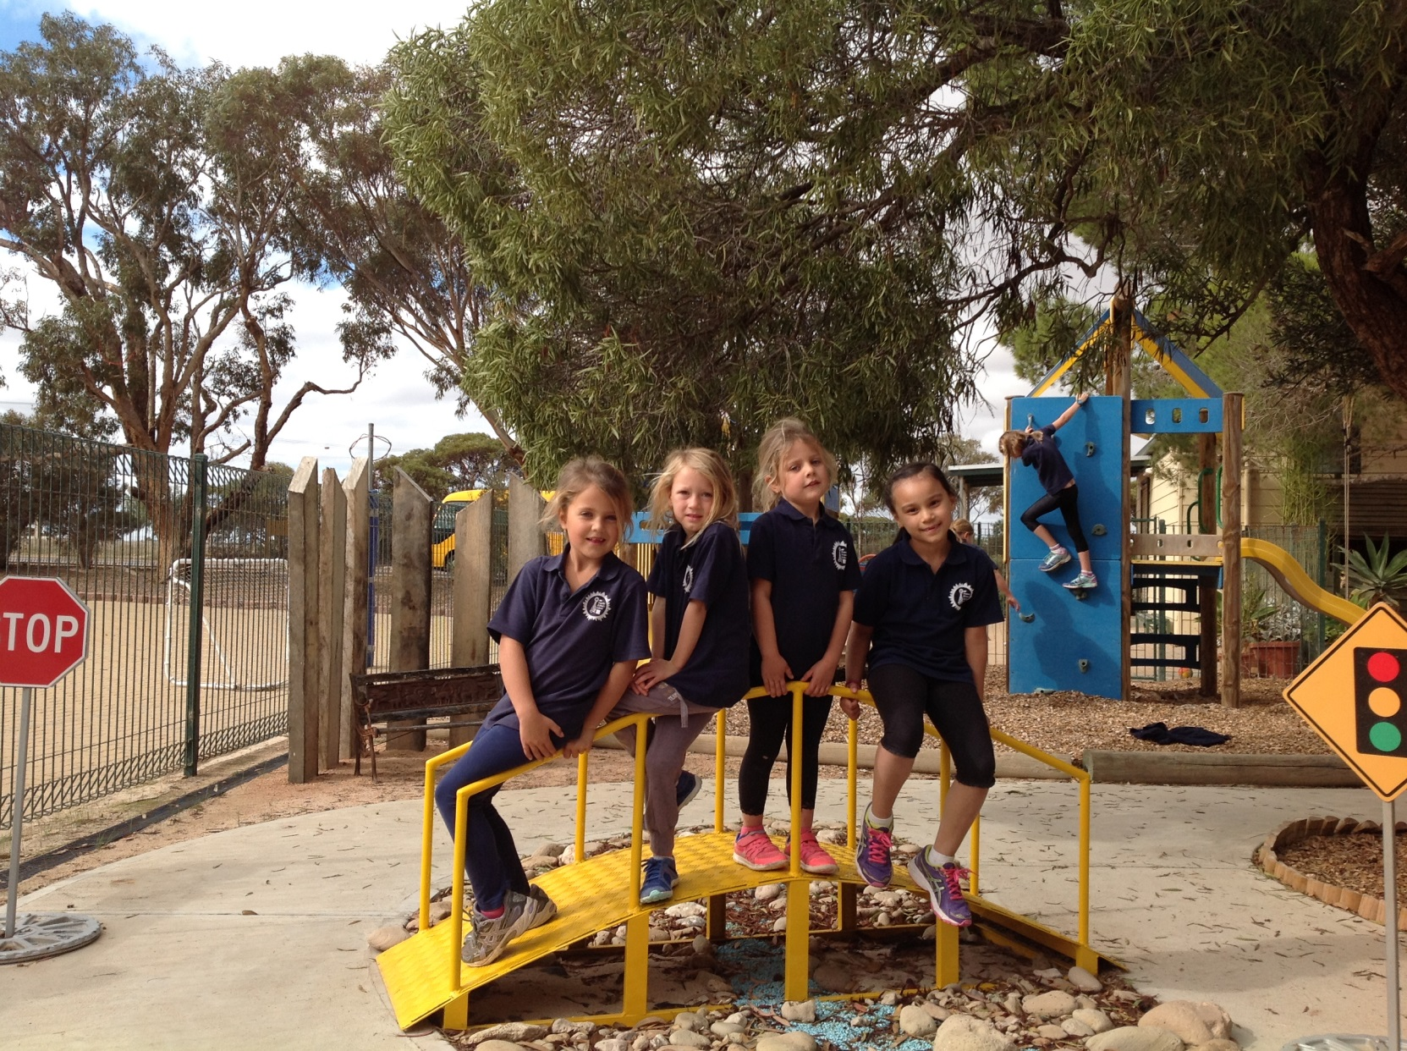
Our kindy has had many things added lately such as the bridge.

