Slide 1
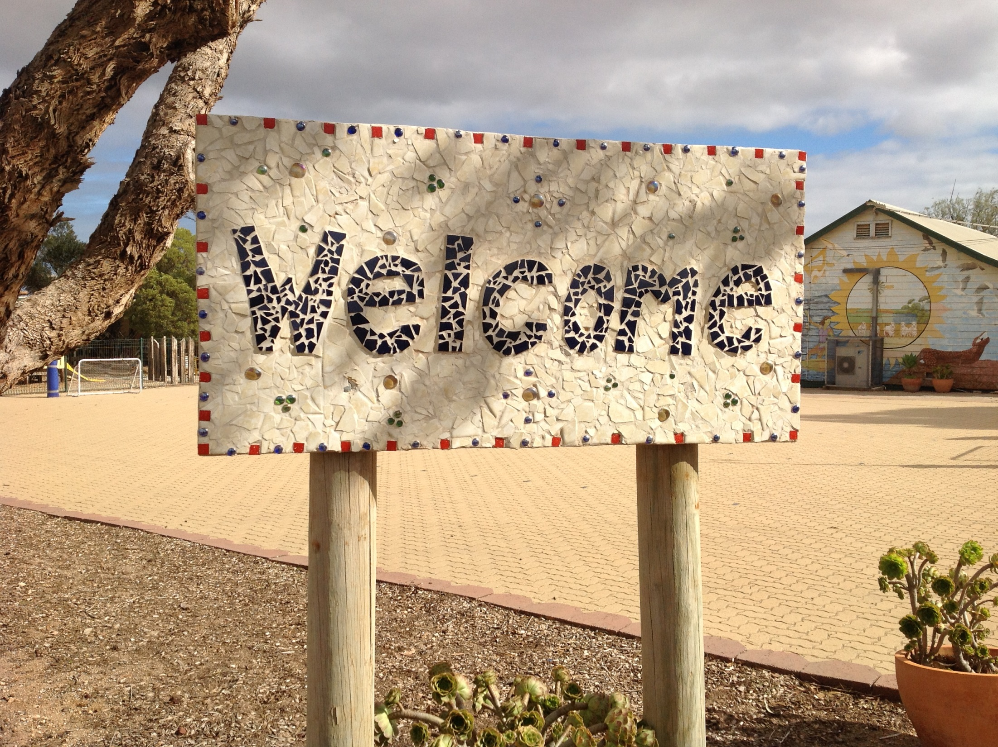
to Penong Primary School!!!

Slide 2
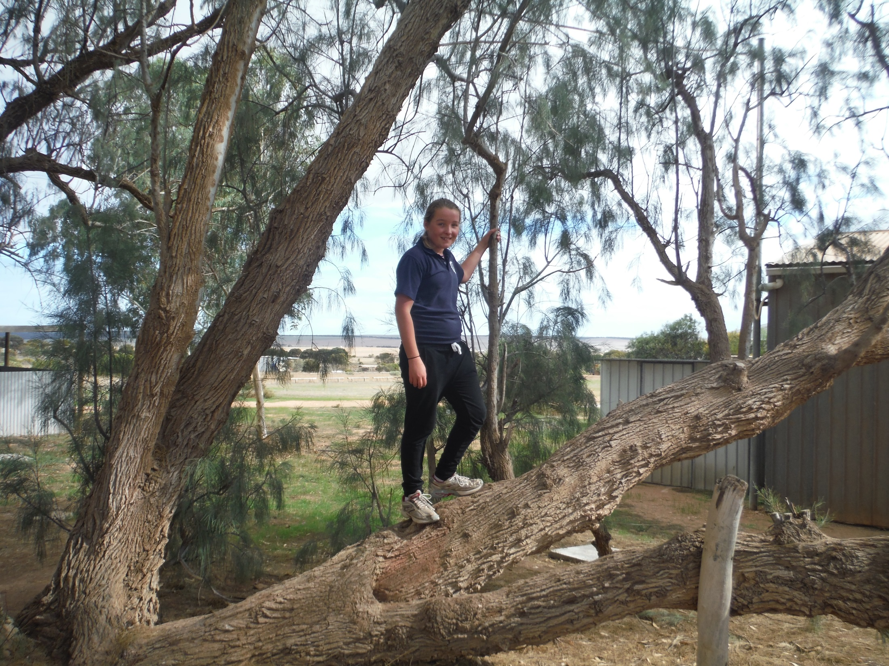
This is our tree on which we play on.

Slide 3
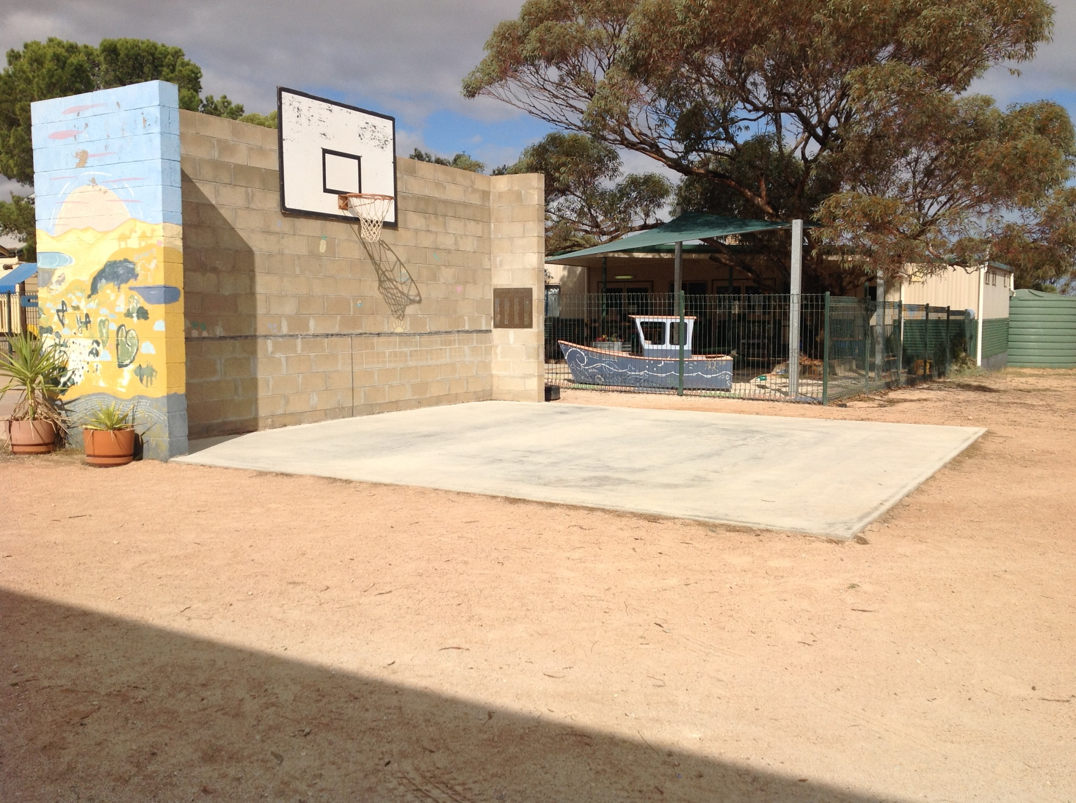
We play basket ball and dodge ball at the hitting wall.

Slide 4
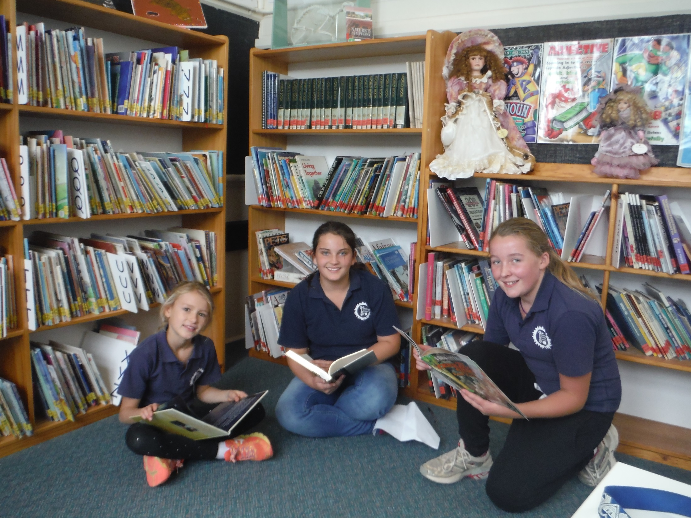
Our plentiful library.

Slide 5
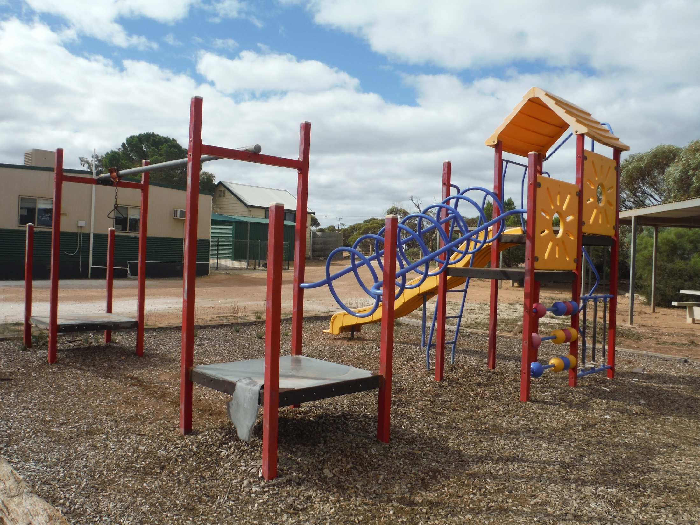
One of our three playgrounds.

Slide 6
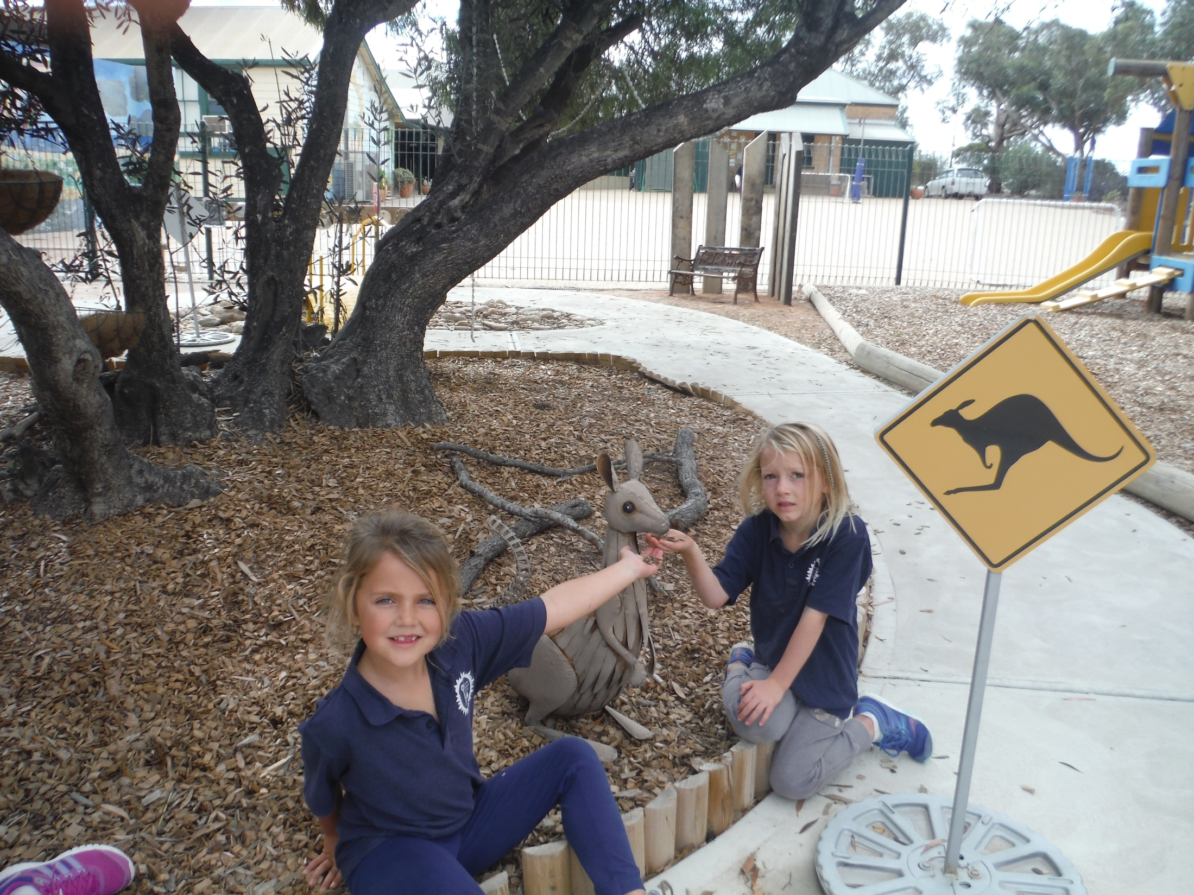
Some of our younger students in the kindy.

Slide 7
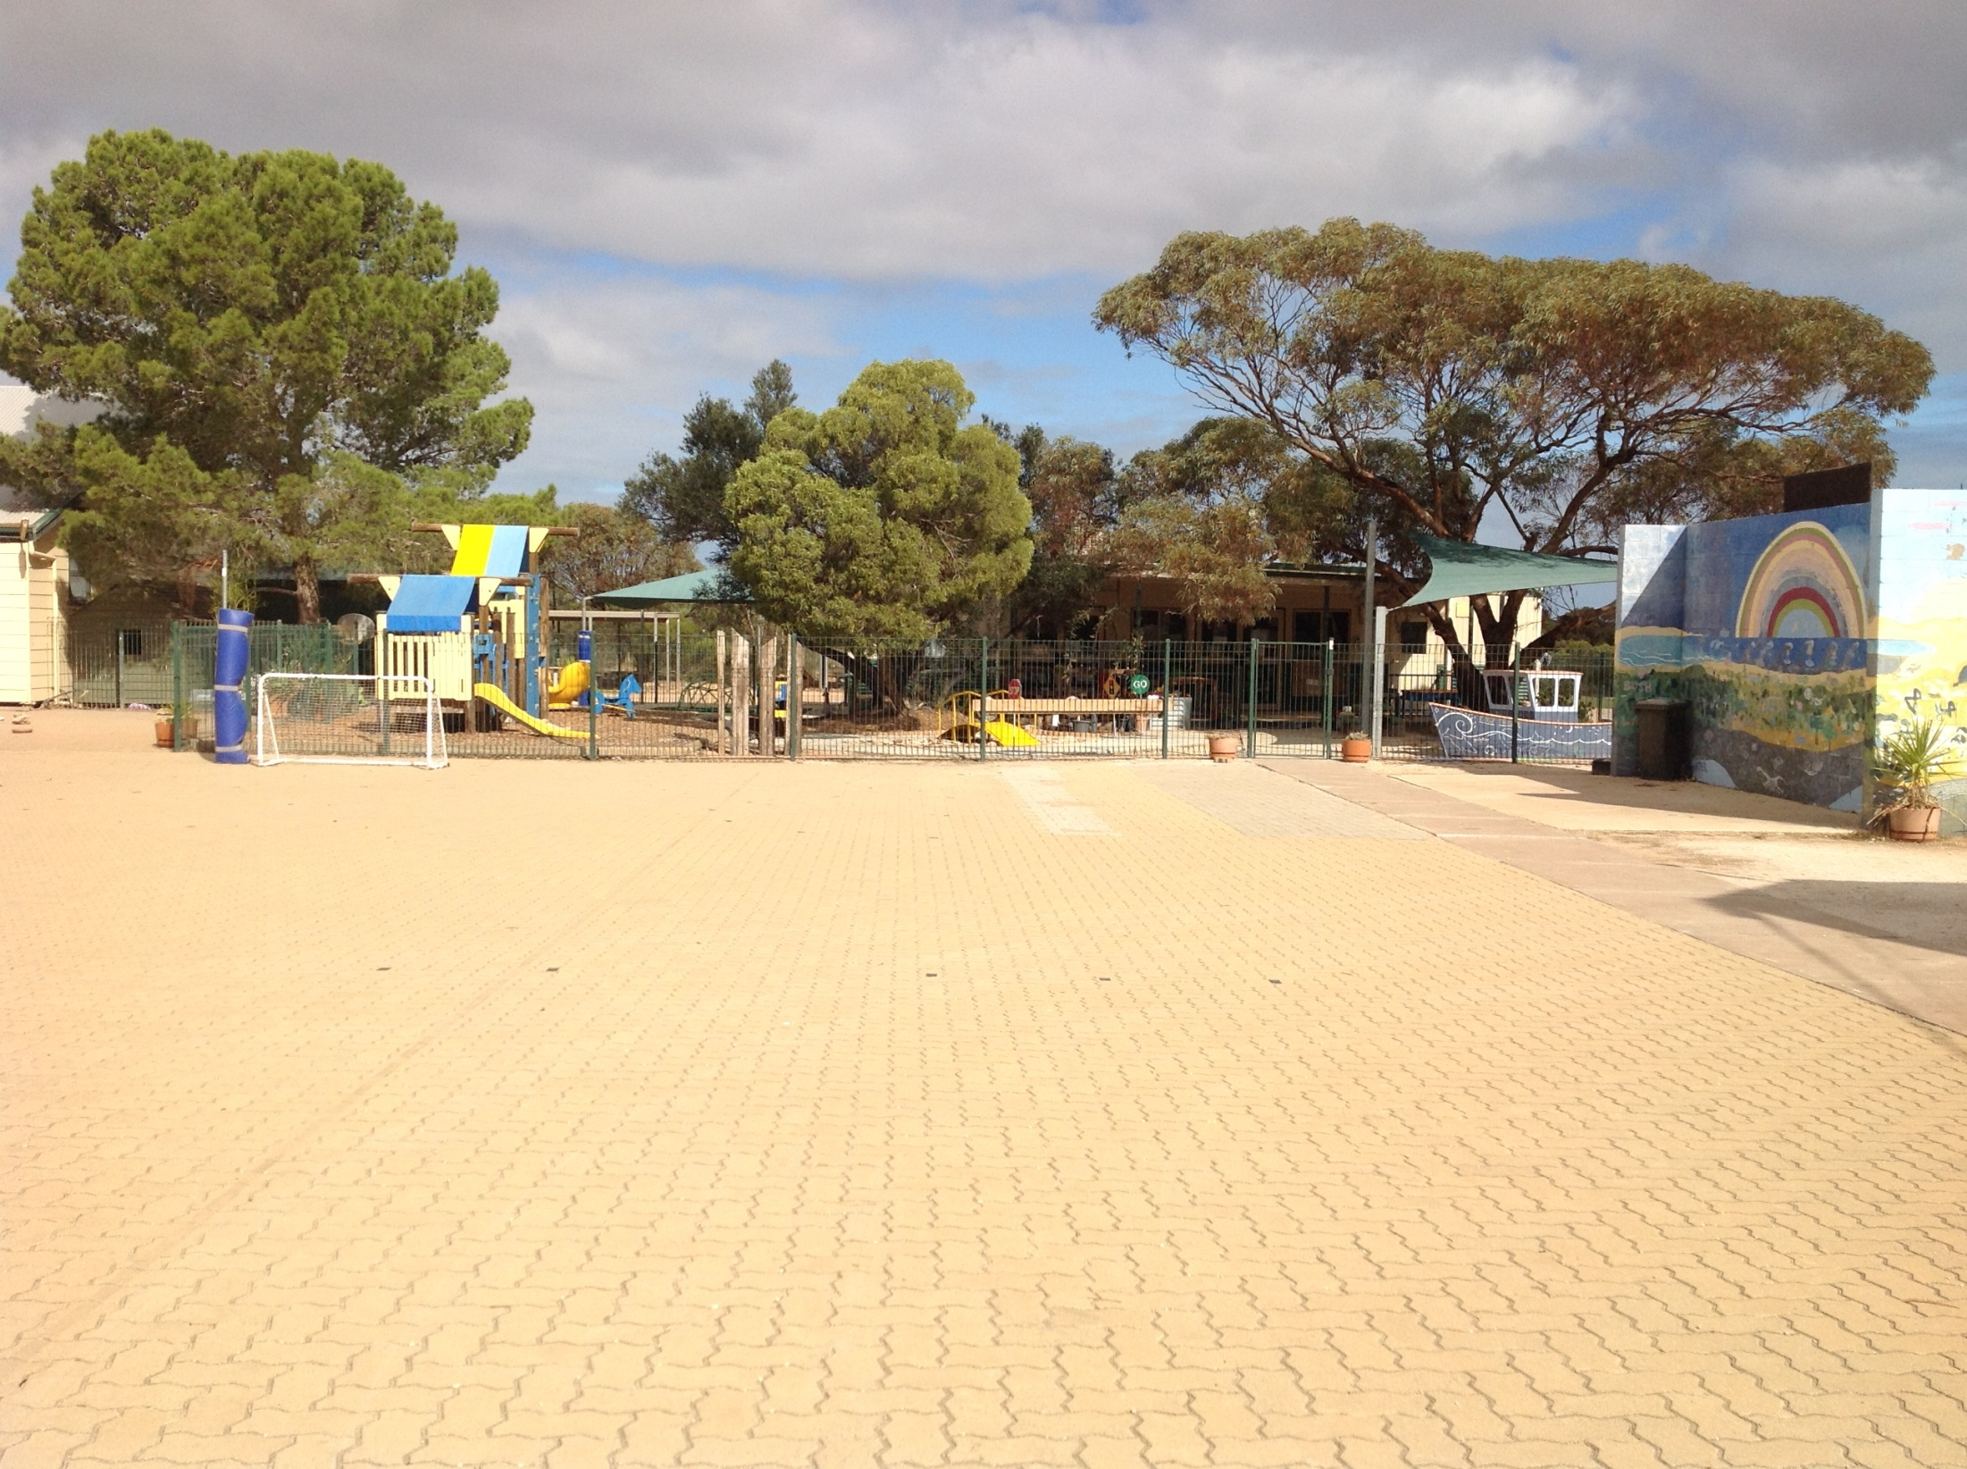
This is where we play morning fitness and P.E.

Slide 8
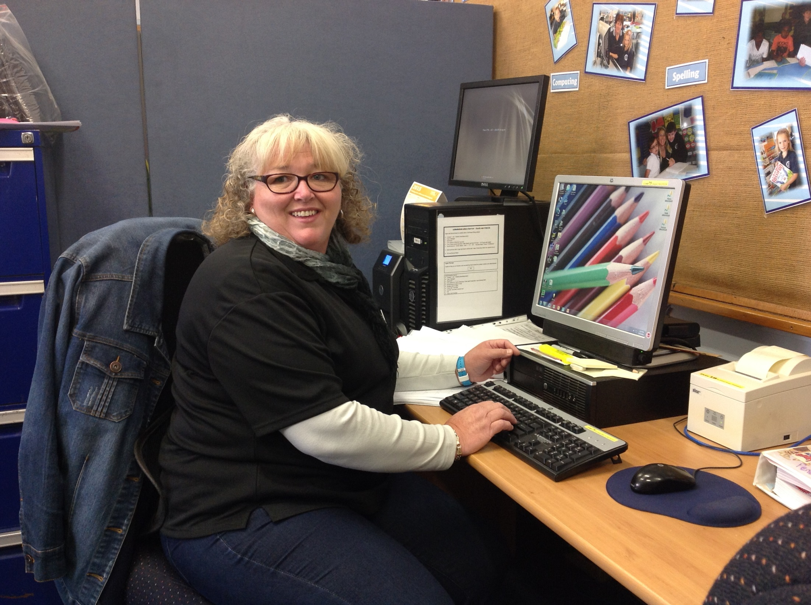
Friendly teachers and staff.

Slide 9
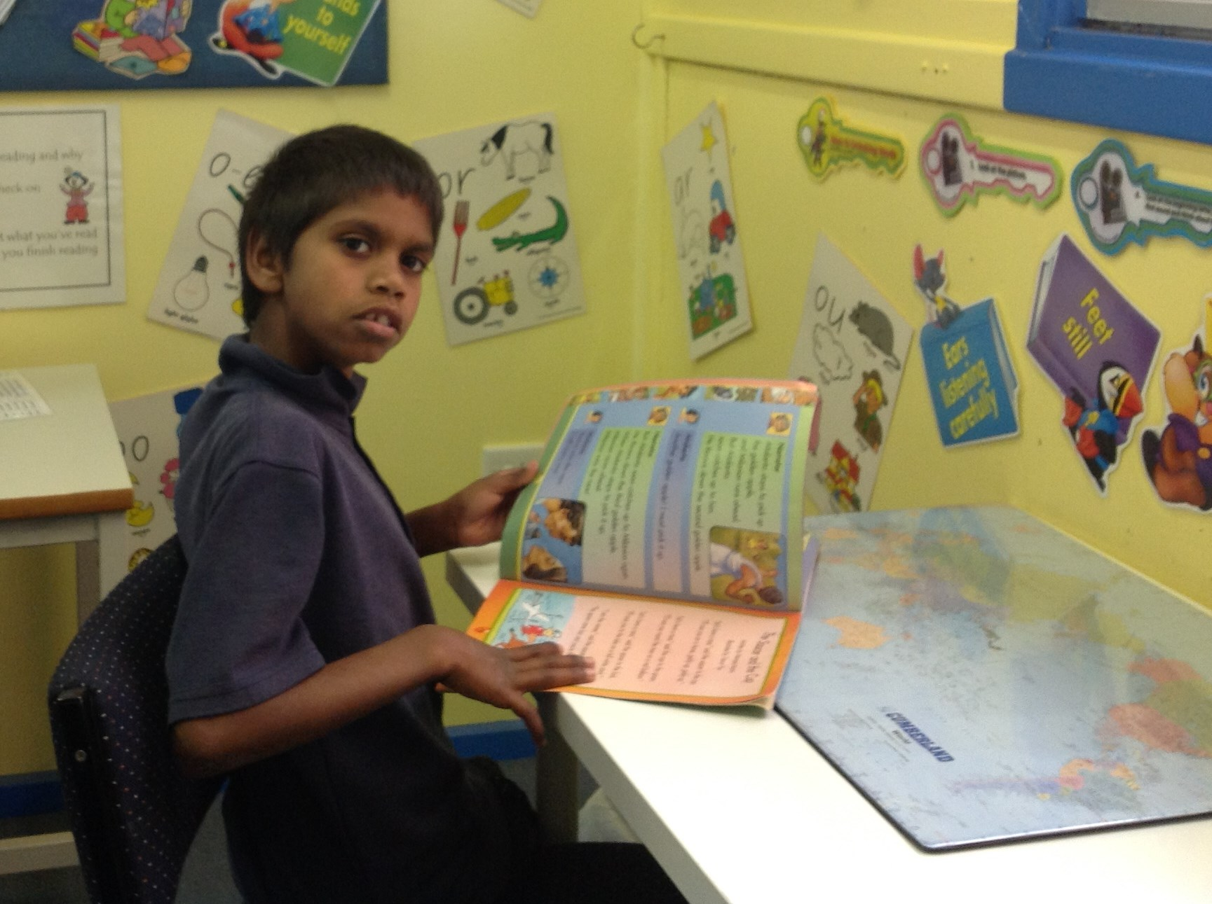
Our teachers listen to us read aloud.

Slide 10
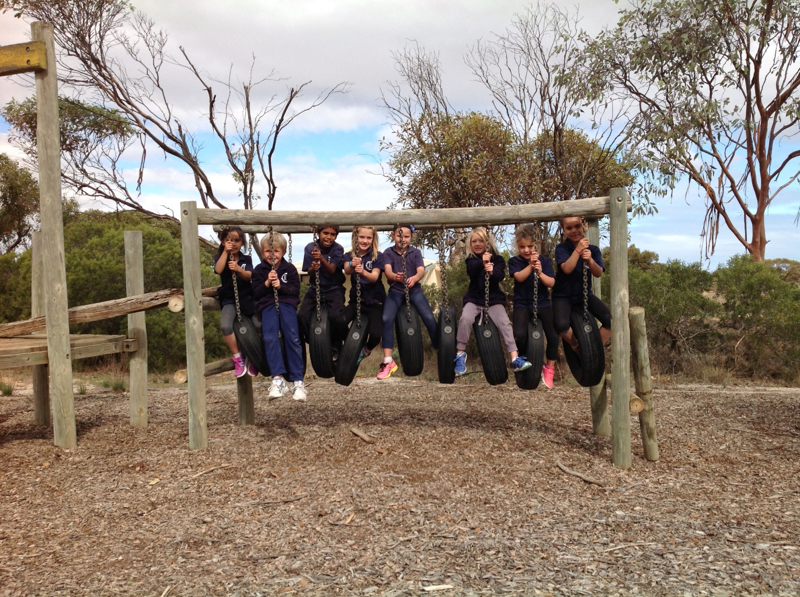
The Junior Primary riding our horses.

Slide 11
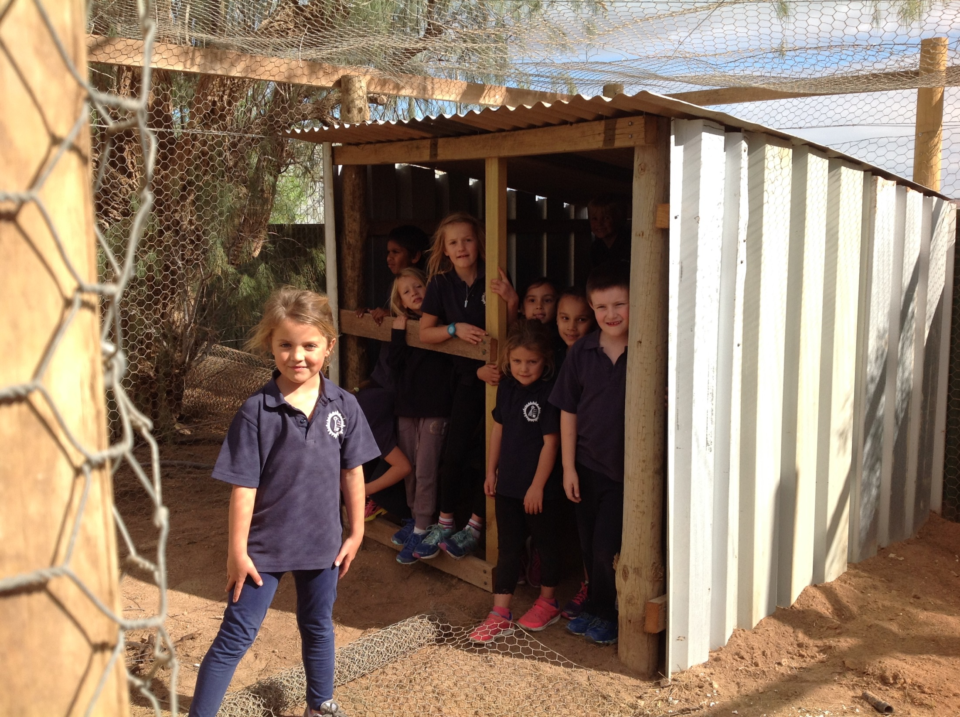
Our brand new chicken shed.

Slide 12
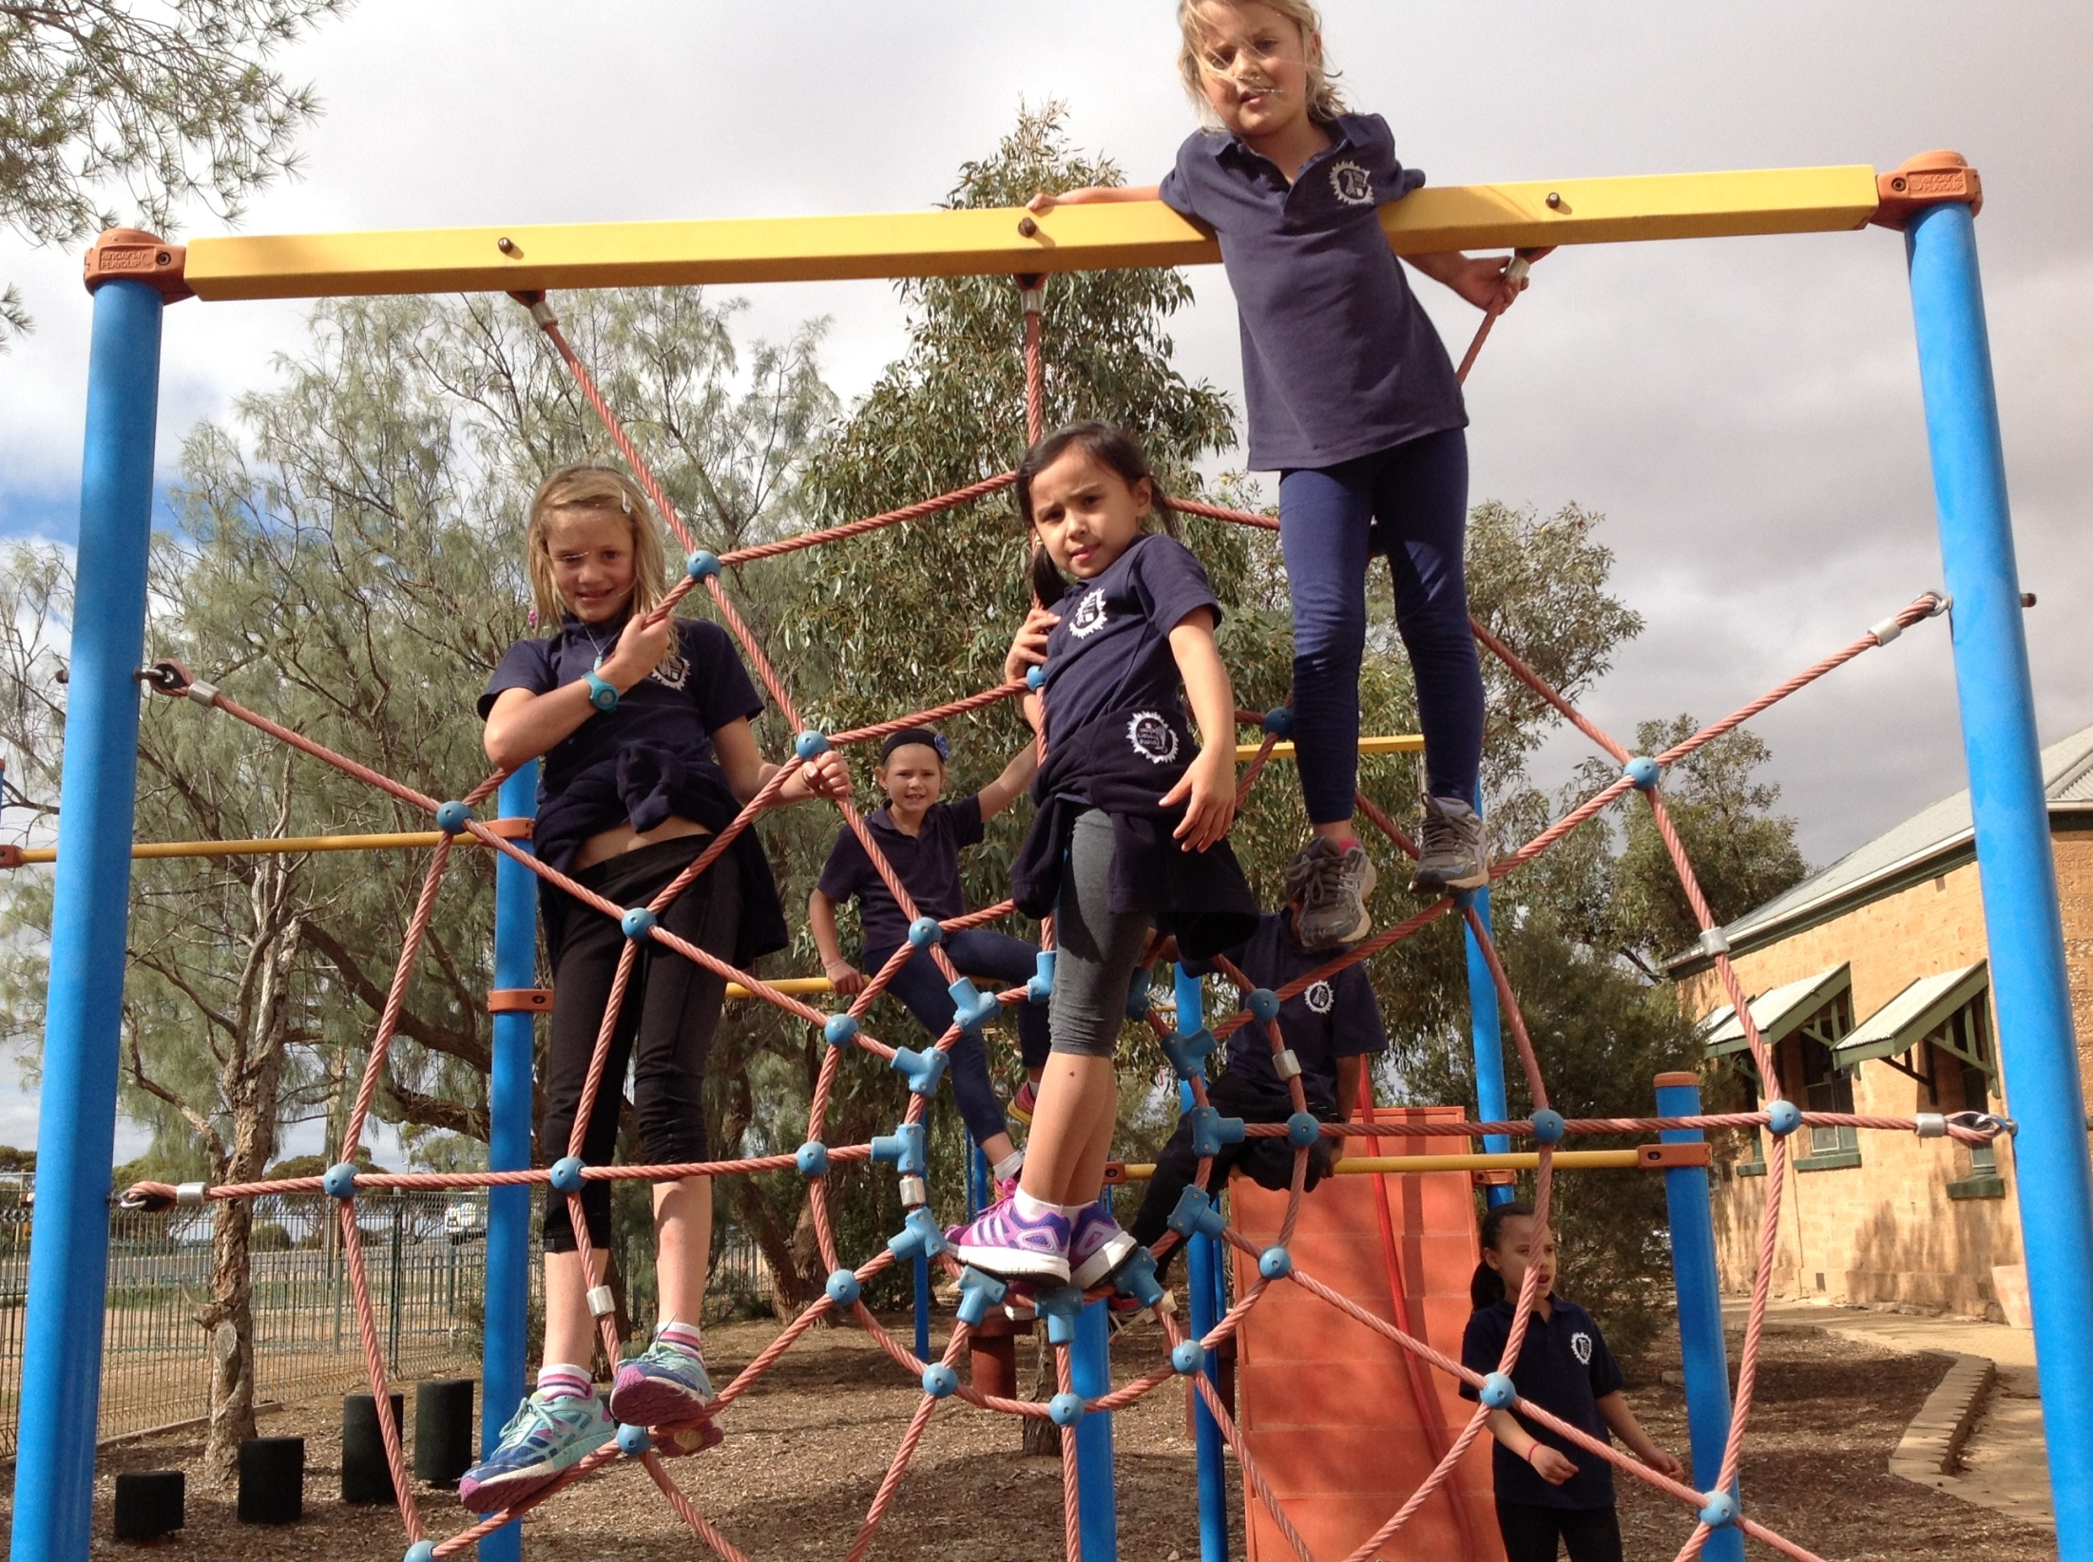
The spider web at the front of the school.

Slide 13
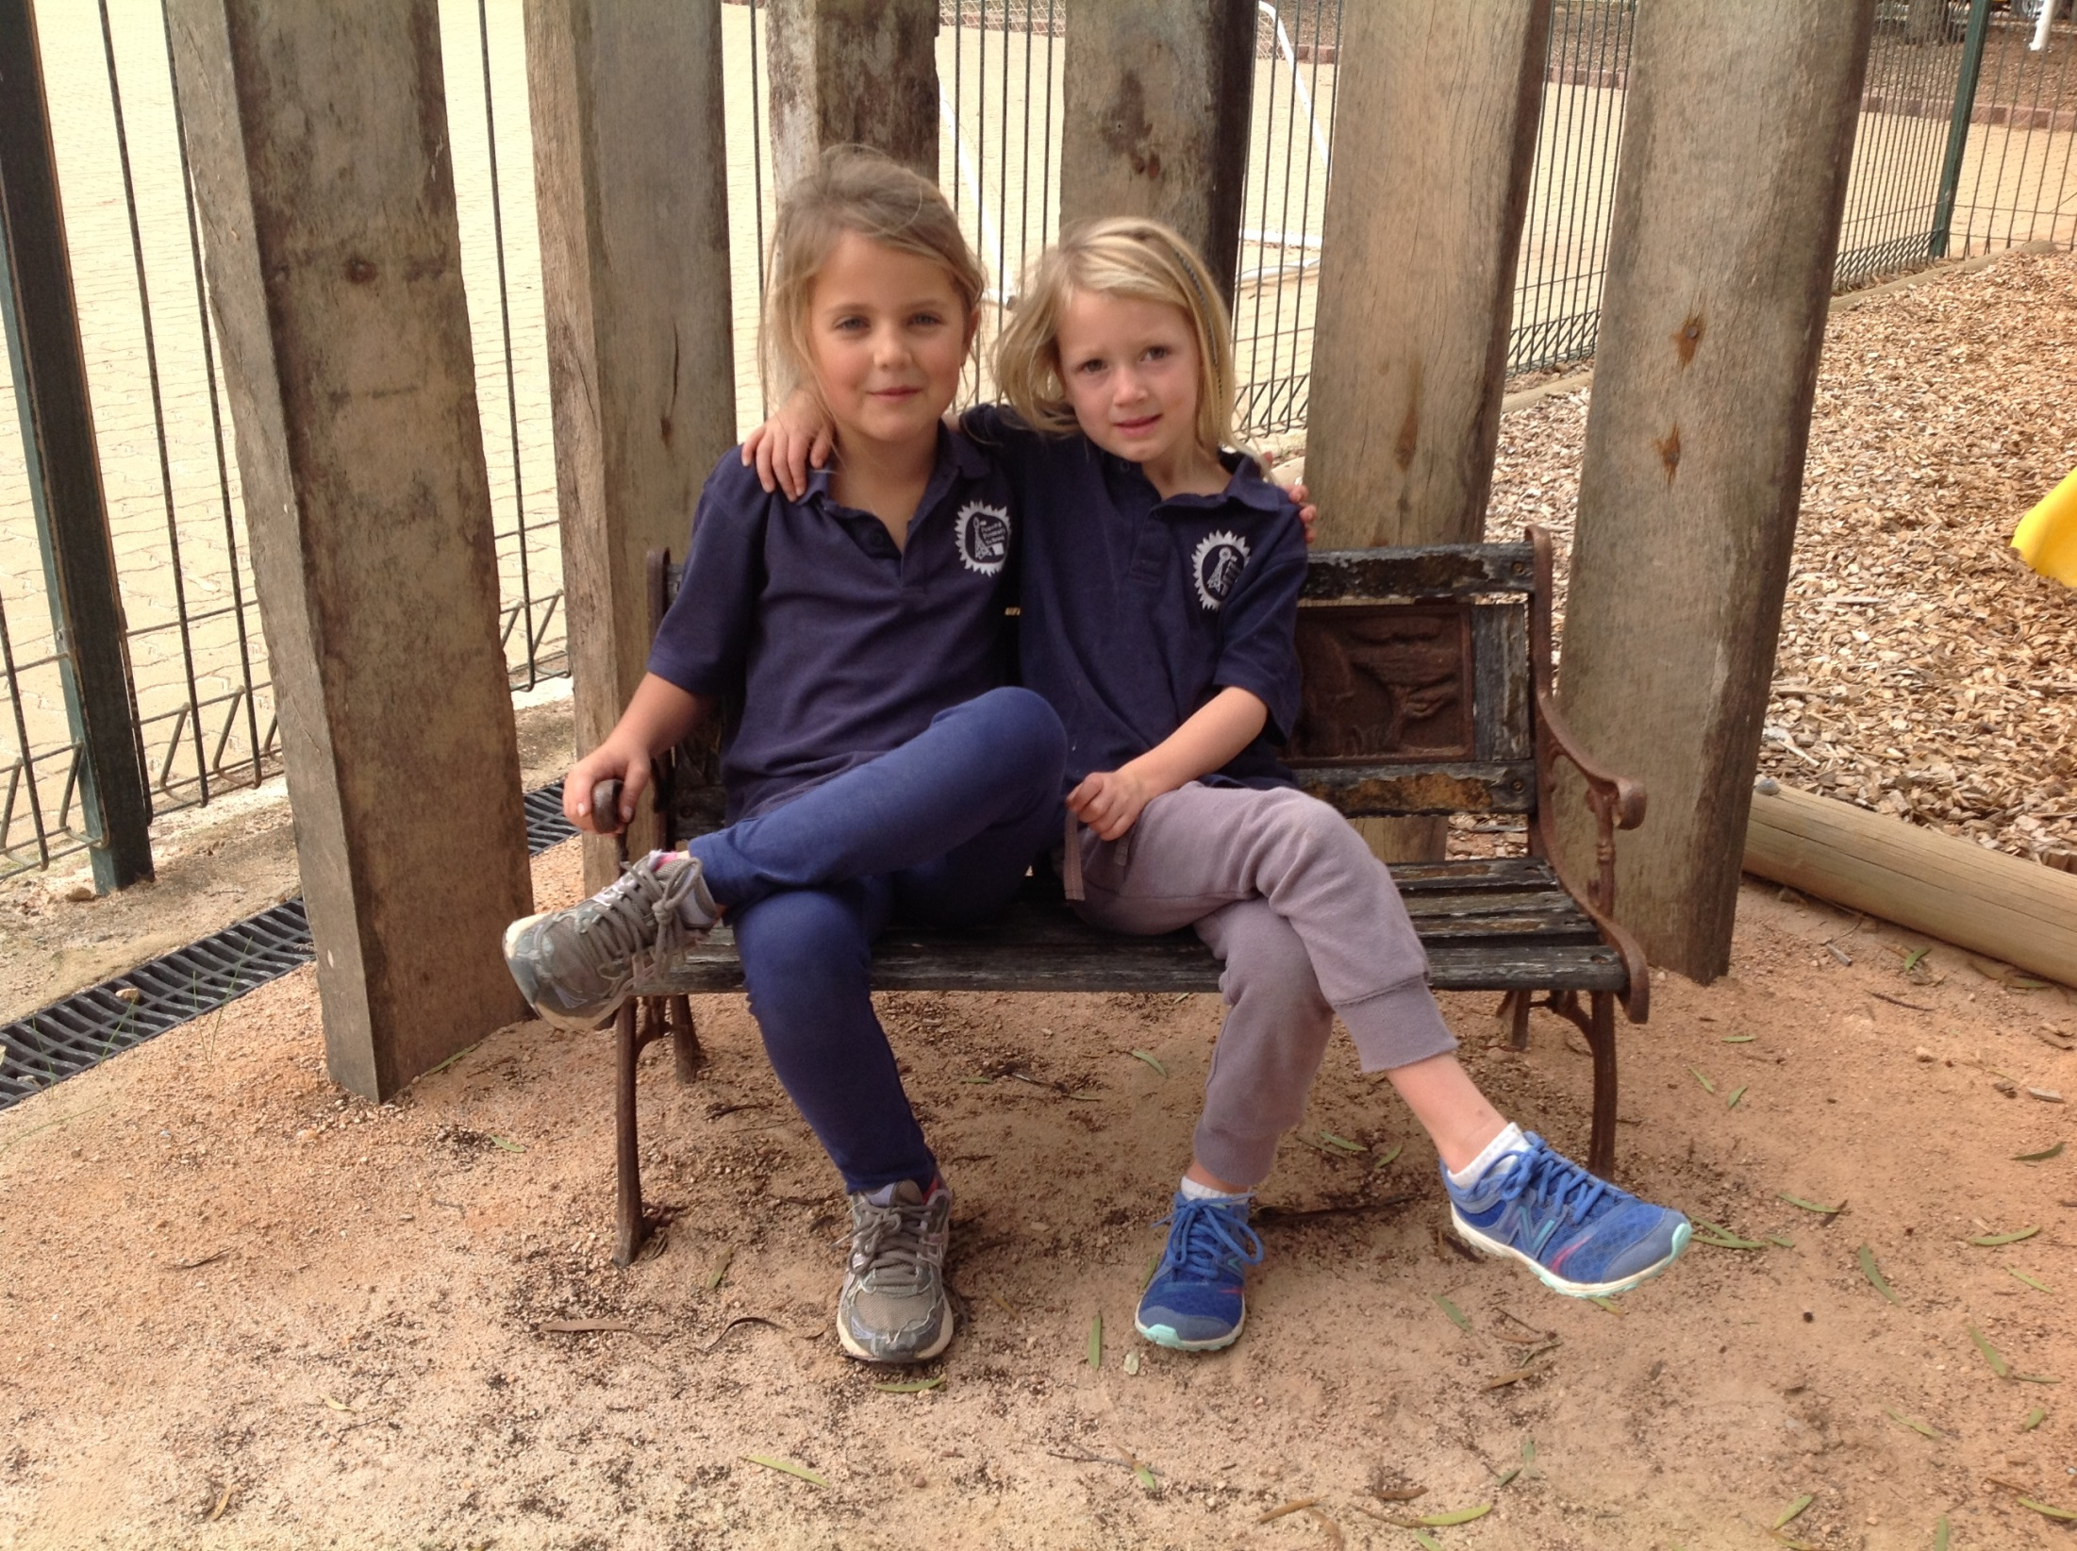
Friendships and fun!!

Slide 14
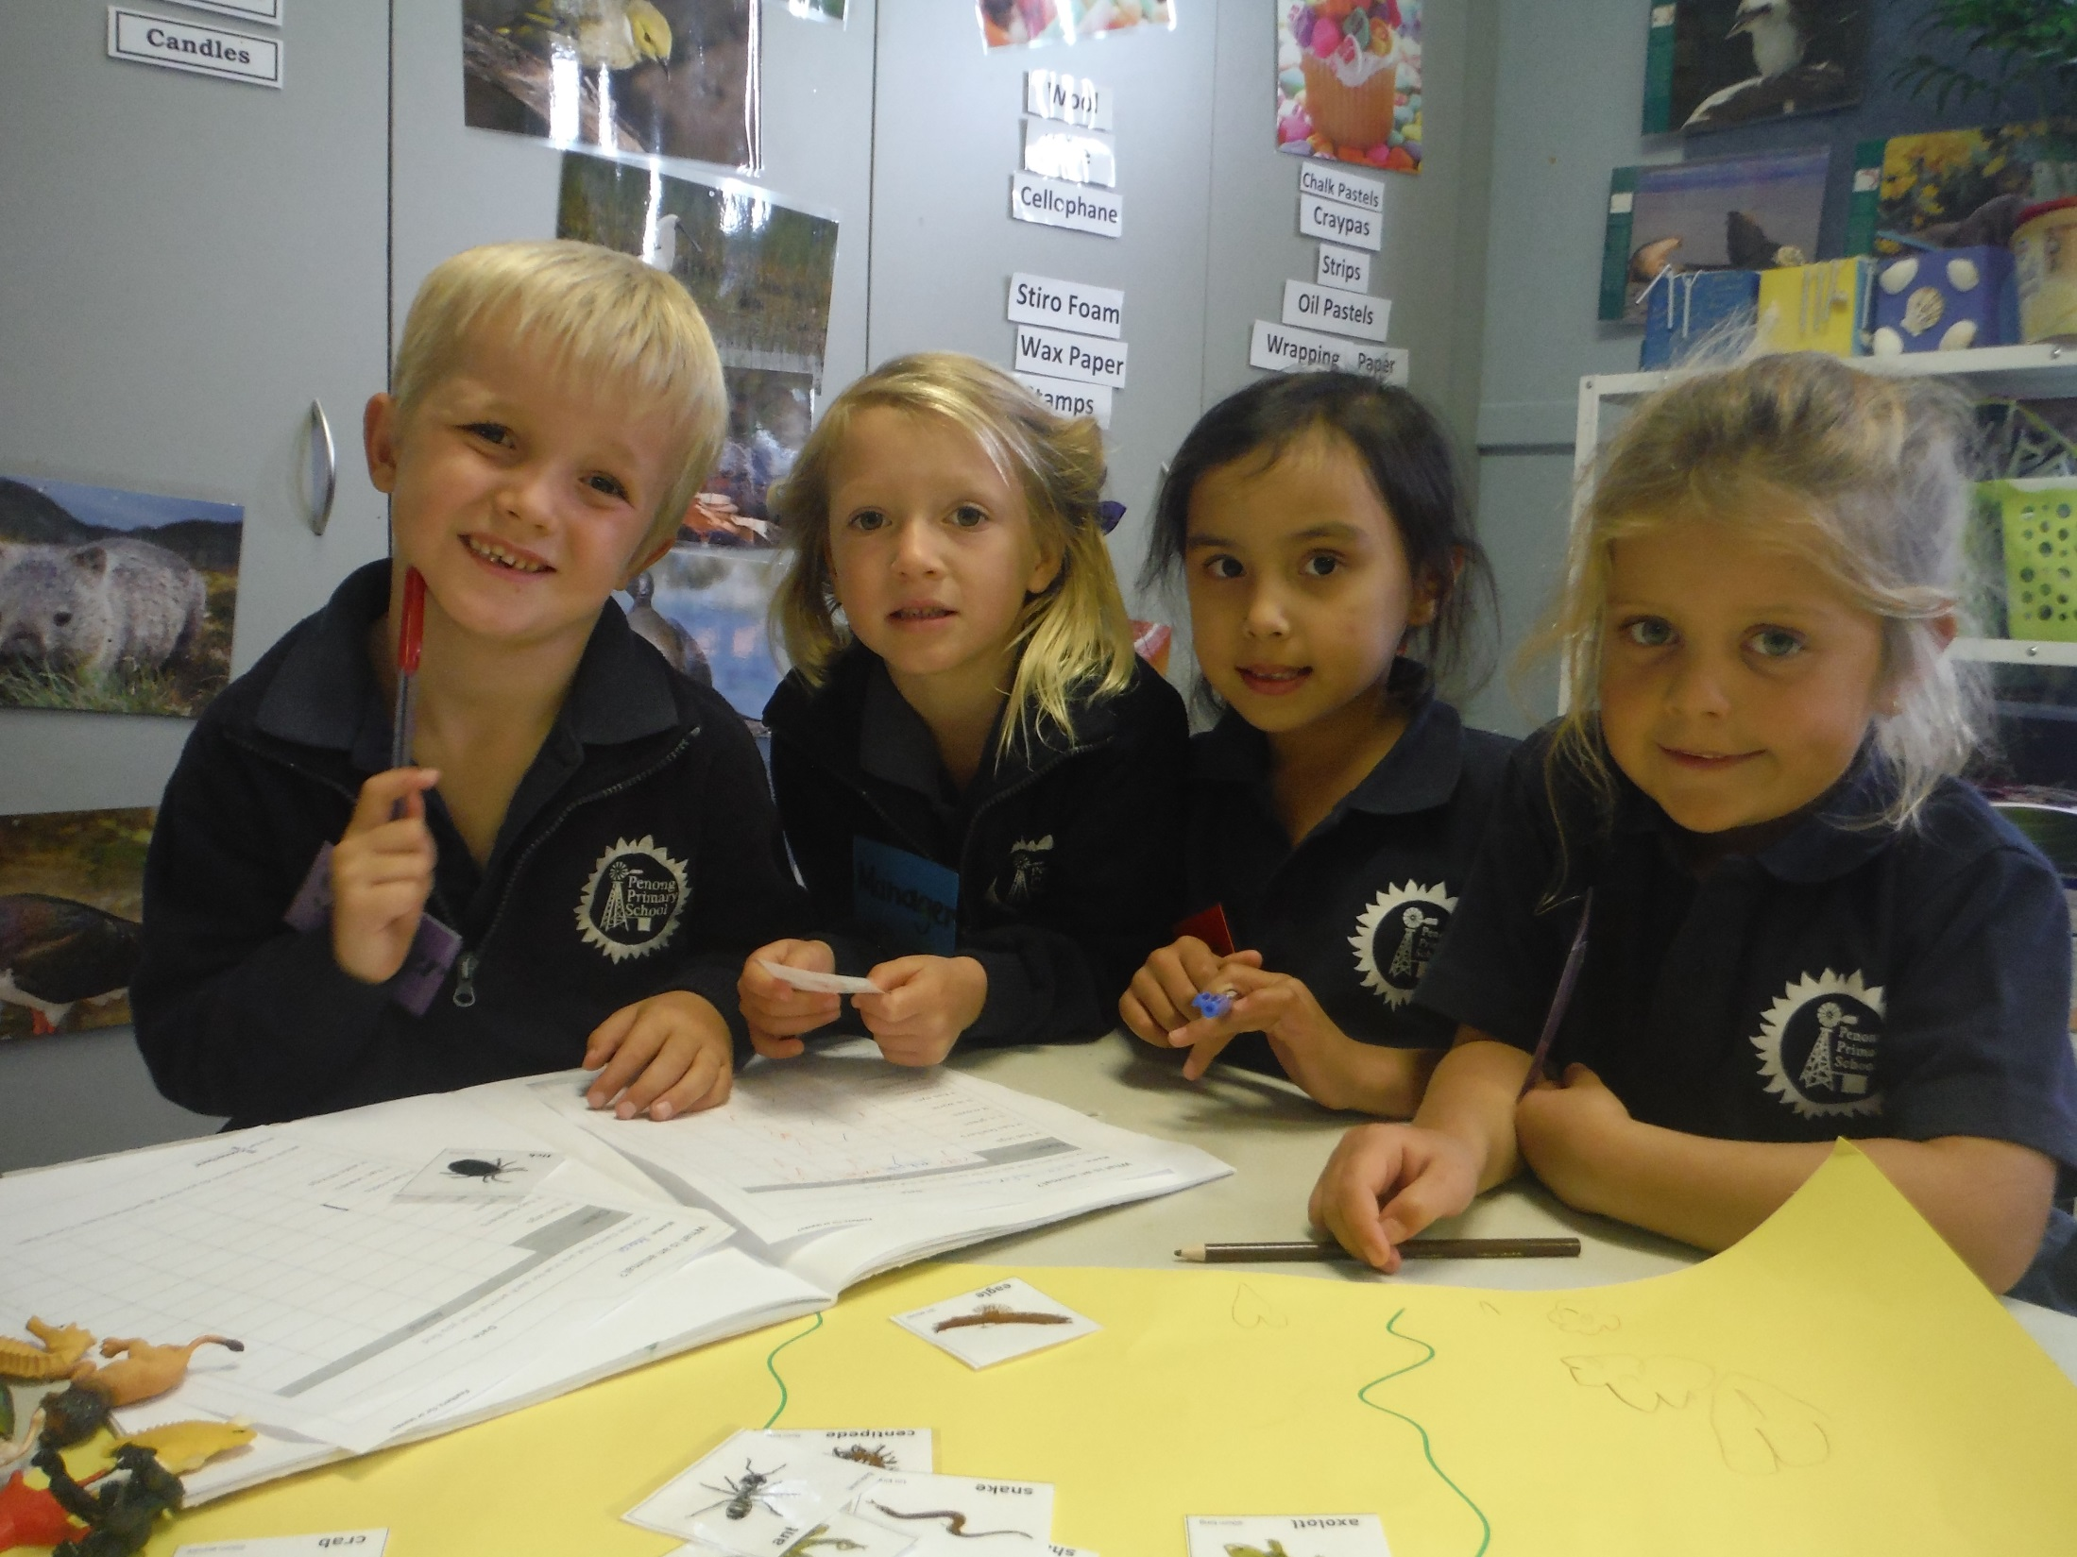
Our youngest students during science on living and non living.

