Slide 1
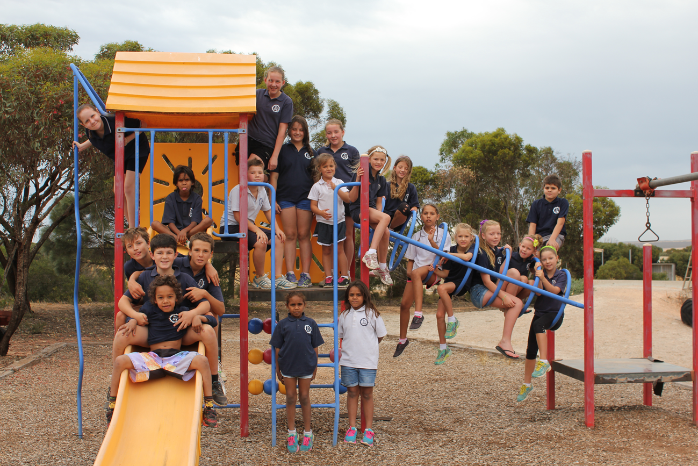
The whole school on 1 of our 3 playgrounds

Slide 2
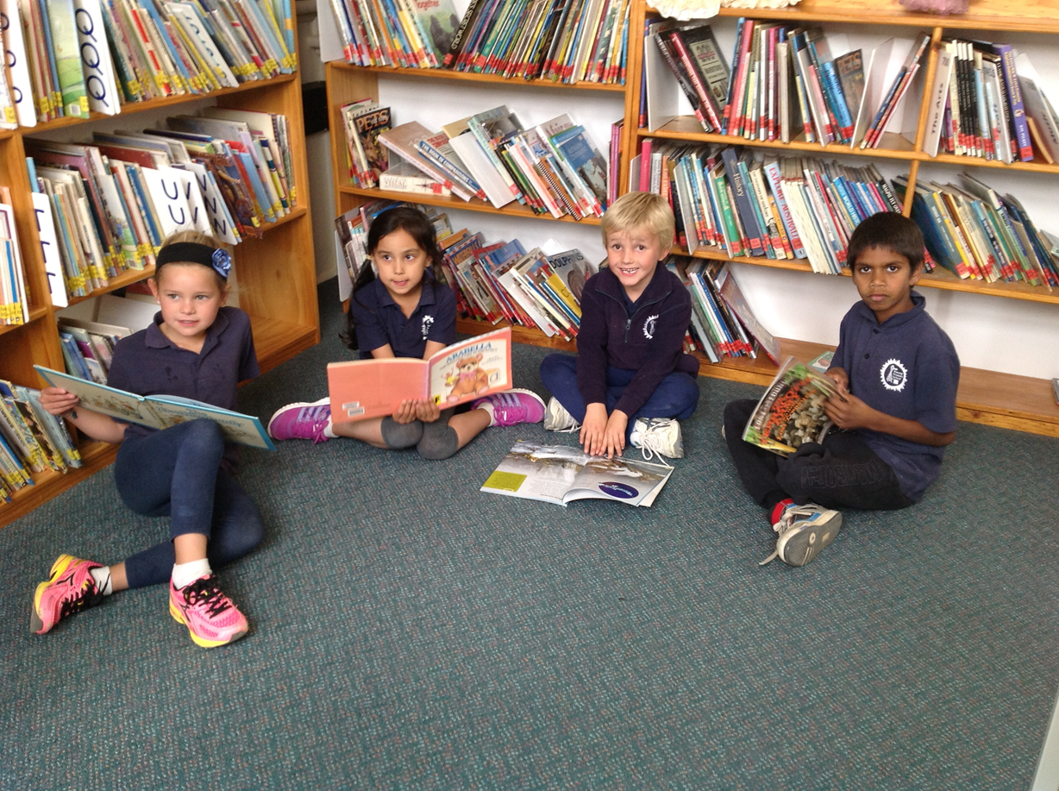
J.P reading in our school library

Slide 3
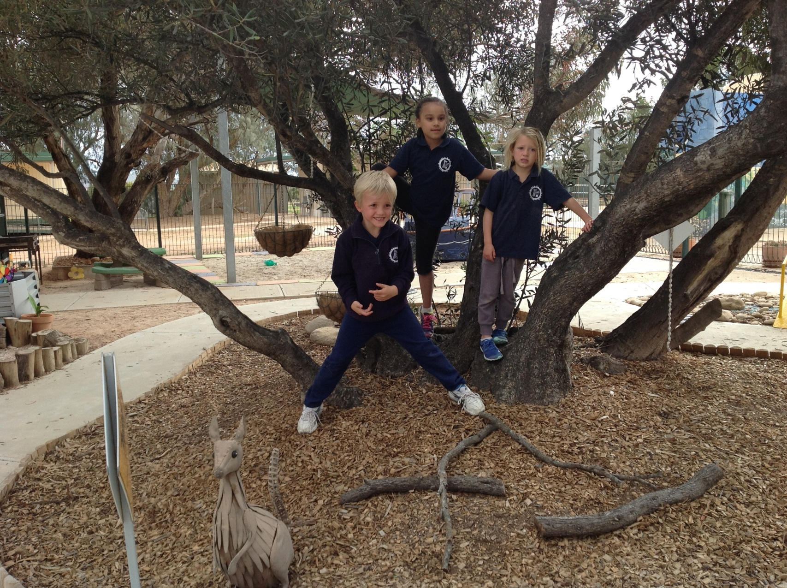
Kindy kids in the kindy yard

Slide 4
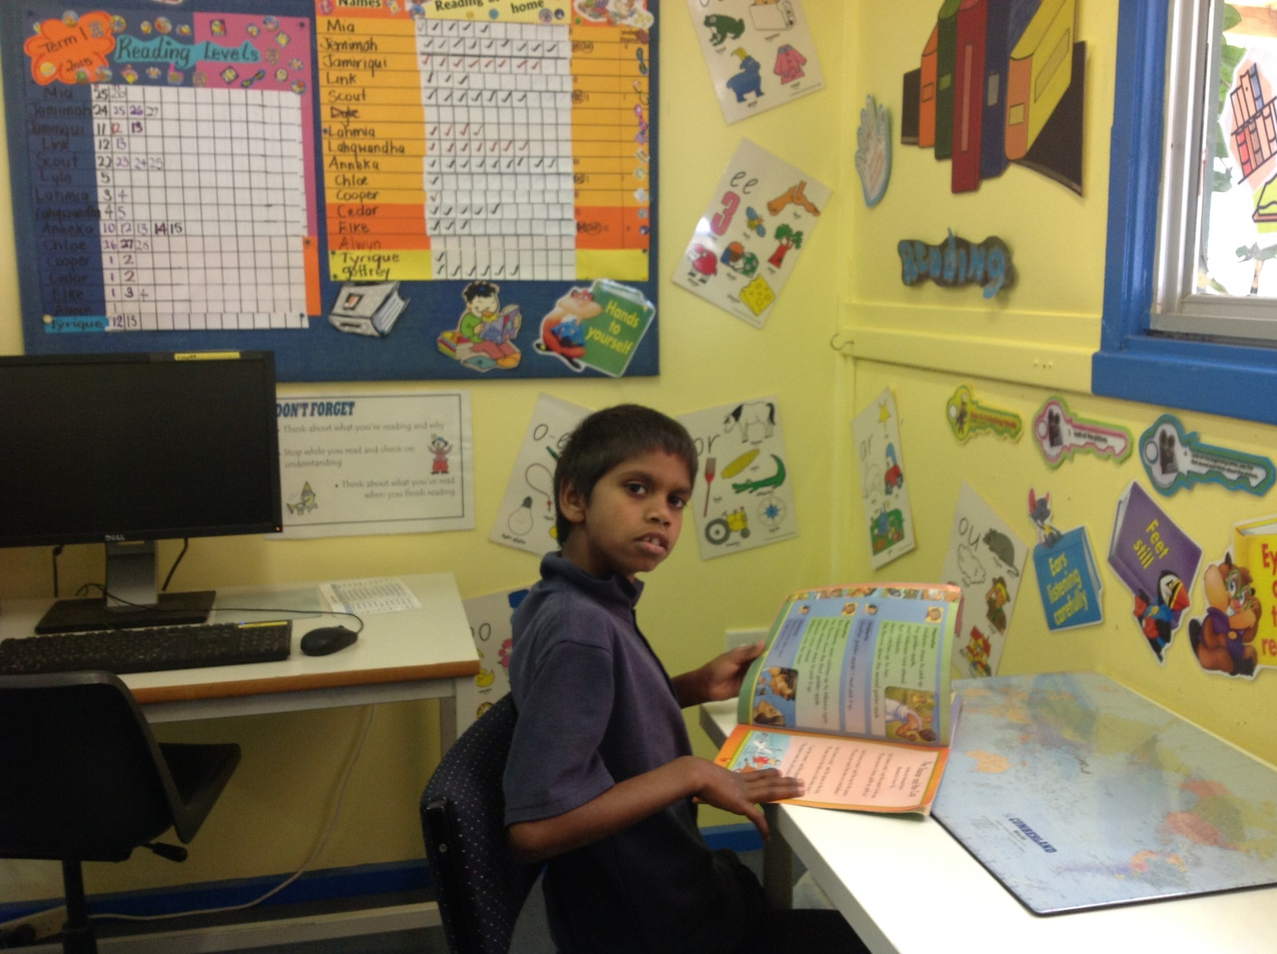
Jamiriqui reading in the reading room

Slide 5
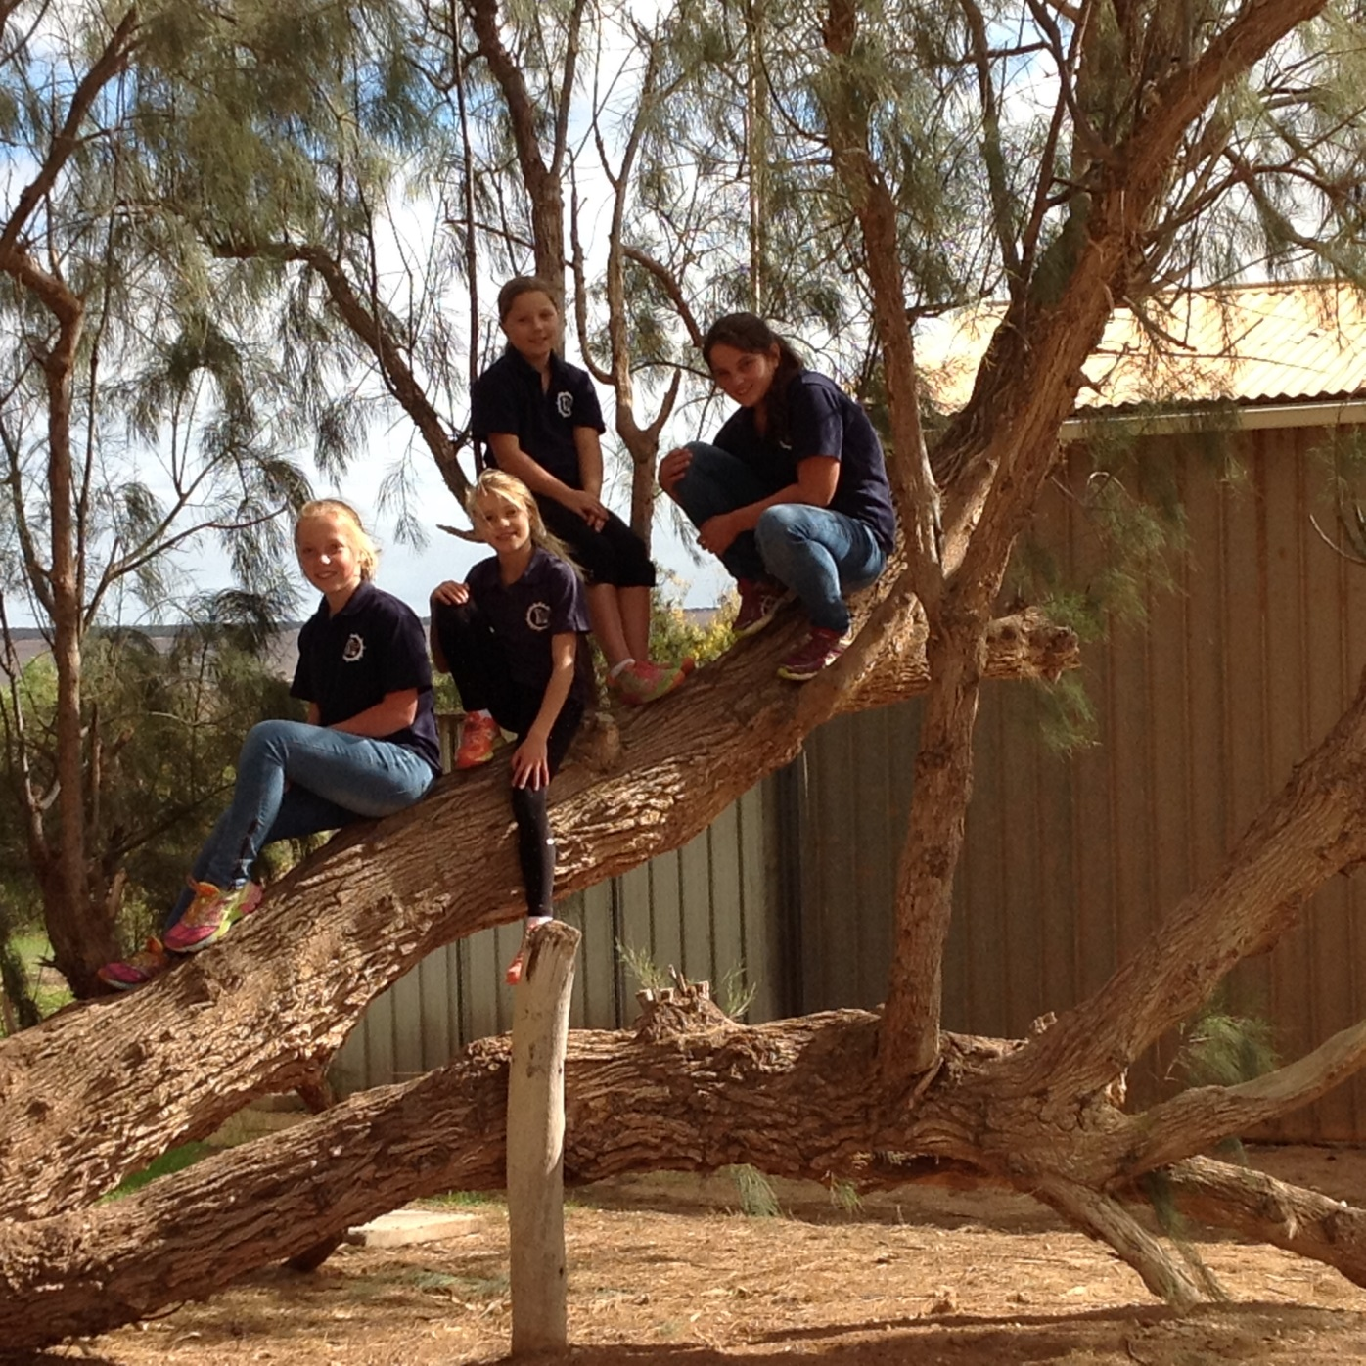
U.P climbing in the climbing tree

Slide 6
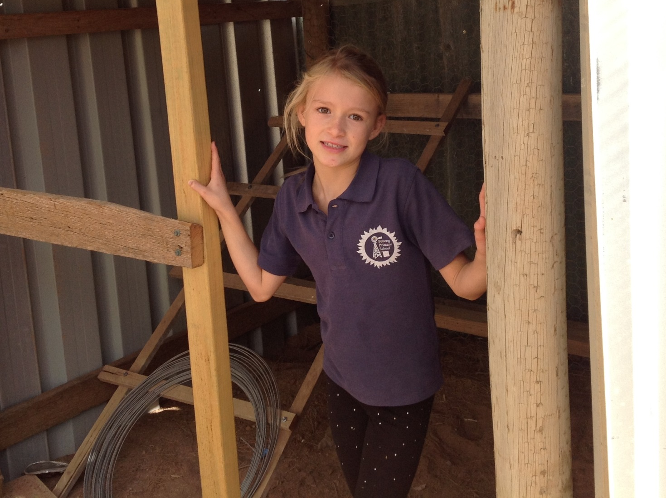
Java in the new chicken house

Slide 7
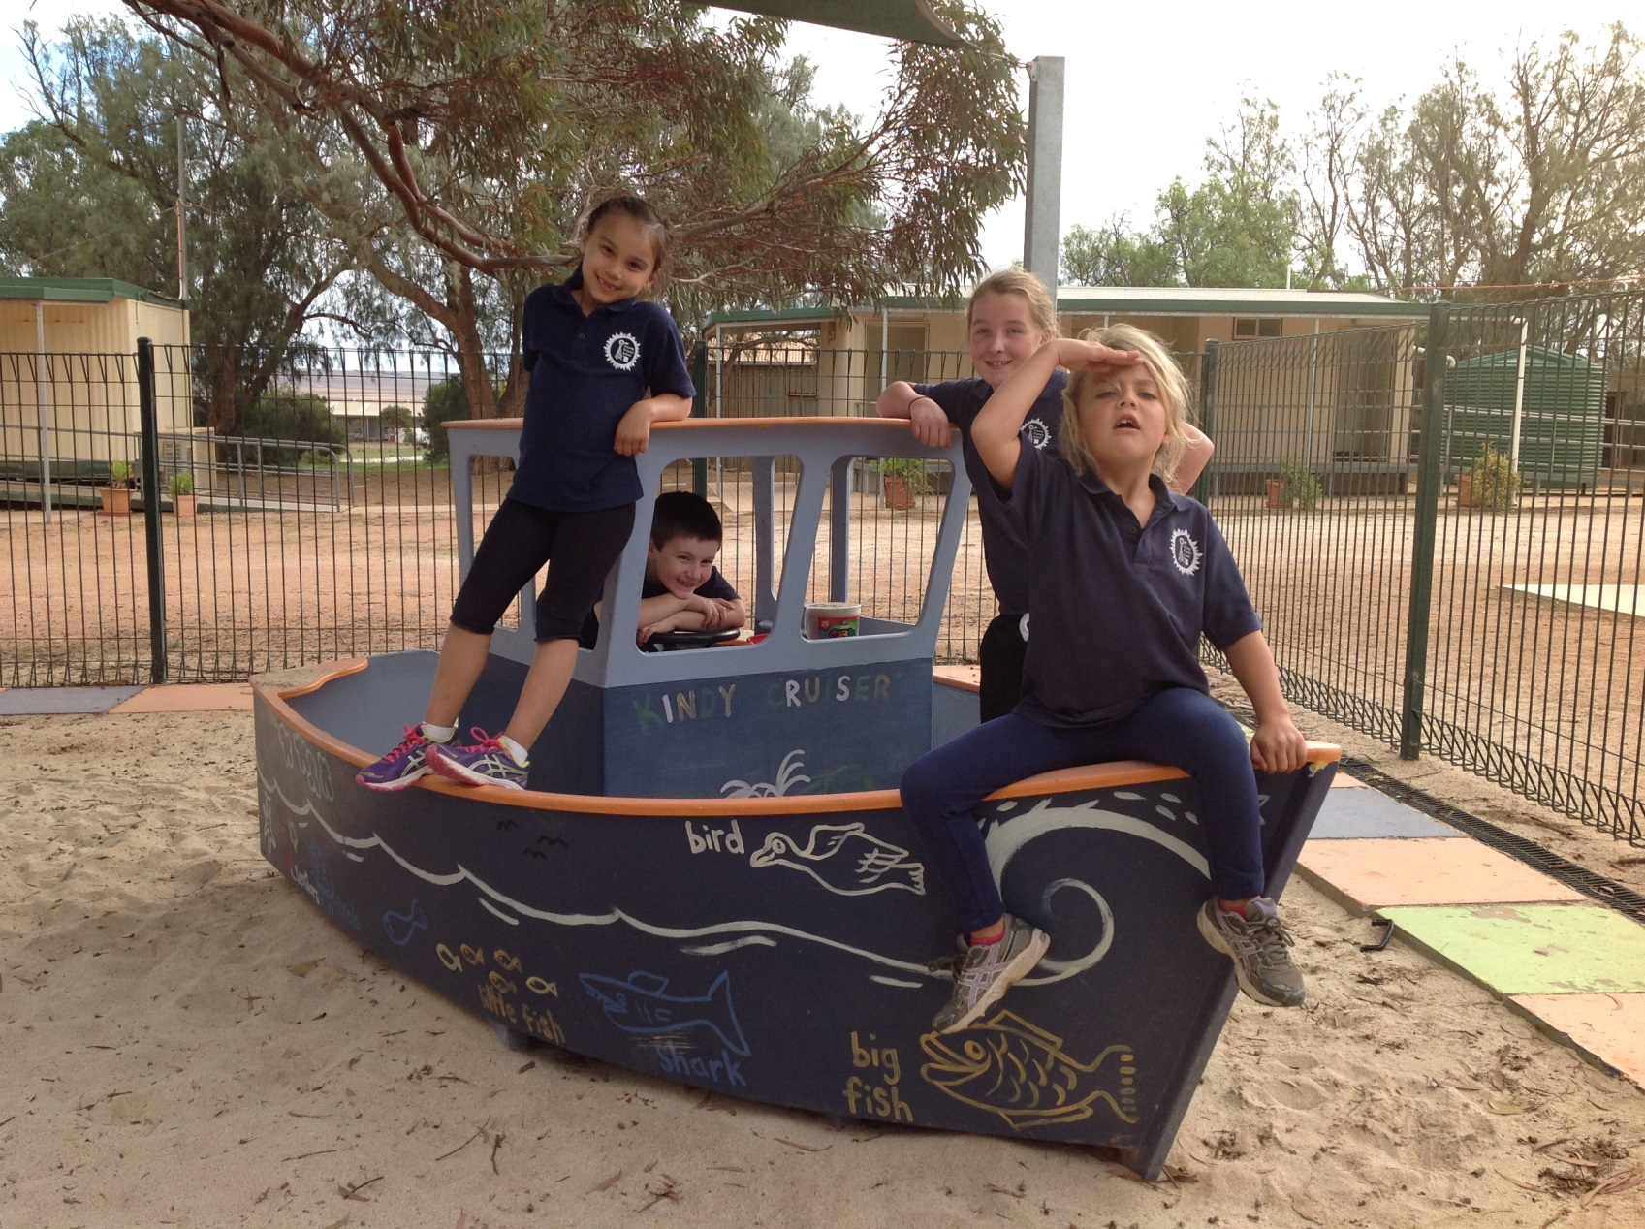
Jade, Link, Chloe, and captain Scout

Slide 8
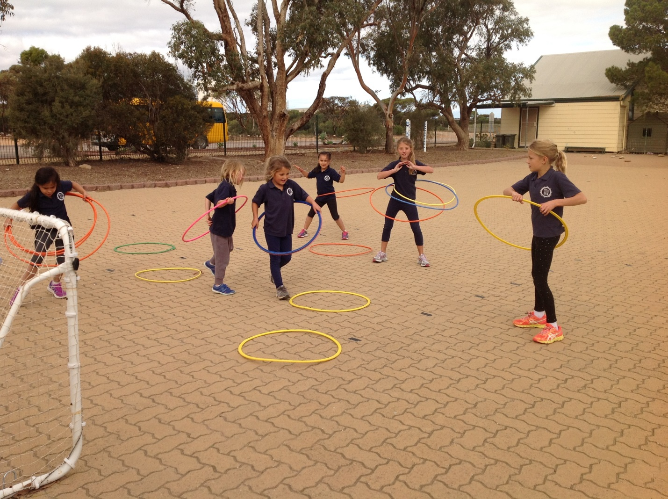
Students hoola hooping at lunch time

Slide 9
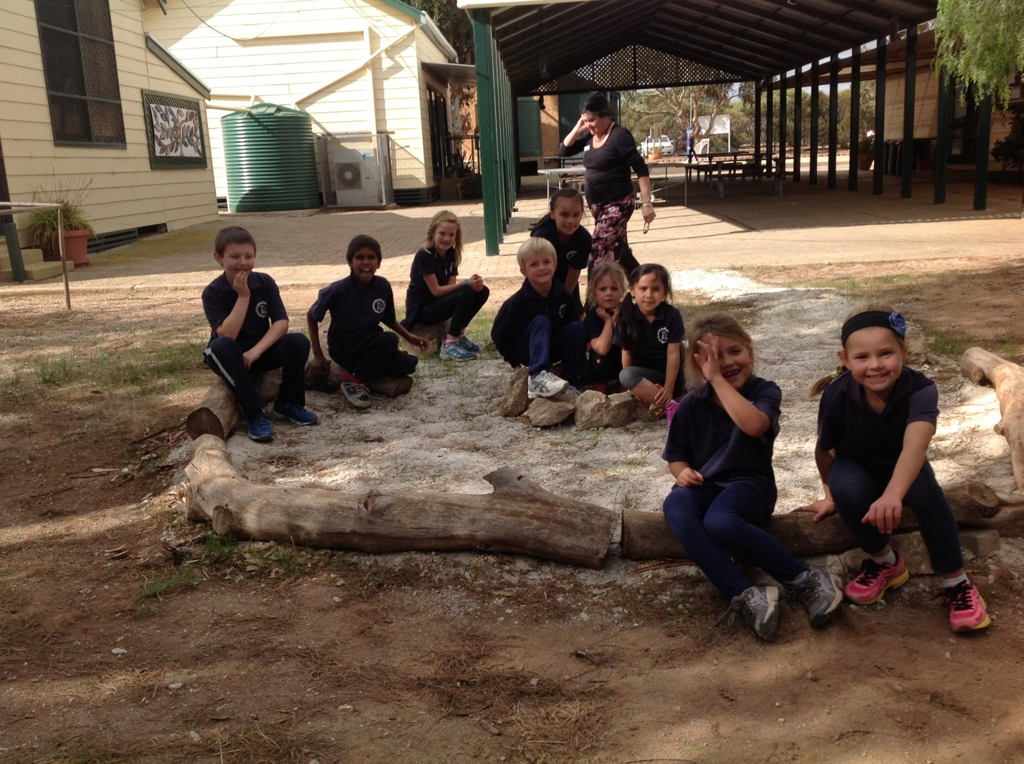
J.P chilling out at our relaxing camp

Slide 10
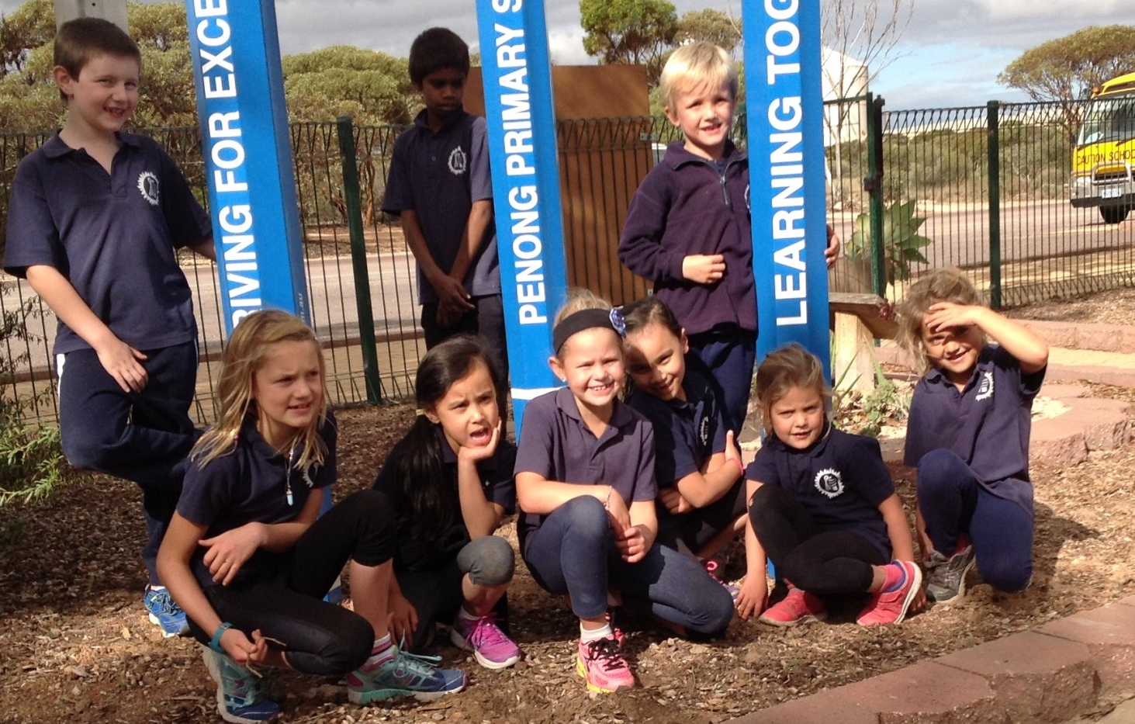
J.P at our goal pencils

